Slide 1
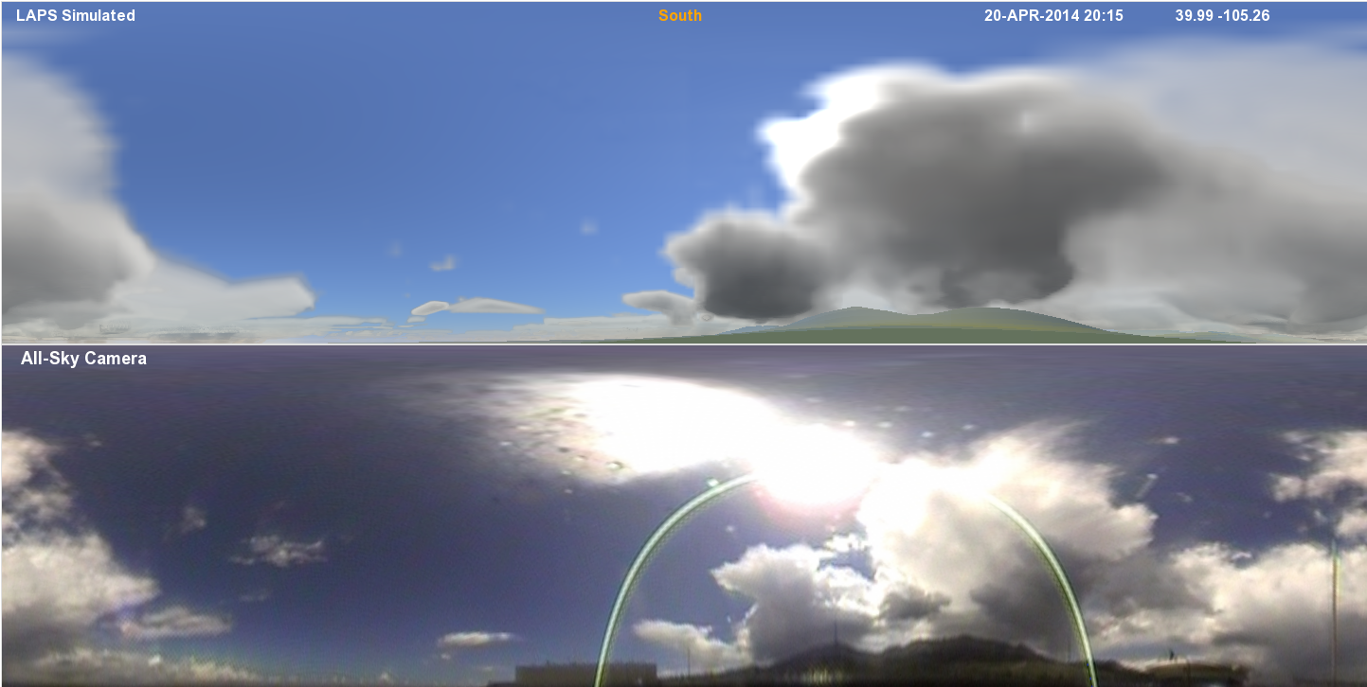
Image Processing – Carrying on the Viking Tradition
Steve Albers (NOAA/ESRL/GSD & CIRA)
Updated 7/15/2016

Slide 2
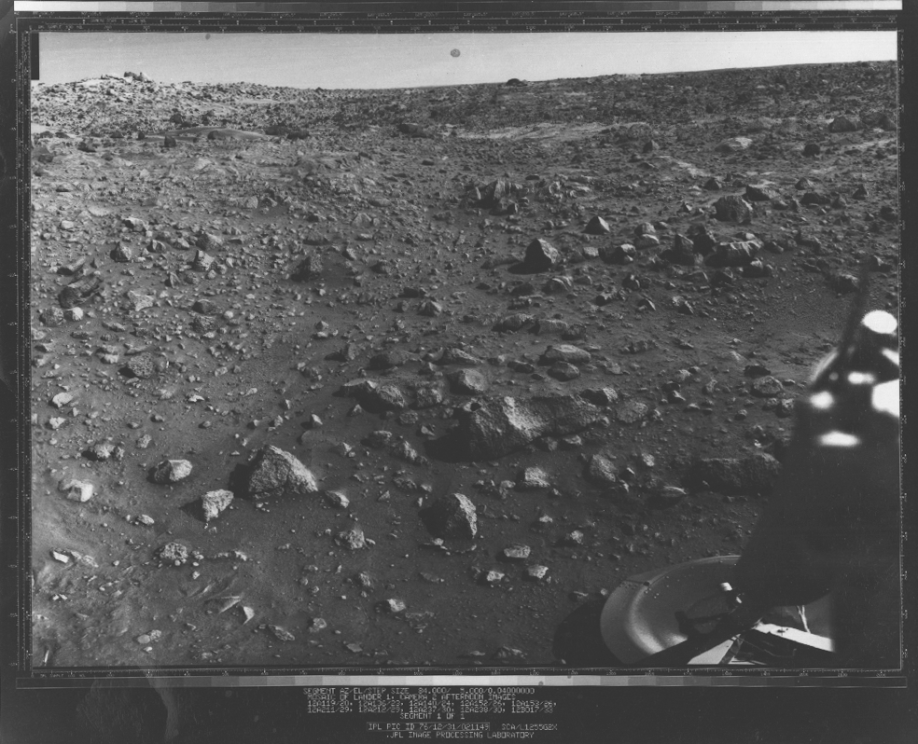
VL-1 Hi-Res Mosaic
Images merged at JPL Image Processing Laboratory

Slide 3
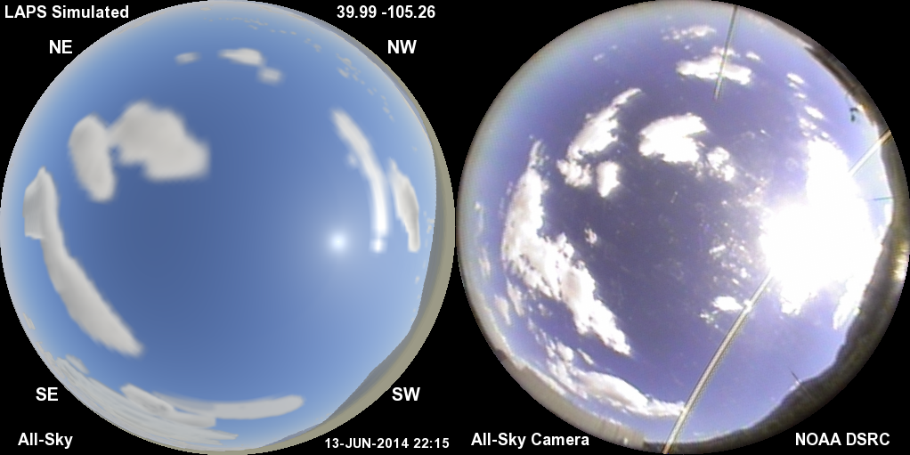
Model Simulated All-Sky Image (left) Compared with All-Sky Camera (right)
A way to peer into the model analysis (or forecast)

Slide 4
Simulated Weather Imagery Purpose
Helps communicate capabilities of high-resolution real-time model, literally “peering inside”
Real-time Analyses
Forecasts
Visually / physically realistic display conveys lots of information
Clouds, Precipitation, Aerosols, Land Surface
Display output for scientific and lay audiences
Connect weather phenomena with what can be seen in the sky (bringing science and art together)
Helps guide improvements in cloud, etc. analyses and model initialization
Sensitive independent validation of both model fields and visualization package
Potential use as an input for model data assimilation
Variational forward model (e.g. GSI or vLAPS)
4

Slide 5
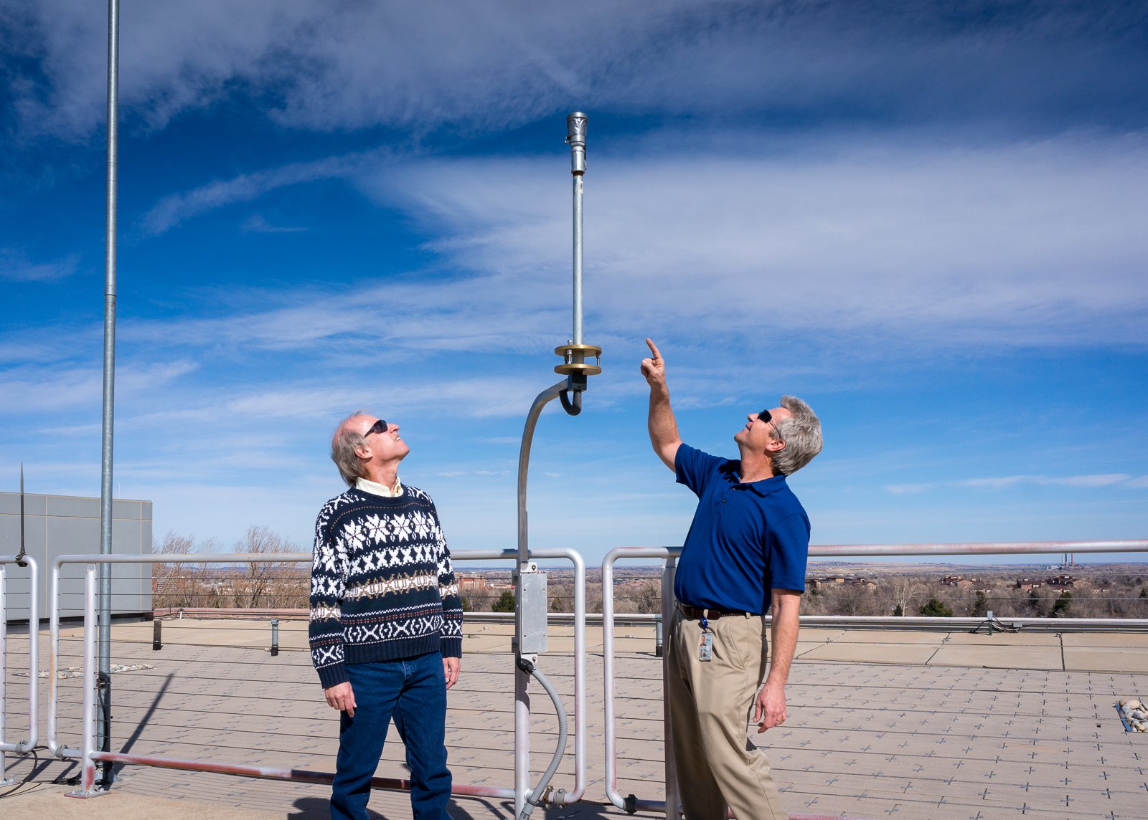
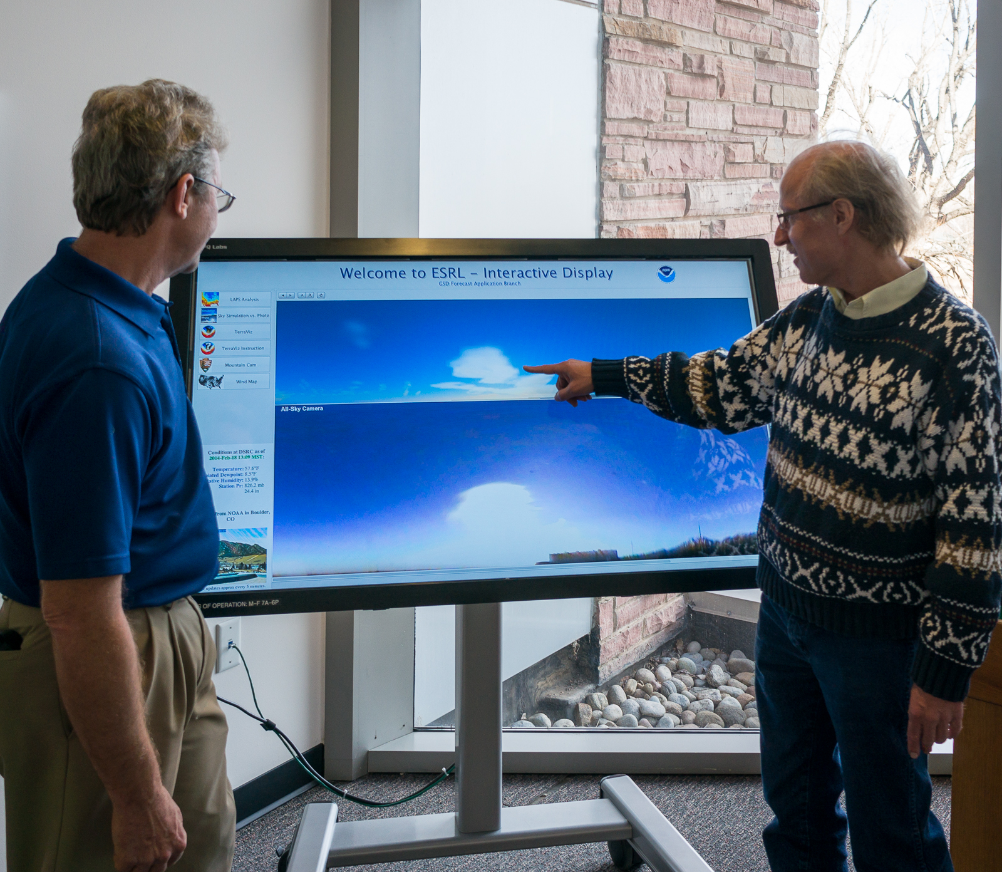
DSRC Rooftop
“Moonglow” Camera
Acknowledgement to Kirk Holub
(GSD) as camera engineer
Other cameras:
Mt. Evans webcam
(Meyer-Womble Observatory
Univ. of Denver)
Longmont Astronomical Society
300m BAO Tower (Erie, CO)

Slide 6

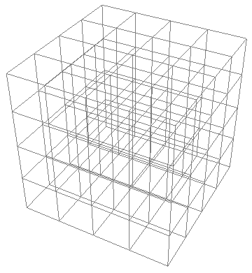
Ray Tracing Techniques
3D Short Wave
θ
θ = scattering angle
6

Slide 7
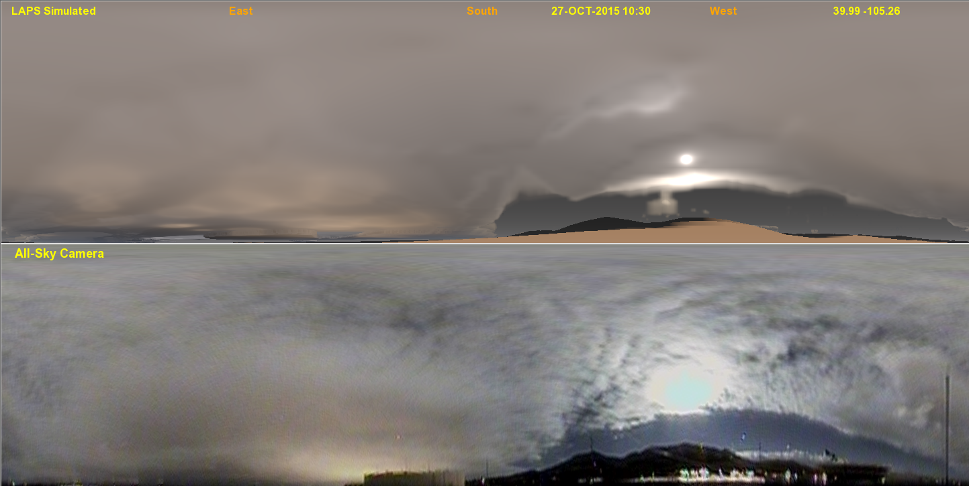
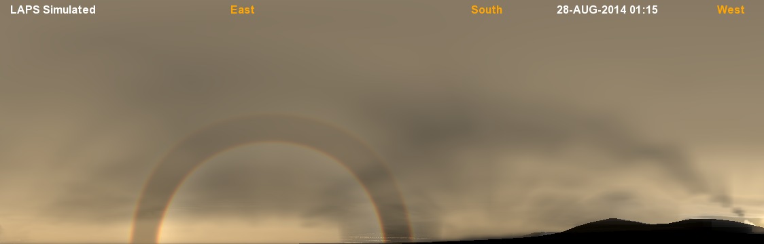
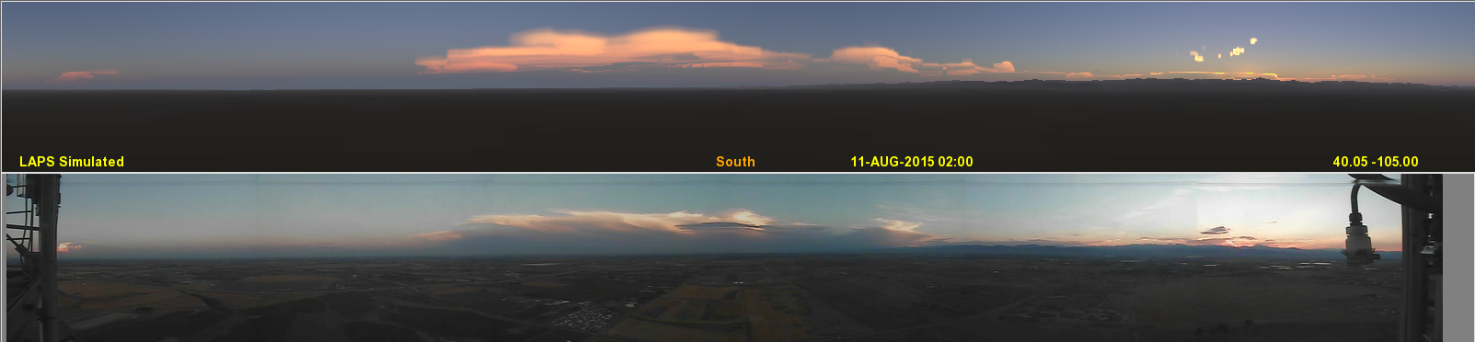
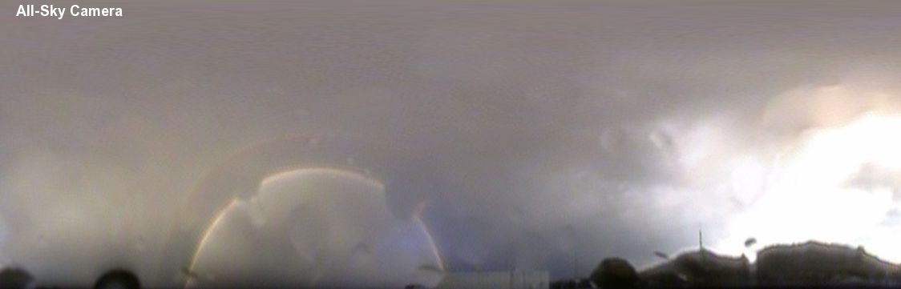
FOUR SIMULATED vs OBSERVED COMPARISONS
Daytime clouds
Nighttime clouds
SIMULATED
OBSERVED
Rainbow
SIMULATED
Sunset colors
OBSERVED

Slide 8
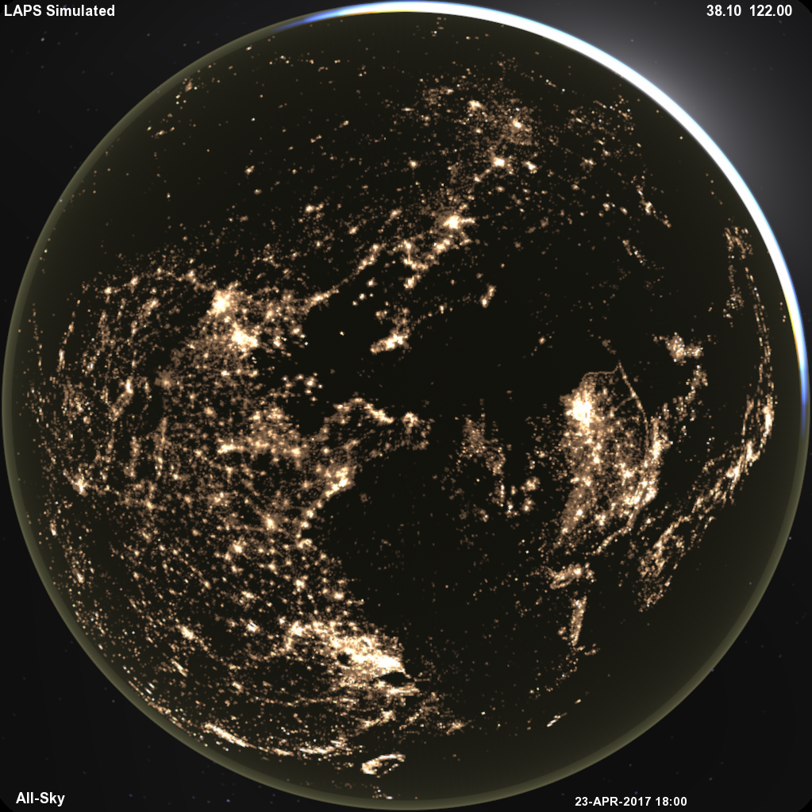
Nighttime View
Twilight / Airglow 790km up
+ City Lights, Zodiacal Light, Galactic Glow

Slide 9
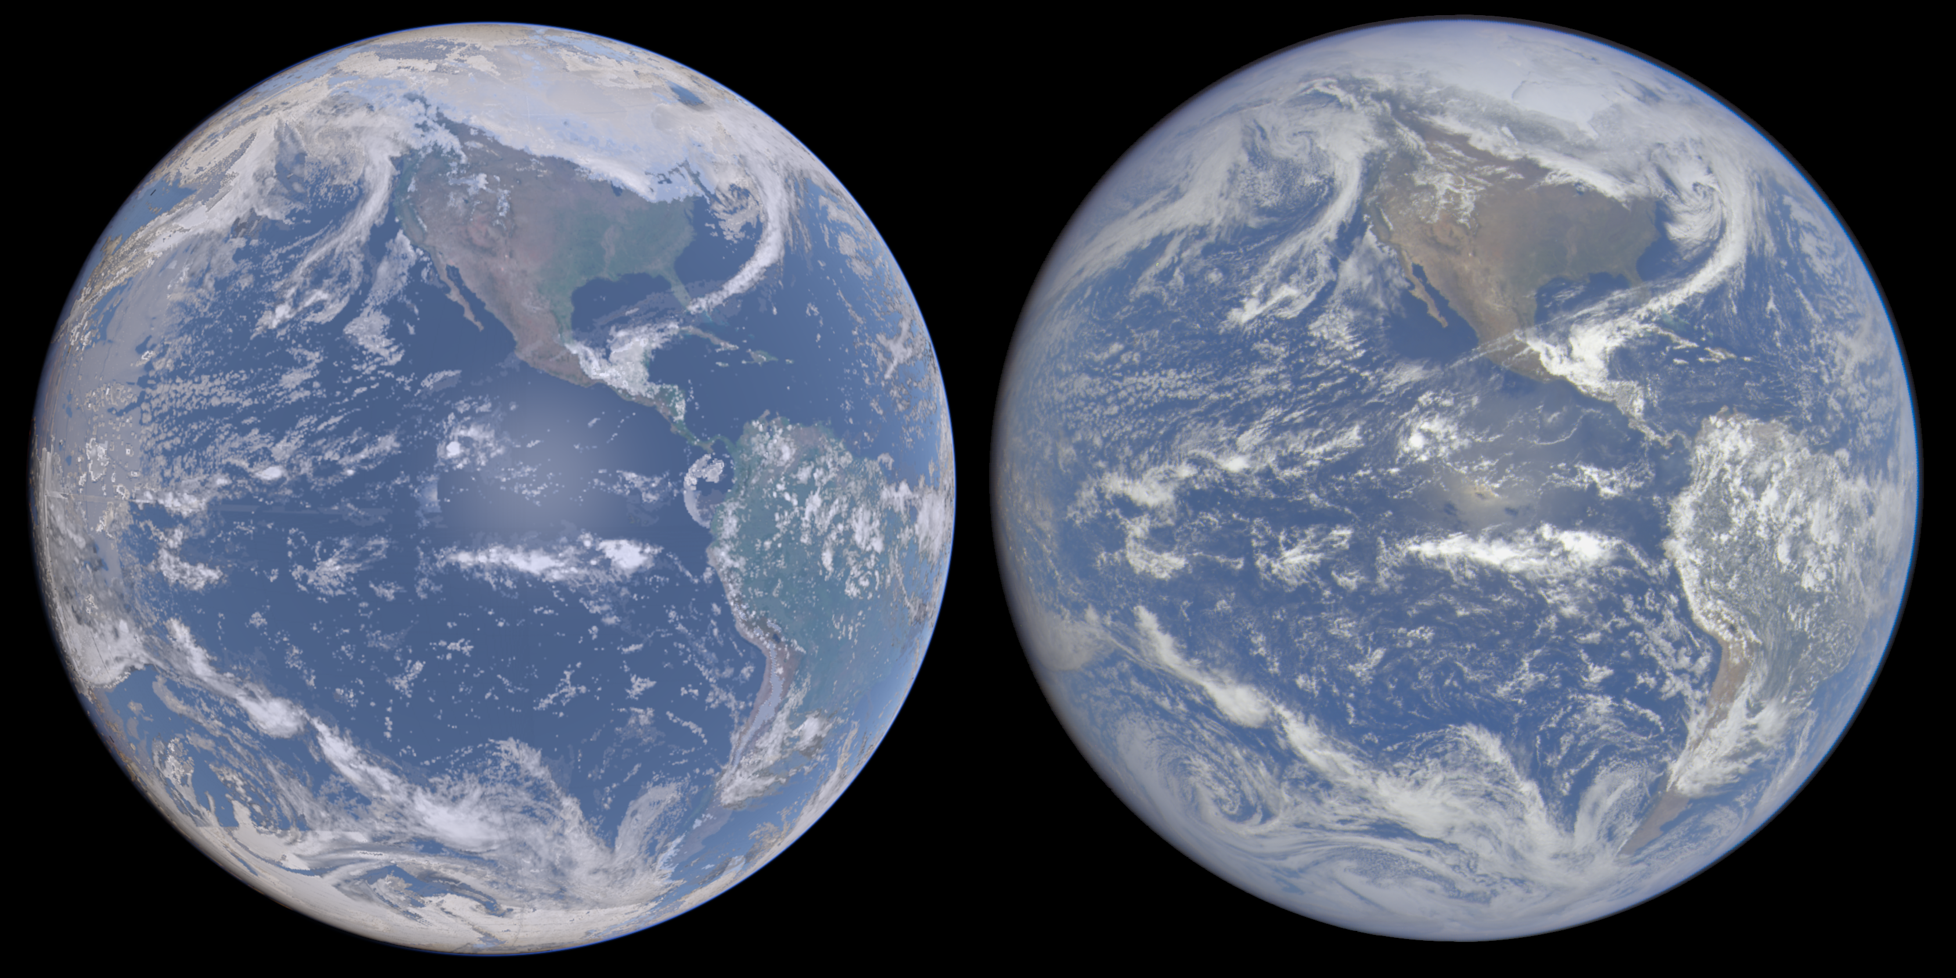
Full Disk Earth View
SIMULATED
OBSERVED (DSCOVR)
Earth global view
Compare with
DSCOVR or Himawari

Slide 10
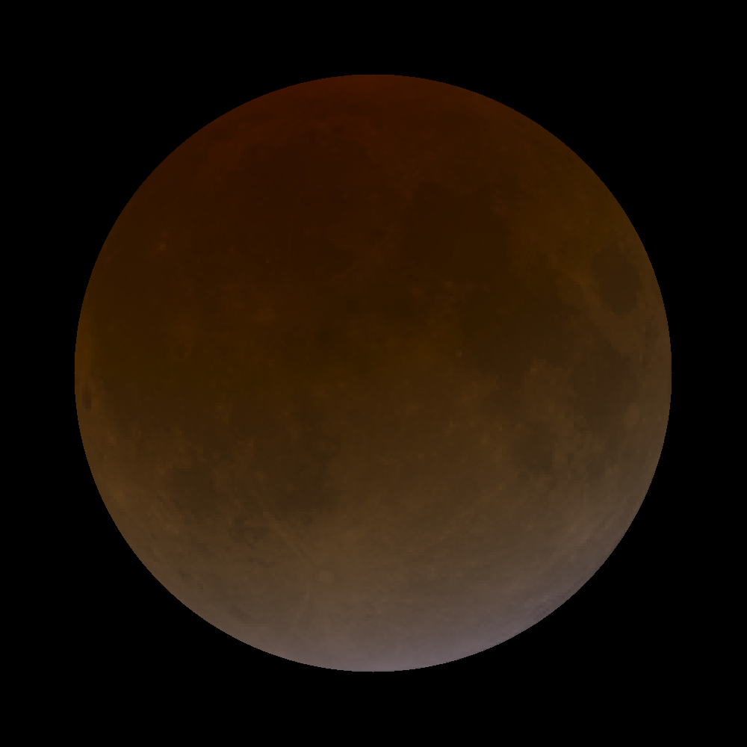

Atmospheric Simulations
Lunar Eclipse
Sensitive to stratospheric aerosols, ozone, clouds
Martian Sky – Mainly Dust

Slide 11
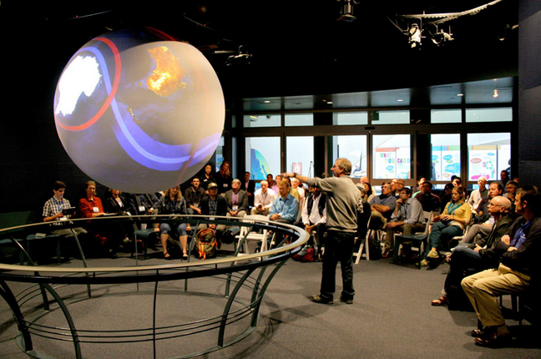
Science On A Sphere
6 foot sphere installed at 140+ science centers worldwide
Hi resolution animations are projected (4 projectors)
Over 600 datasets
Shows many Earth and Planetary Science datasets
Realtime display capability

Slide 12
3D Modeling & Visualization Efforts
Mars global 3-D terrain / texture from HIRISE
~1 meter resolution
Augmented by Rover / Lander Images
Curiosity (with rover model and images)
Viking (with lander model so far)
Active Image Processing Community
Herobrine (Unmanned Spaceflight Forum)
Sean (Unmanned Spaceflight Forum)
eyes.nasa.gov/curiosity (from NASA – SSERVI)
Valve Destinations (Virtual Reality Software Package)

Slide 13
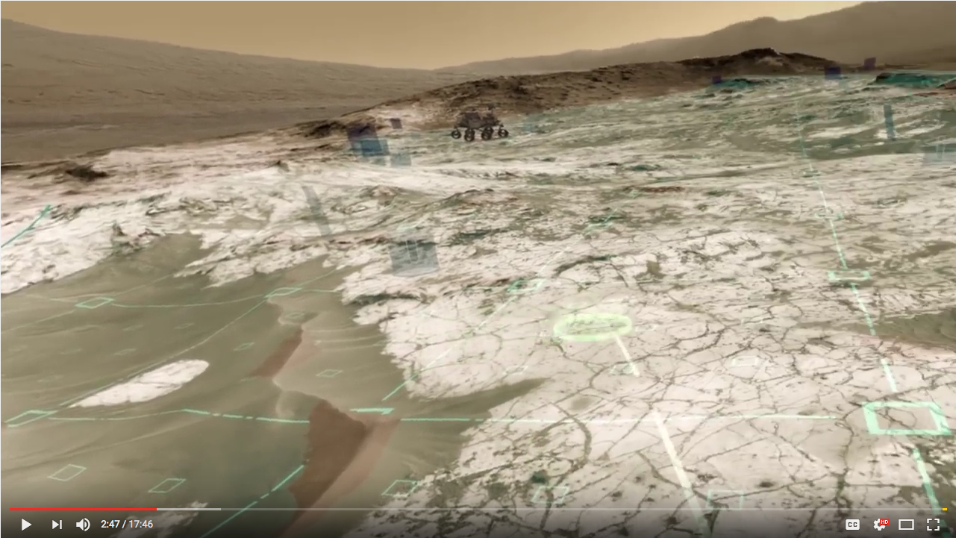
3D Modeling & Visualization Efforts
3-D model from HIRISE + Curiosity Images: Courtesy of “Herobrine”
(Scott Manley - https://www.youtube.com/watch?v=e76uBfWxD74)

Slide 14
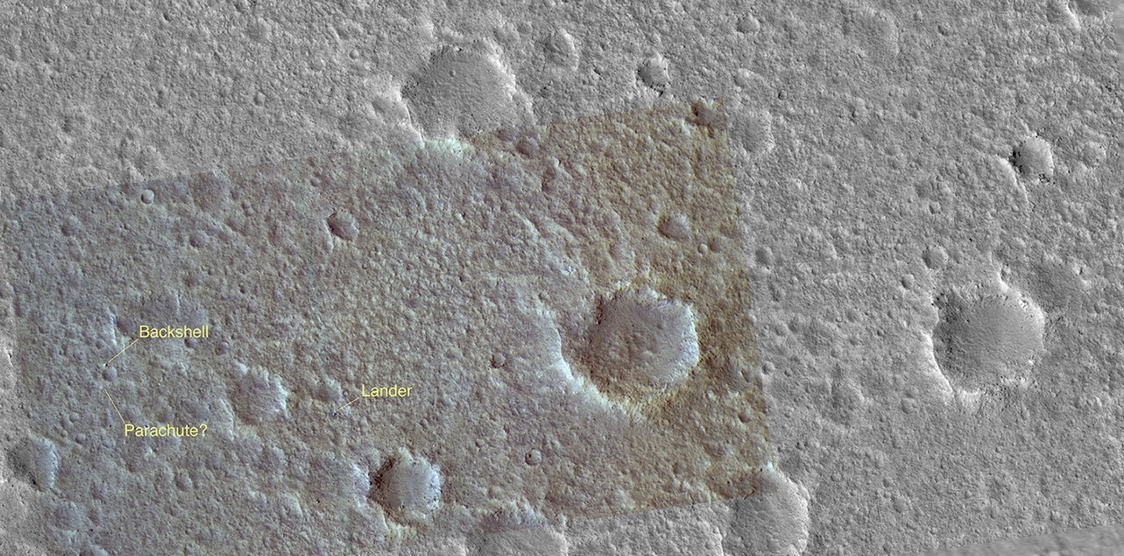
3D Modeling & Visualization Efforts
HIRISE – VL1 surroundings

Slide 15
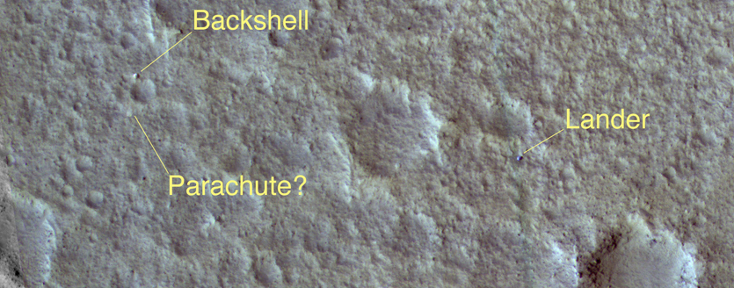
3D Modeling & Visualization Efforts
HIRISE – VL1 Closeup

Slide 16
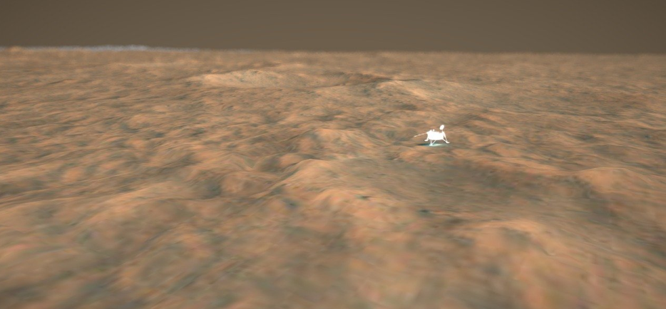
3D Modeling & Visualization Efforts
3-D model from HIRISE + VL-1 model: Courtesy of Sean Doran

Slide 17
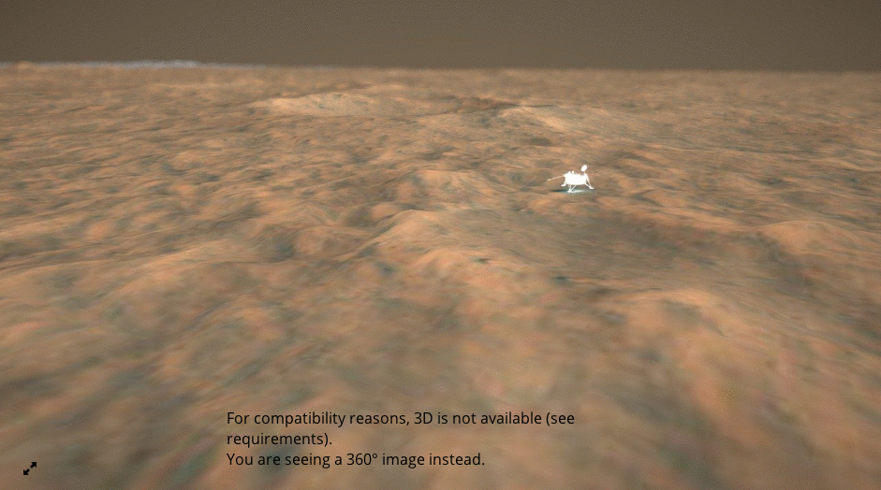
3D Modeling & Visualization Efforts
3-D model from HIRISE + VL-1 model: Courtesy of Sean Doran

Slide 18
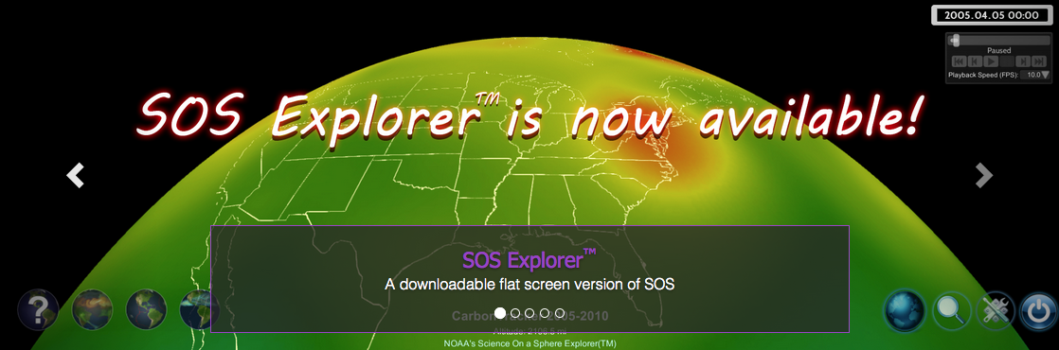
SOS Explorer
Flat screen version of SOS with HD / UHD resolution
“Full” version for Museums
“Lite” version for free download
Has 92K texture Mars image (~400 meter resolution)
So far limited to “full” version
Prototype has Oculus Rift headset option (virtual reality)
Headset for immersive Virtual Reality
Can show 3-D Mars datasets (topography + texture)

