Slide 1
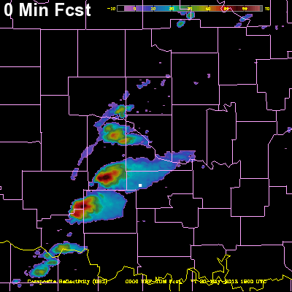
LAPS / WRF Forecast Animation (1km grid – simulated all-sky camera and radar)
NORTH
Moore tornado storm - May 20, 2013
Initialized 1900 UTC / Valid times 1900-2020 UTC
Moving storm perspective at 1-minute intervals
“Chaser Cam”
Good hot-start continuity between 0- and 1-minute forecasts
“.” ^{is} ^{observer position}
Jiang, H., et al., 2015: Real-time applications of the variational version of the Local Analysis and Prediction System (vLAPS). Bull. Amer. Meteor. Soc., 96, 2045–2057

