Slide 1
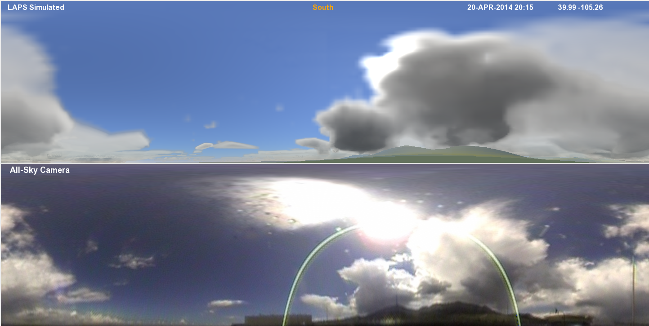
Visualization and Validation of NWP Cloud and other Fields with Simulated Weather Imagery
Steve Albers, Kirk Holub, Yuanfu Xie, Hongli Jiang, Jun Zhou, Zoltan Toth (NOAA/ESRL/GSD)
Updated 2016

Slide 2
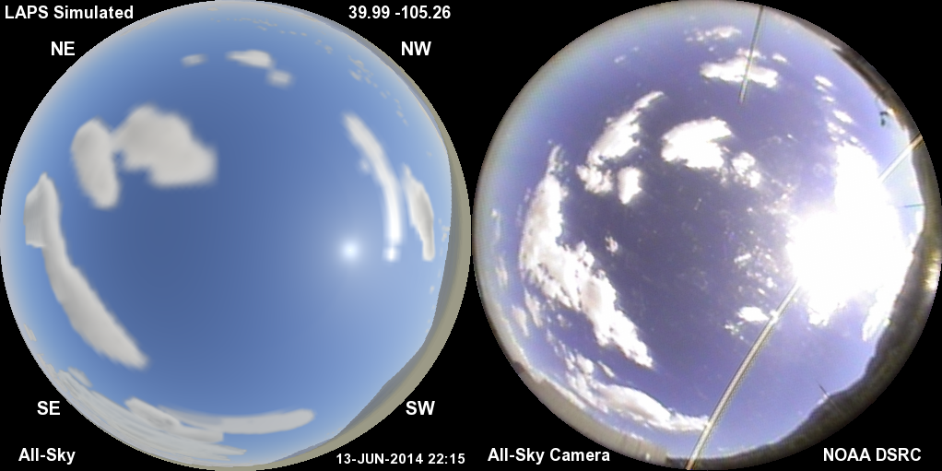
Model Simulated All-Sky Image (left)
Compared with All-Sky Camera (right)
A way to peer into the model analysis (or forecast)

Slide 3
Simulated Weather Imagery Purpose
Helps communicate capabilities of high-resolution real-time model, literally “peering inside”
  Real-time Analyses
  Forecasts
Visually / physically realistic display conveys lots of information
  Clouds, Precipitation, Aerosols, Land Surface
Display output for scientific and lay audiences
  Connect weather phenomena with what can be seen in the sky (bringing science and art together)
Helps guide improvements in cloud, etc. analyses and model initialization
  Sensitive independent validation of both model fields and visualization package
Potential use as an input for model data assimilation
  Variational forward model (e.g. GSI or vLAPS)
3

Slide 4
All-sky Simulation Context
Unique combination of analysis (or forecast) system with all-sky images having these elements
  Real-time model data (clouds, precip, aerosols, gas, land surface)
  Vantage point can be inside the atmosphere
  Visually realistic (e.g. light scattering effects)
  Works day and night
  High resolution (including sub-kilometer)
  Rapid update (e.g. 15 min)
  Other visualizations we’ve seen have just some of these elements
Coupling of 3-D model with camera imagery provides opportunities for improved, more detailed cloud and solar radiation forecasts
Techniques are applicable to other visualization packages (e.g. TerraViz), and various models
4

Slide 5
Sky & Weather Simulation Ingredients
3-D cloud / hydrometeor analyses (or forecasts)
  Cloud liquid / ice, rain, snow, graupel
  LAPS / HRRR systems developed at ESRL/GSD (e.g.)
  Typical grid resolution = 500m – 3km
Land Surface (3-color spectral reflectance - including snow cover)
Aerosol parameters
  Optical depth (~.03-.30)
  Scale height (~750-3000m)
  Size distribution
Locations of sun, moon, planets, stars
Nighttime city lights (via VIIRS), airglow
Specify vantage point – easily movable
  Latitude, longitude, elevation / altitude (surface to lunar distance)
  Viewing window up to full 360º sphere (virtual reality)
5

Slide 6
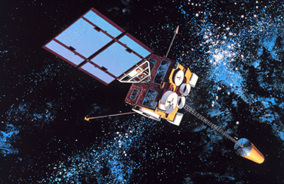

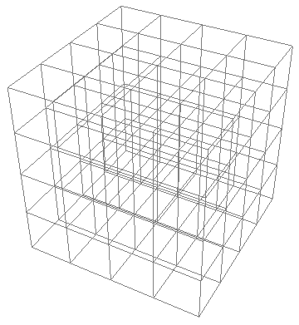
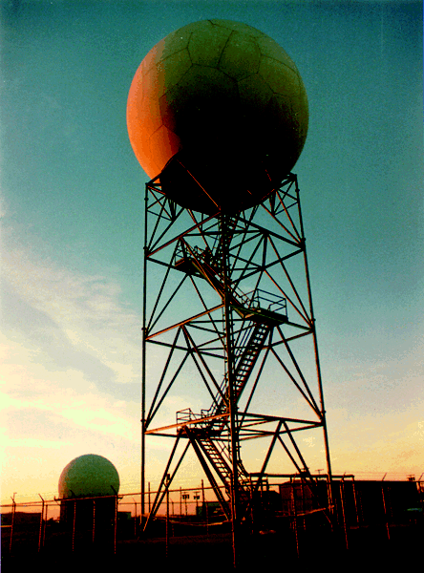
Cloud analysis
(e.g. from LAPS)
11um,VIS,3.9um
First Guess →
METAR
METAR
METAR
(Albers et. al. 1996)
6

Slide 7
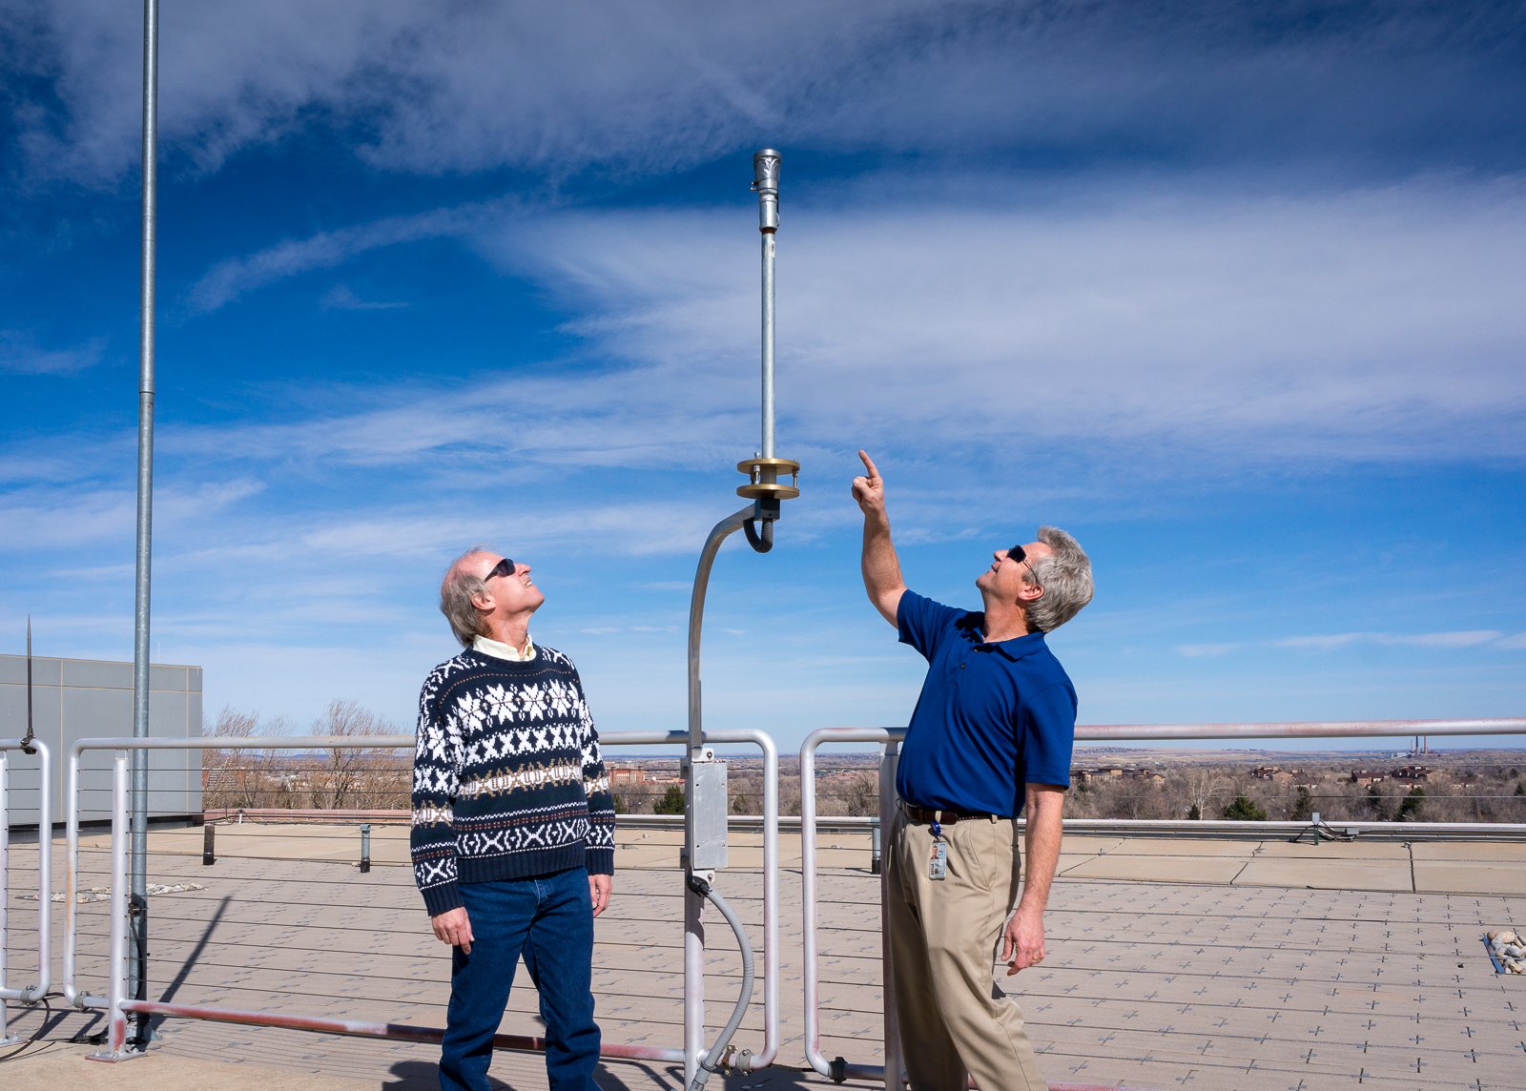
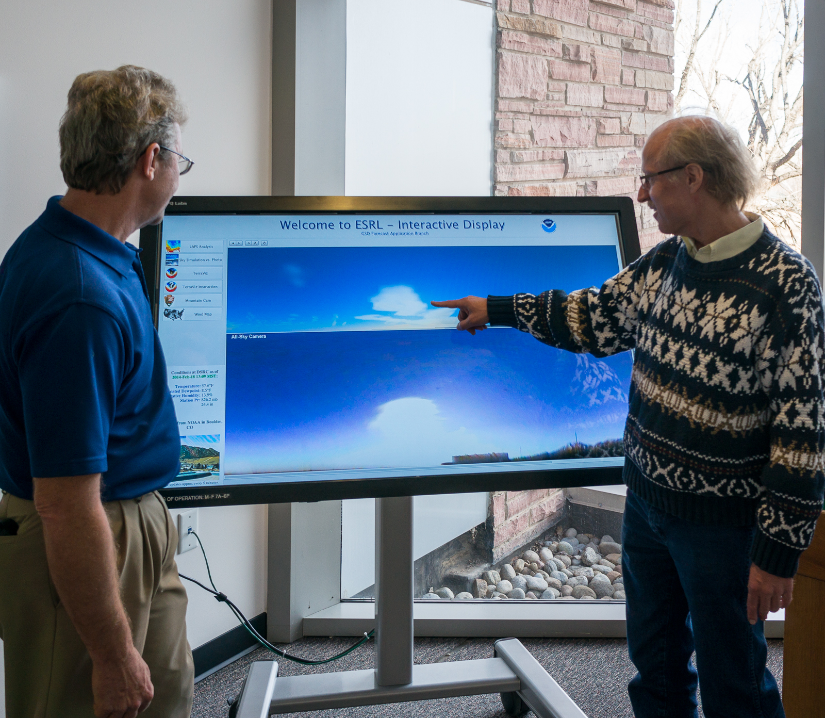
DSRC Rooftop
“Moonglow” Camera
Acknowledgement to Kirk Holub
(GSD) as camera engineer
Other cameras:
Mt. Evans webcam
(Meyer-Womble Observatory
Univ. of Denver)
Longmont Astronomical Society
300m BAO Tower (Erie, CO)

Slide 8
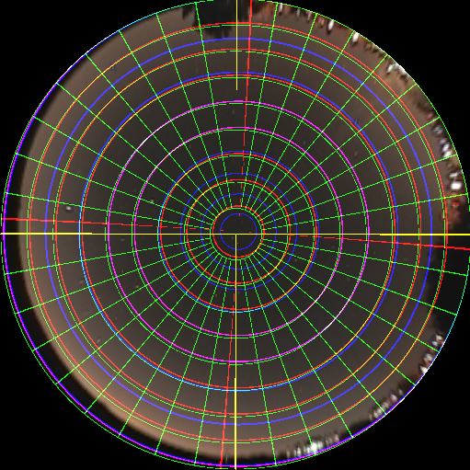
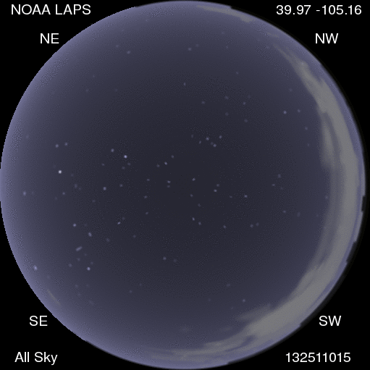
Camera Image Navigation
Overall correction based on optical axis centering, spherical rotation, and radial lens “distortion”
Stars are used as reference points

Slide 9
Visualization Elements
Light sources include sun, moon, planets, stars, city lights
Ray Tracing through atmosphere including model domain
Scattering by intervening clouds, aerosols, gas
Terrain shown where it’s along the line of sight
Physically and empirically based for best efficiency

Slide 10
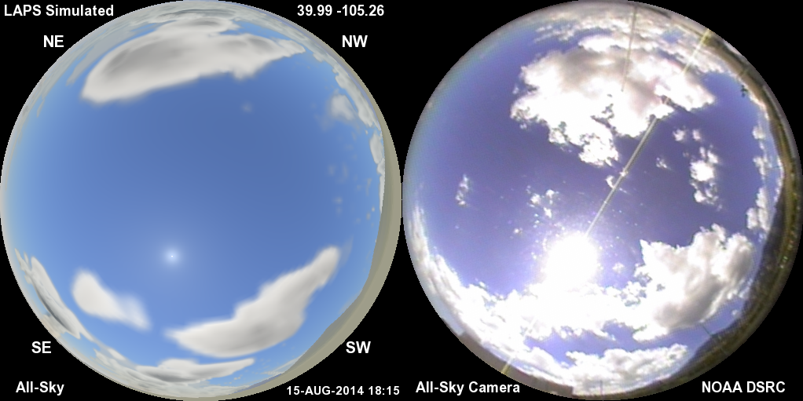
Cloud Illumination Example
Polar (Fish-eye lens) view
Left is LAPS analysis simulation, right is camera image (“Moonglow” camera atop DSRC)

Slide 11
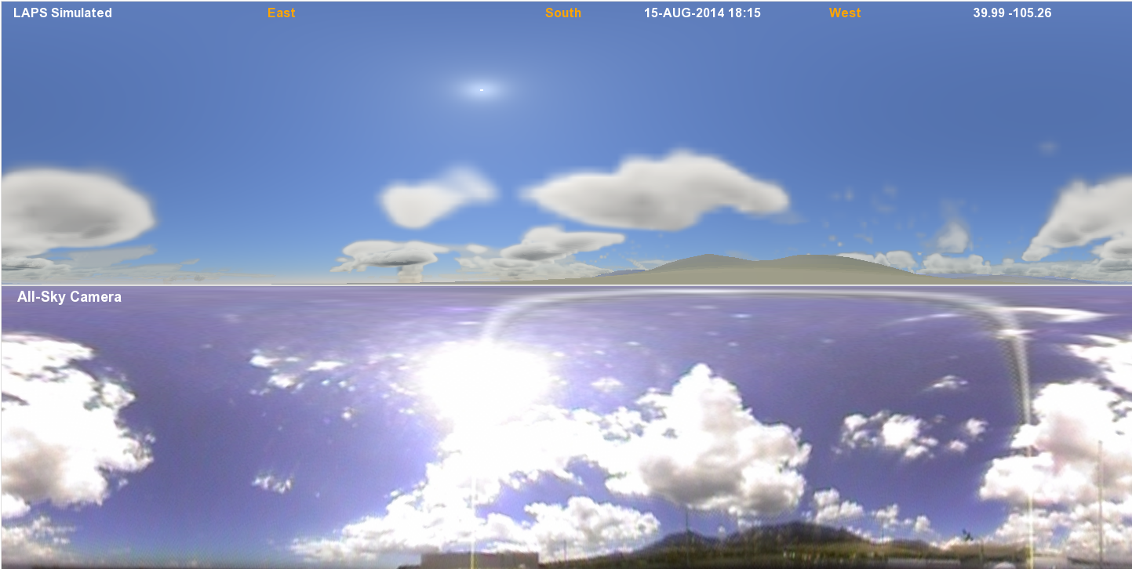
Panoramic (Cylindrical) View
(1/4 degree resolution)
Same time - projected differently

Slide 12
Ray Tracing Techniques
      Determine 3-D short wave radiation field
      Light scattering by hydrometeors, aerosols, gases
  Cloud liquid / ice, rain, snow, graupel
  Determine optical thickness along light ray paths
  Rayleigh and Mie scattering
  Single / Multiple scattering phase functions
  Calculated using 3 colors
  Shadowing effects and terrain
  Light scattering by land / water / snow surface
  Spectral albedo and reflectance (BRDF) used
  Spectral Solar Irradiance fields (GHI, DNI) – Renewable Energy Link
  Terrain slope considered

Slide 13
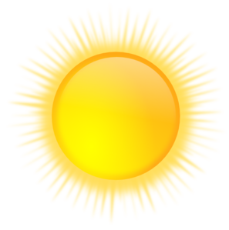
Ray Tracing Techniques
3D Short Wave
τ_{s}
θ
τ_{o}
τ = cloud optical thickness
θ = scattering angle
Notes:
Lines of sight are calculated from both the sun and from the observer. Along both of these pathways cloud (and aerosol) optical depth is determined for further use in the simulated imagery.

Slide 14


Ray Tracing Techniques
Two stages of ray-tracing on model grid
  from sun and from observer
“Clear Sky” ray-tracing done in addition
  gas/aerosols only, largely independent of model grid
      Trace air molecules (gas), aerosols, hydrometeors along ray
      For Gas and Aerosols…
        define optical depth τ to satisfy: transmittance = I/I₀ = e^{-τ}
        τ = number of mean free paths
        integrate extinction coefficient (α) to yield optical depth
        dτ / ds = α
        ds is traveling along light ray
        τ = α ds

Slide 15
Ray Tracing Techniques compared among RTMs
 | Present Technique | CRTM | RRTMG | SHDOM | Monte Carlo
3-D Radiation (including sideways between columns) | Y | N | N | Y | Y
Multiple Scattering | Approximate | Y | Y | Y | Y
Fast Running | Y | Y | Y | Y | N
Ground- air- or space-based observer | All | Space | Space | All | All
Curved Earth Shadow / Twilight | Y | N | N
Moon/Stars/City Lights | Y | N | N
2-D (directional) images | Y | Y | TOA SW up (Isotropic) | Y | Y
Wavelengths | VIS | VIS + IR | VIS + IR
Grid Resolutions | All | All | All | <=100m | All

Slide 16
Ray Tracing Techniques (on model grid)
      For Hydrometeors…
  Cloud liquid, cloud ice, rain, snow, graupel (as available)
  Integrate hydrometeor content along path - liquid/ice water path (LWP/IWP)
  LWP units are kg/m**2
Convert LWP/IWP into optical depth (τ)
    Use constant (typical) values of droplet & crystal size (r_{e}), can later be made dynamic
    Account for density ρ (lower for snow or graupel)
    τ ≈ (1.5 LWP)/(r_{e}ρ) (Stephens 1978, with ρ term added)

Slide 17
Initial ray-trace from sun through 3-D grid
Determines 3-D short wave radiation field
  Efficient simplified approach
Uses model 3-D hydrometeor analysis or forecast
Specified in 3 colors to work with sun near the horizon
  luminance units are presently used (nL)
  may switch to spectral radiance
Moon can be light source at night

Slide 18
Scattering of Sunlight by Clouds & Precip
(initial gridded ray trace from sun)
Calculate fraction of incident sunlight scattered up & down
  Based on optical depth and backscatter fraction
Backscatter fraction (for a single scattering event)
  Ratio of backscattering coefficient to extinction coefficient
  .063 for liquid, .14 for cloud ice or snow, 0.3 for graupel
  Low values explain why clouds can look opaque yet still darker gray even when lit in full sunlight from behind the observer
  Remainder of light continues downward (through cloud) via forward scattering

Slide 19
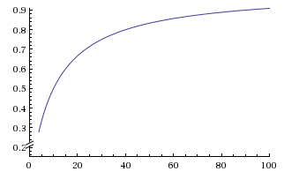
Cloud / Precip Multiple Scattering
(initial gridded ray trace from sun)
a
b ~ 0.1
τ
Determine cloud albedo (a) using optical depth (τ) and backscatter fraction (b)
  a = bτ / (1 + bτ)
  Asymptotically approaches 1 for high τ
  Reproduces figure in Mishchenko et. al. (1996) within a few % (for non-absorbing clouds)
  Works with cloud liquid and cloud ice (random fractal crystals)
  Reduces to expected relationship a = bτ for small values of τ
Light not reflected (back-scattered) is assumed to be transmitted (directly and via forward scattering), thus transmittance = (1. – a)
Absorption by clouds is small and can be neglected

Slide 20
2nd Ray-Tracing Step (from observer)
Trace from viewer into sky using ¼º x ¼º cylindrical grid
Ray path travels through clear air, aerosols, clouds, and may hit terrain
First estimate is clear sky value (modified as follows)
  Scattered by clouds (can show up either bright or dark)depends on optical depth of cloud and elongation from sun (scattering angle), as well as pre-computed cloud illumination (3-D shortwave radiation field)
  Phase function varies with single/multiple scattering
Cloud/Aerosol scattering can obscure distant terrain

Slide 21
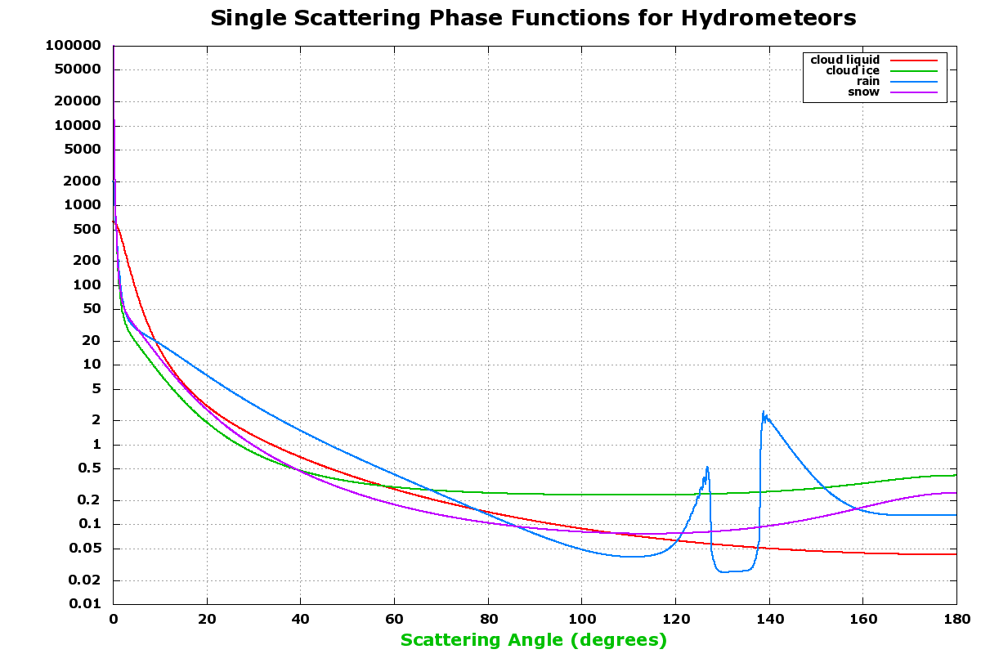
Cloud / Precip Scattering (Thin Clouds)
0º scattering angle looks toward the sun, 180º is opposite
Phase function (y-axis) averages to 1 over the sphere
Approximation to more rigorous Mie theory
Multi-parameter Henyey-Greenstein functions
  each term uses asymmetry factor “g”

Slide 22
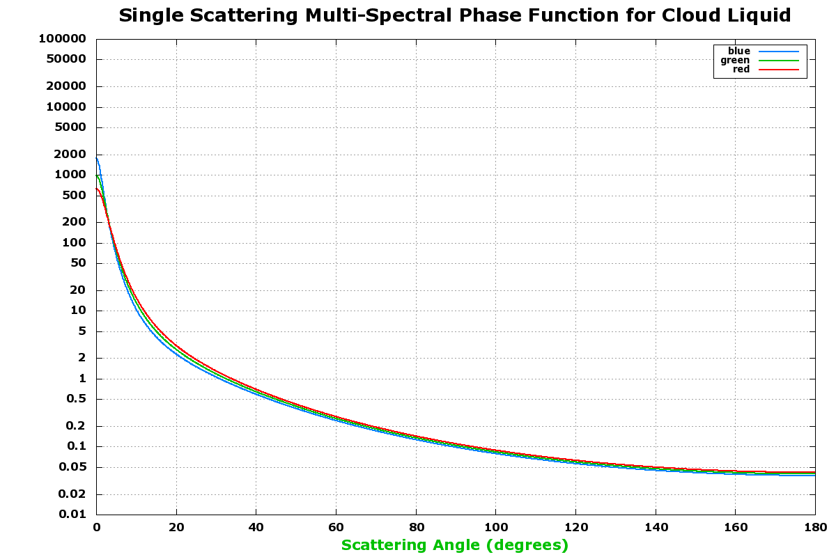
Multi-Spectral Cloud Liquid (Thin Clouds)
Integrates to 1 over the sphere
Approximation to more rigorous Mie Theory
Multi-parameter Henyey-Greenstein functions
  each term uses asymmetry factor “g”
Rainbows added in near 140 degrees

Slide 23
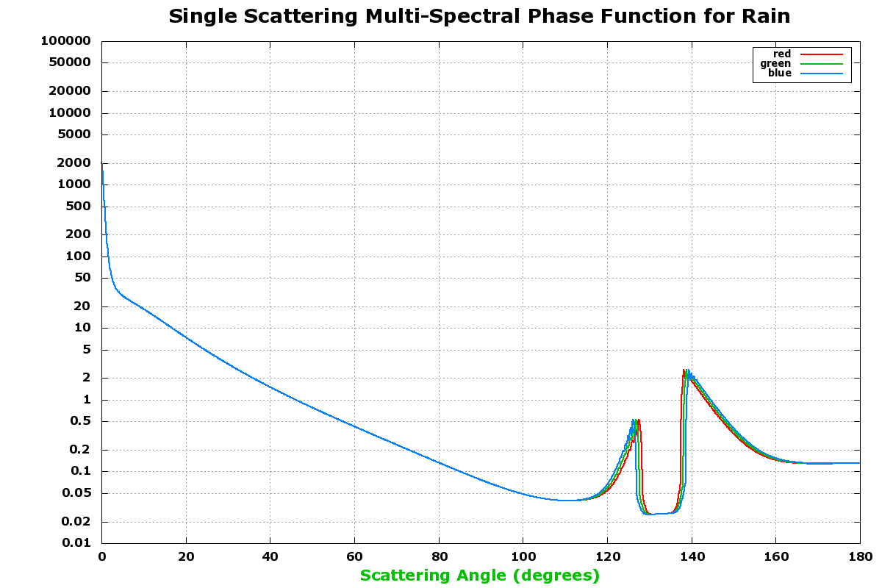
Multi-Spectral Rain Scattering
Rainbows added in near 125 and 140 degrees
Primary
Secondary

Slide 24
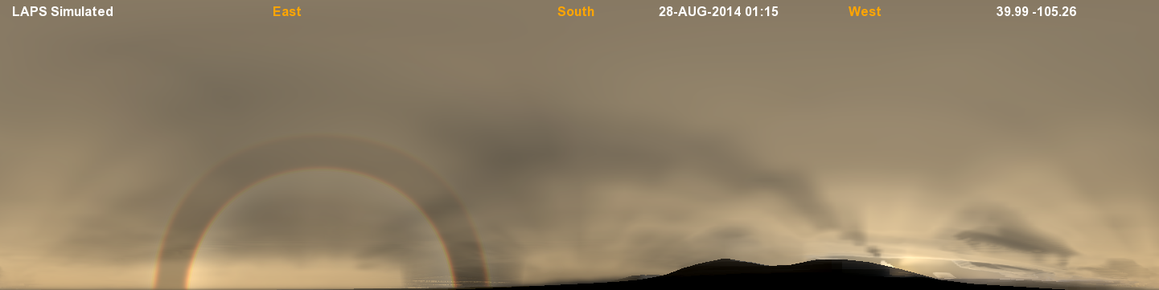
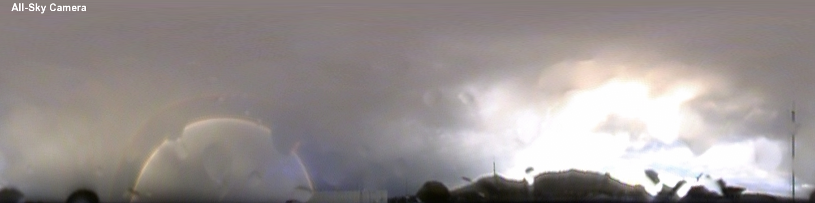
Rainbow Case Comparison
August 28 2014 01:15UTC

Slide 25
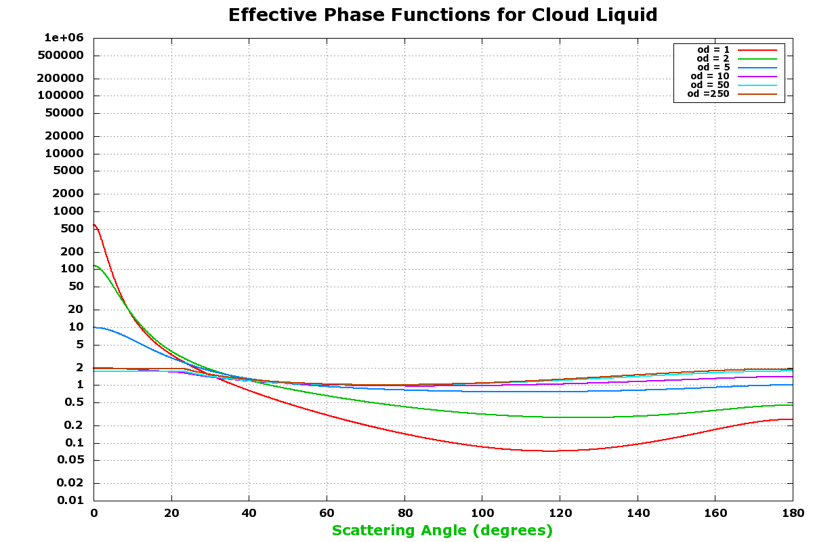
Cloud Liquid Scattering (various optical depths)
Multiple scattering is now occurring
Modify “g” values (taking g^{τ}) applied within Henyey-Greenstein functions to yield an effective phase function
Spreads out solar “glare” or sharp forward scattering peak as cloud thickens
Phase function used in conjunction with 3-D short wave radiation field
Transitions into thick cloud phase functions (shown next)

Slide 26
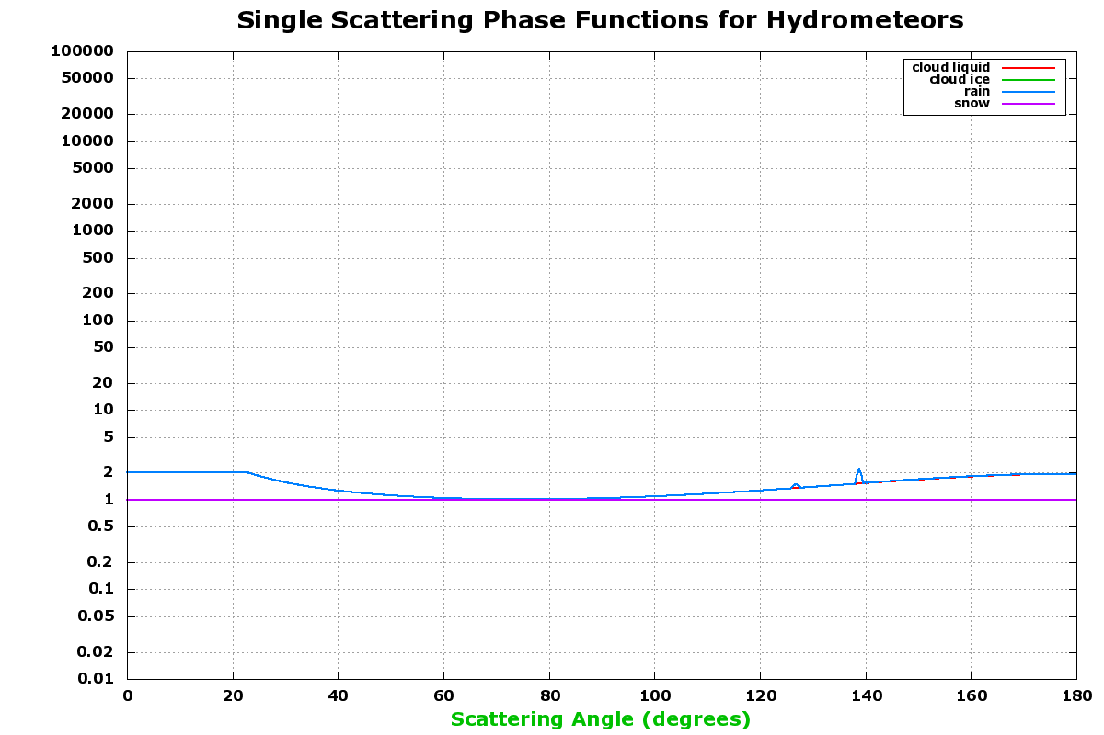
Cloud / Precip Scattering (Thick Clouds)
Multiple
Effective phase functions flatten with multiple scattering
Easily measured phase function of Venus used as a guide
Phase function used with 3-D short-wave radiation field

Slide 27
More on Cloud/Precip Scattering
Mie scattering phase function means thin clouds are brighter near the sun (silver lining), cloud corona
Thick clouds are the opposite, being lit up better when opposite the sun
Rayleigh scattering by clear air can redden distant clouds
Future enhancement would be to add more optical phenomena such as halos, improved coronae
  with clouds/precip at specific scattering angles
  rainbows can also be improved

Slide 28
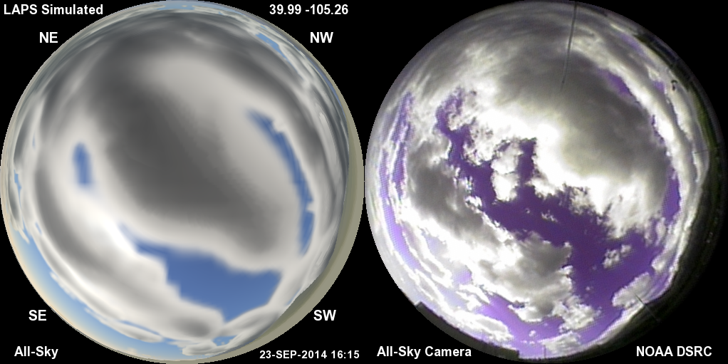
Cloud Illumination Example
Cloud Illumination (and scattering)

Slide 29
Clear Sky Ray Tracing
Separate calculation used as a “no cloud” reference
  Considers entire atmosphere (even above / outside model grid)
  Combined later with information from model grid ray tracing
Source can be sun or moon
Considers gas + aerosols without clouds
Rayleigh scattering by N₂, O₂ air molecules (blue sky)
  Minimum brightness 90 degrees from light source
  Blue-Green sky color near horizon far from sun
Mie scattering by aerosols (haze)
  Brighter near the light source (aureole)
Ozone (O₃) absorption (most evident during twilight)
Added brightness from planets, stars, city lights, airglow

Slide 30
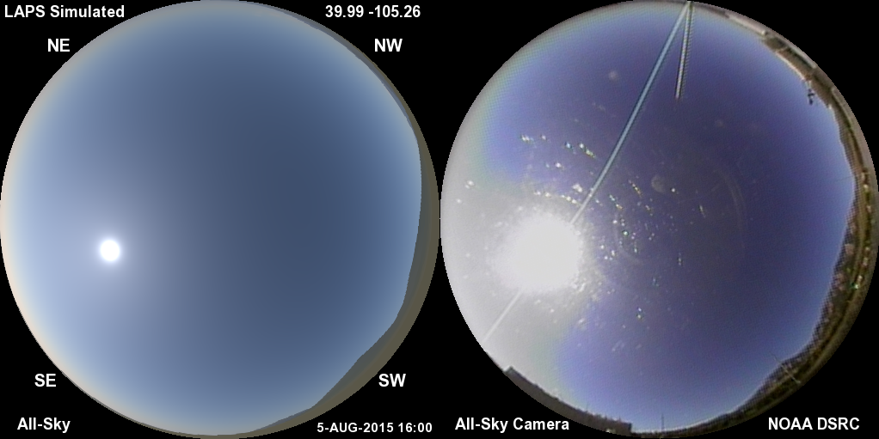
Daylight Clear Sky
Low aerosol content (τ~.05) with aureole around the sun
Bimodal aerosol size distribution contributes to condensed aureole
Standard gamma brightness function to match camera image
Image brightness proportional to actual scene enhances realism

Slide 31
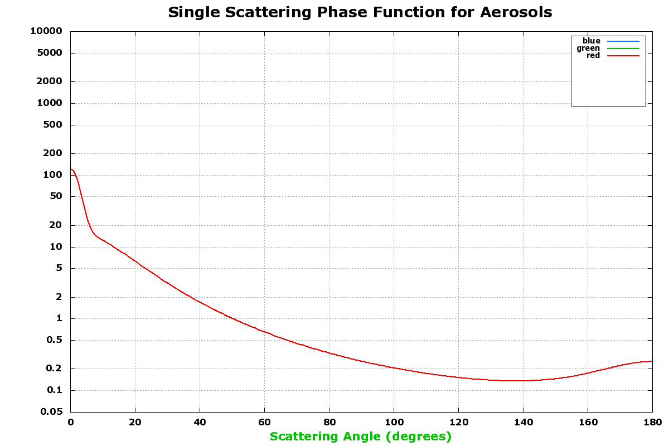
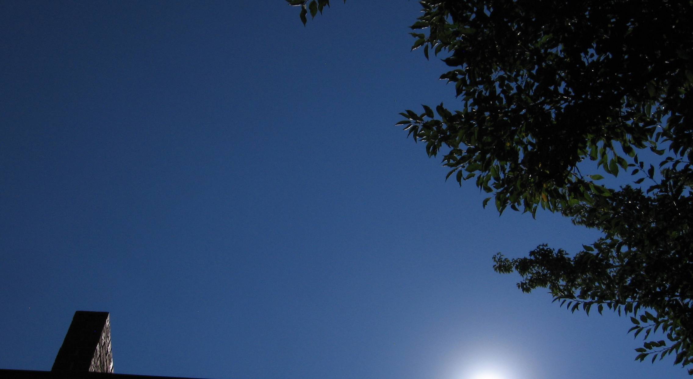
Closeup of Solar Aureole
Aureole (glow around sun)
Aerosols modeled with vertical extinction coefficient profile and scattering phase function. Phase function and Angstrom exponent depend on size distribution

Slide 32
Aerosol Scattering Phase Function
Multi-parameter phase function
  Linear combination of Double Henyey-Greenstein functions
  Approximates Mie scattering for non-spherical aerosols with bi-modal size distribution
  Agrees with recent AERONET aerosol phase function measurements in Boulder area
  Central peak is adjustable (higher with more large aerosols)
Used with Aerosol Optical Depth & Single Scattering Albedo
Wavelength dependent phase function?
  Plus Angstrom exponent (wavelength dependence for τ)
Consider size distribution of aerosols from chemistry model?
  Connect to aerosol phase function database?

Slide 33
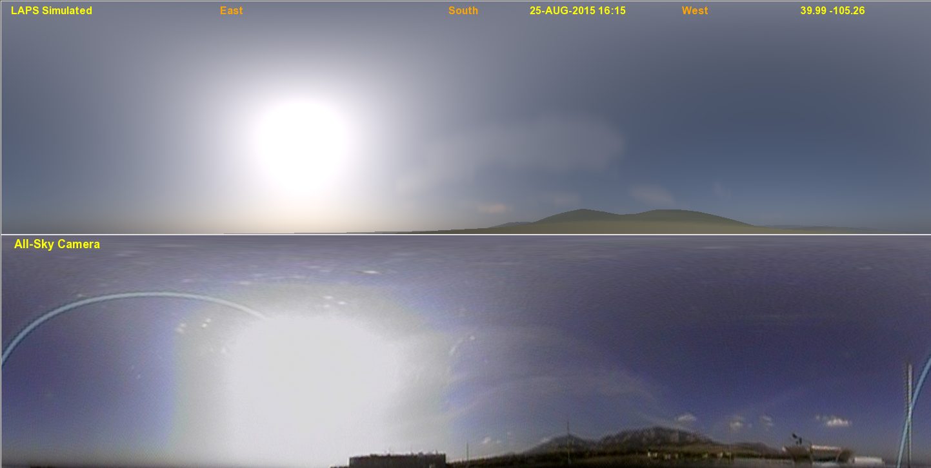
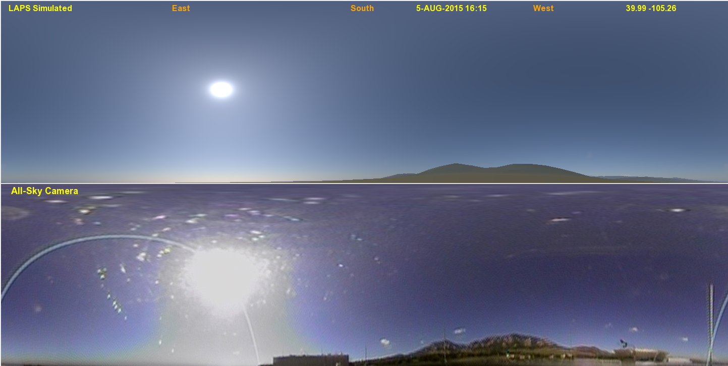
Smoke Event Comparison - 1
SIMULATED
AOD ~ 0.23
OBSERVED
SIMULATED
AOD ~ 0.05
OBSERVED

Slide 34
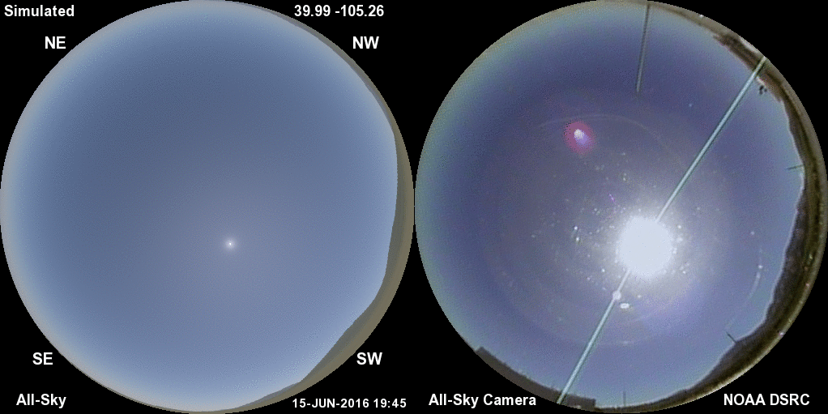
Smoke Event Comparison
SIMULATED
OBSERVED
AOD ~ 0.045 – 0.09, note changing radiance pattern between horizon and zenith
“Inscatter” also varies in front of the mountains by AOD and distance

Slide 35
Clear Sky Illumination (continued)
Cloud shadows in clear air can show crepuscular rays
  Obtained from model grid ray-tracing info
Brightness and color changes shown during twilight
  3-D orientation of Earth’s shadow considered
  Secondary scattering added to reduce contrast in Earth’s shadow that appears opposite the sun

Slide 36
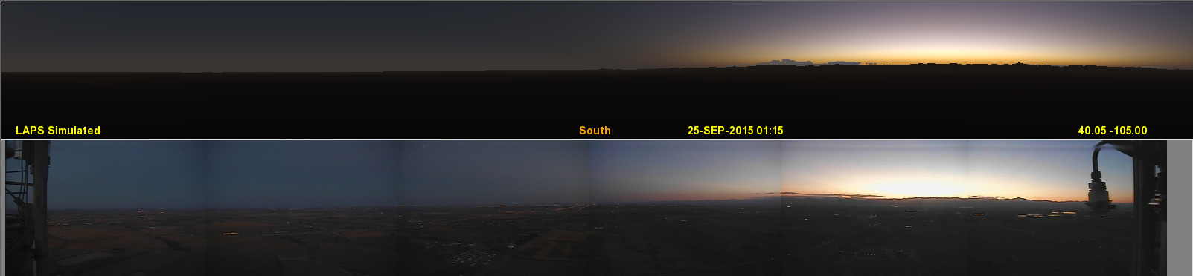
Twilight Comparison – BAO Tower
SIMULATED
OBSERVED
Colors relate to handling of multiple scattering & ozone absorption
Stratospheric (and tropospheric) aerosols can affect twilight appearance
Twilights from Boulder were volcanically enhanced in late 2015

Slide 37
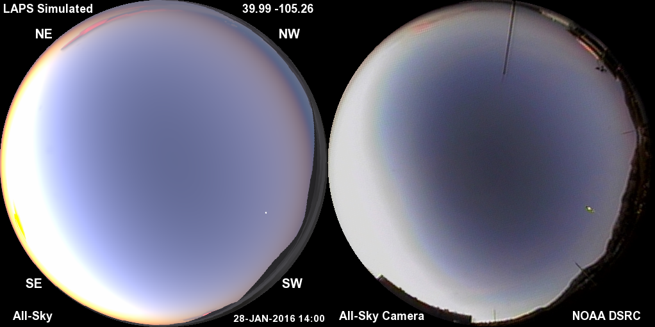
Twilight Comparison – Fisheye View
Colors relate to handling of multiple scattering & ozone absorption
Stratospheric (and tropospheric) aerosols can affect twilight brightness

Slide 38
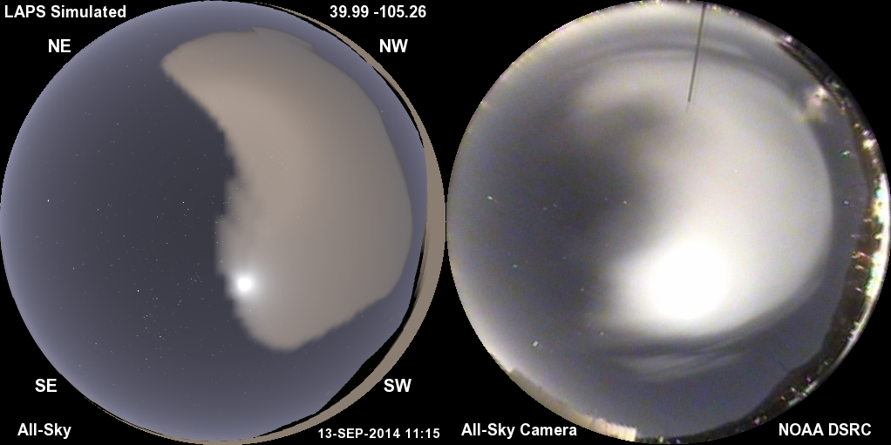
Nighttime Clouds (and stars)
Illumination by moonlight and artificial surface lighting

Slide 39
Terrain / Land Surface Rendering
Topography data allows showing mountains near the horizon
Terrain Albedo (e.g. a dark forest)
Adjusted by snow cover
Illumination decreases in cloud shadows
Terrain can be obscured by intervening clouds, haze, or clear air (very long distances)

Slide 40
Image Display
Color / Radiance aspects of rendering
  3 narrowband wavelengths
  Relative to solar spectrum
  Converted to sRGB colorspace for display
  White point color temperature is solar value (5780K)
Flexible vantage point
  shows below the horizon (e.g. from a mountain top)
  above ground vantage anywhere in atmosphere
  from space up to 40000km (geosynchronous)

Slide 41
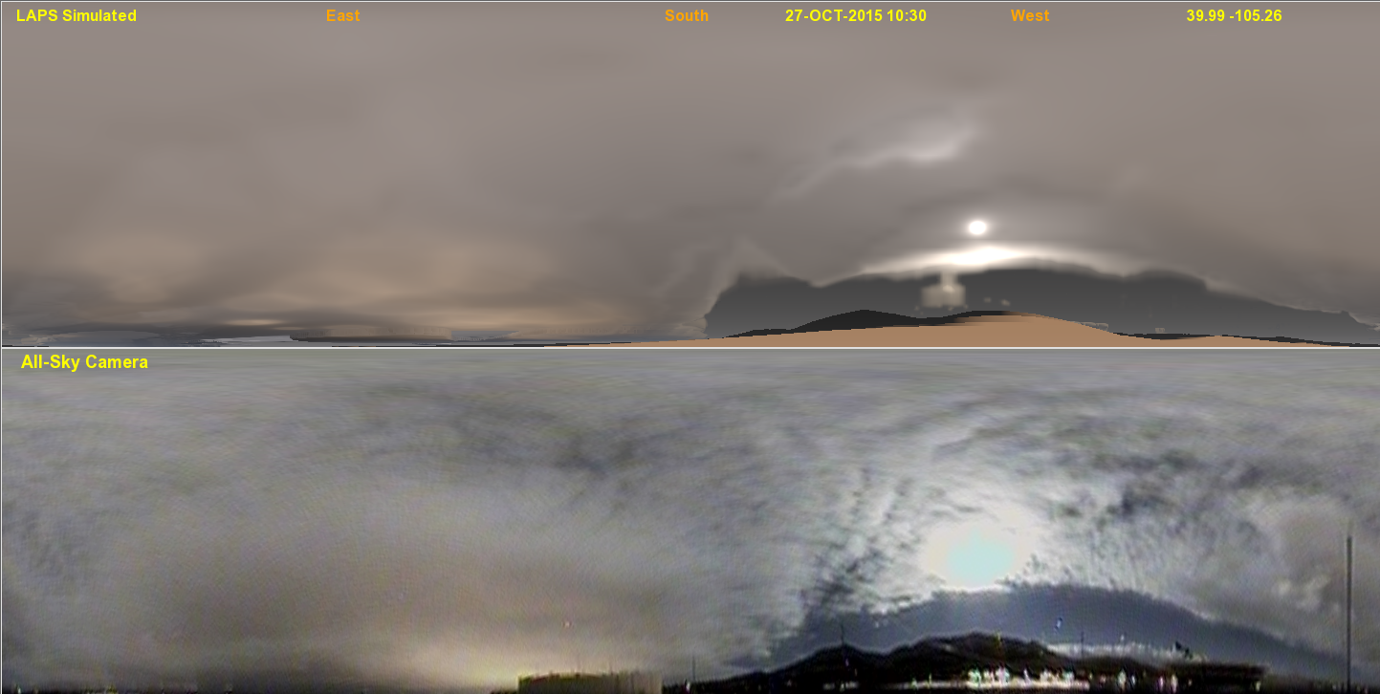
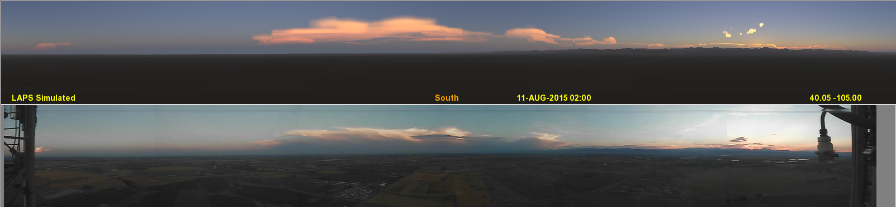
FOUR SIMULATED vs OBSERVED COMPARISONS
Daytime clouds
Nighttime clouds
SIMULATED
OBSERVED
Rainbow
SIMULATED
Sunset colors
OBSERVED

Slide 42
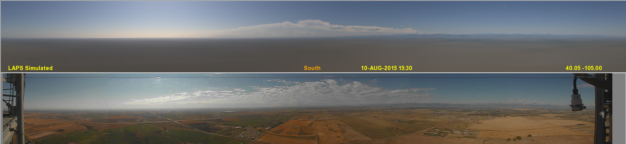
BAO Tower – Erie CO
Camera operated by ESRL/PSD
Panoramic view from 300m AGL
Sky near horizon seen at relatively high angular resolution
Land Surface rendered based on irradiance and multi-spectral bi-directional reflectance (simple BRDF)

Slide 43
BAO Tower – Erie CO
Camera operated by ESRL/PSD
Sunset Case
Earth’s curvature taken into account

Slide 44
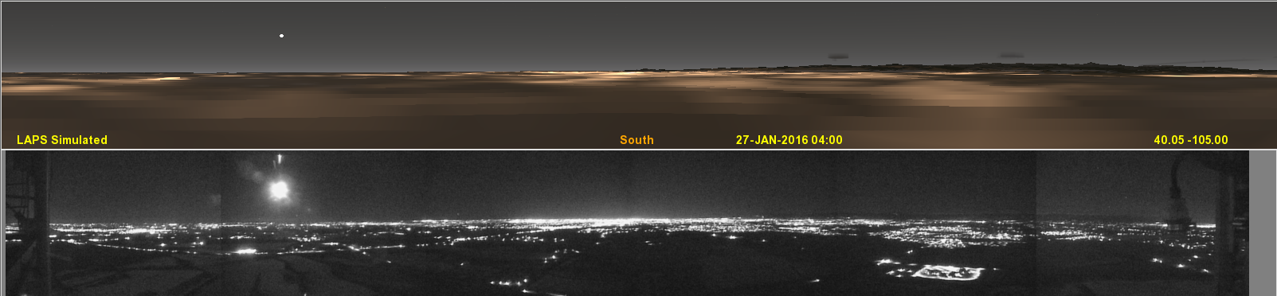
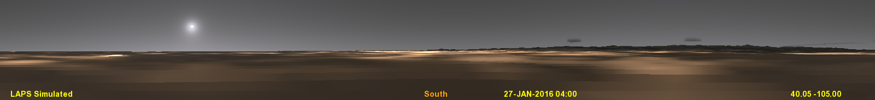
Nighttime Comparison atop 300m BAO Tower in Erie, CO
SIMULATED
OBSERVED
Lunar aureole is bright in this example
VIIRS stable nightlights used in simulation
Good alignment of city lights on larger scales
City lights show aerosol scattering localized over Denver (observed)

Slide 45
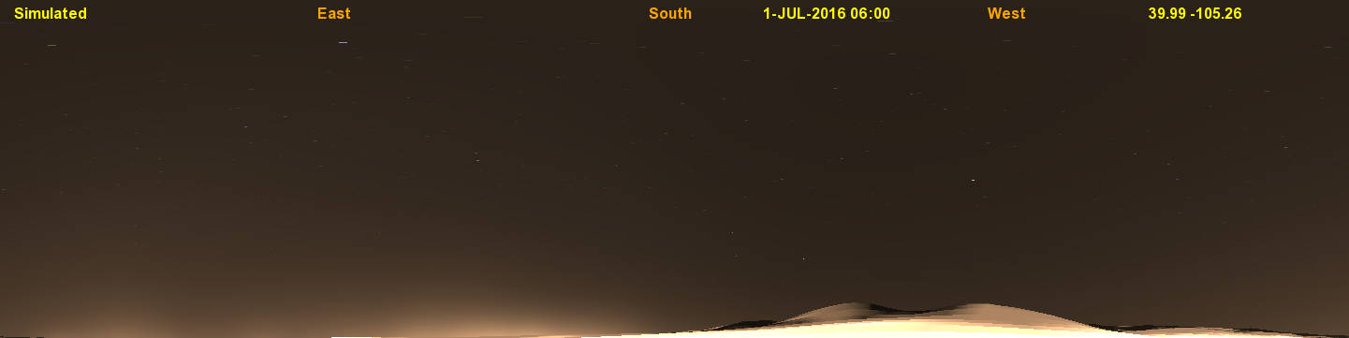
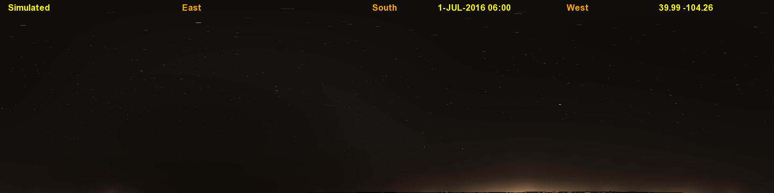
City Lights Atmospheric Scattering
Location in Boulder, CO
Location 110km East of Boulder, CO

Slide 46
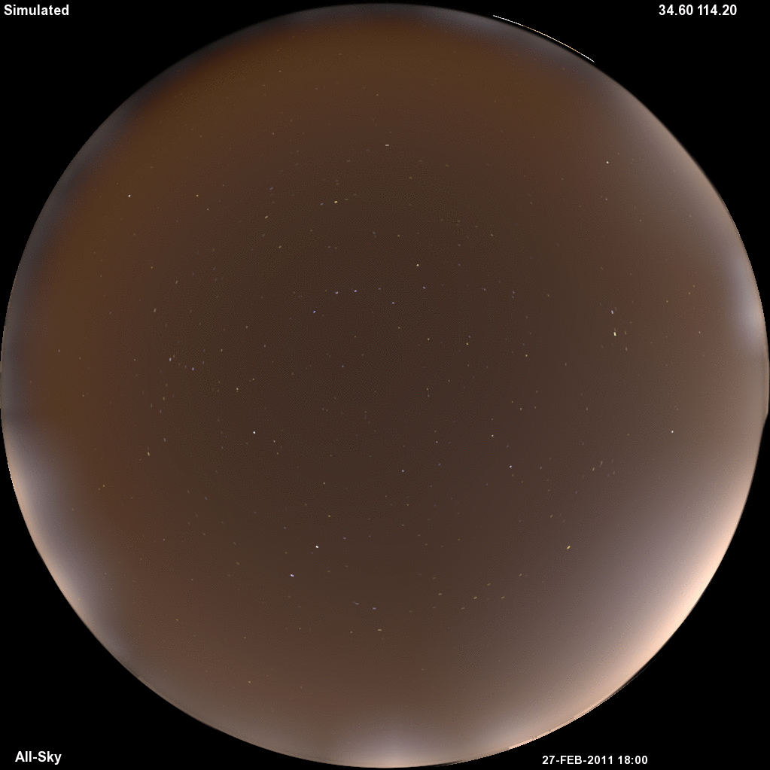
WRF All-Sky Simulation
East Asia
WRF run courtesy Louie Grasso

Slide 47
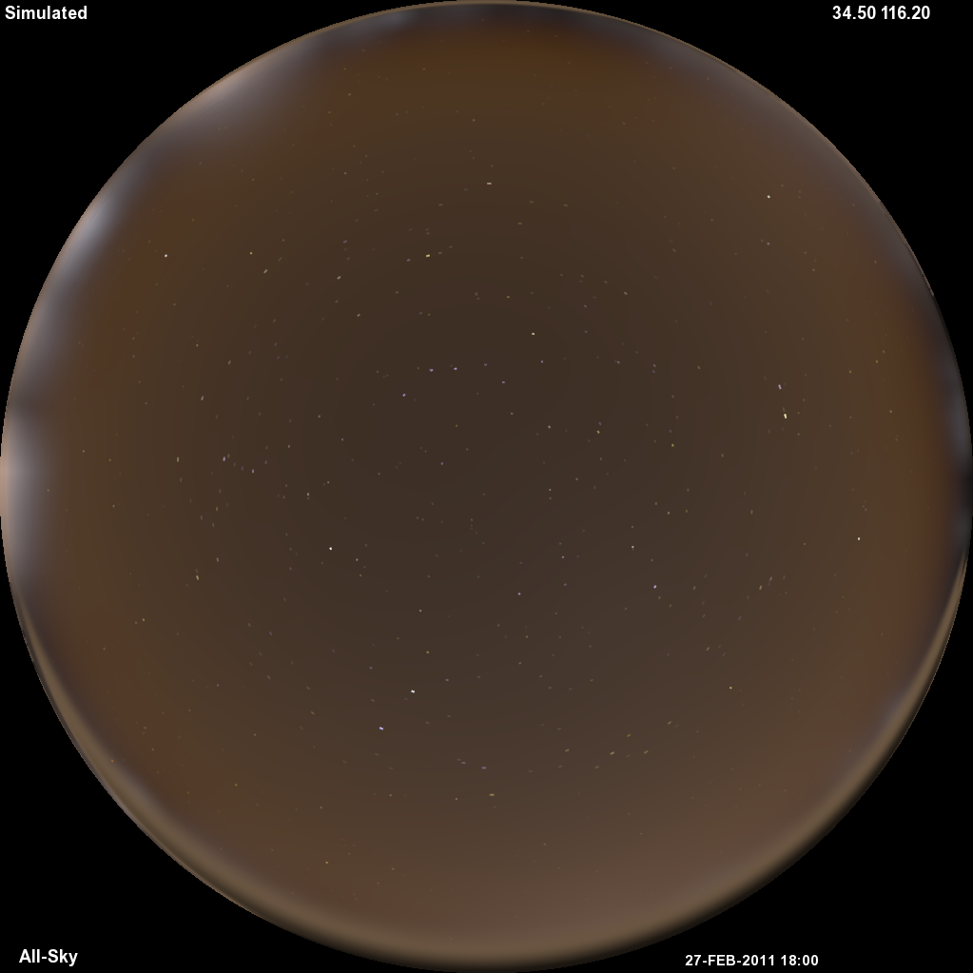
WRF All-Sky Simulation
East Asia (improved scattering)
WRF run courtesy Louie Grasso

Slide 48
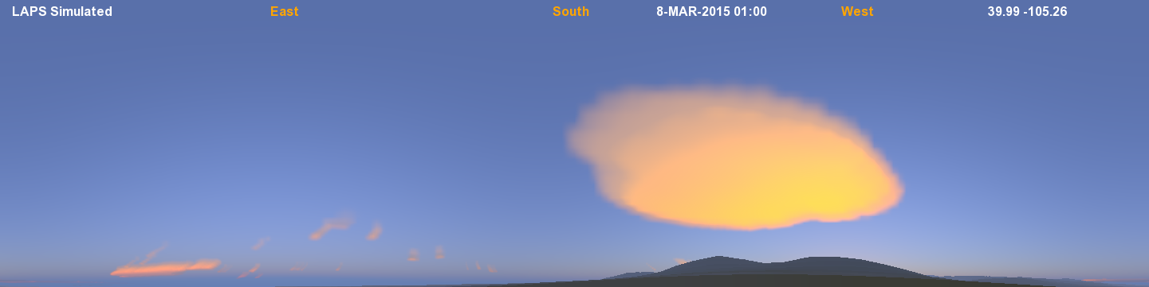
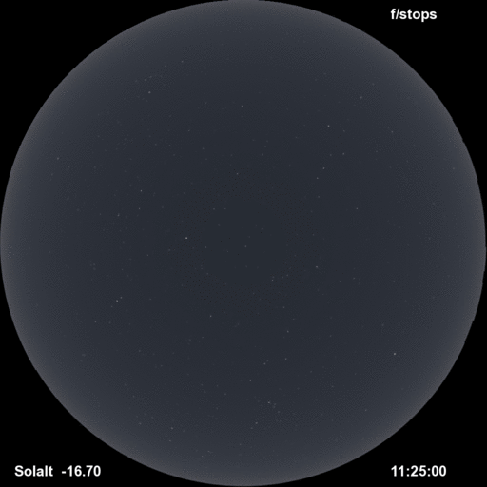
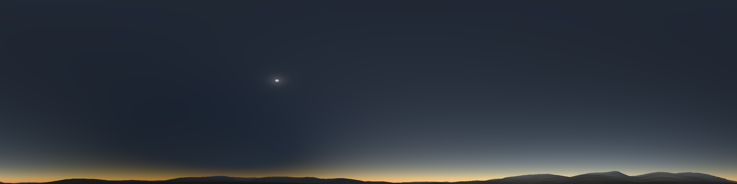
Miscellaneous Renderings
Mountain wave cloud just after sunset
Total Solar Eclipse
(Moon’s shadow projected onto atmosphere)
Twilight Sequence

Slide 49
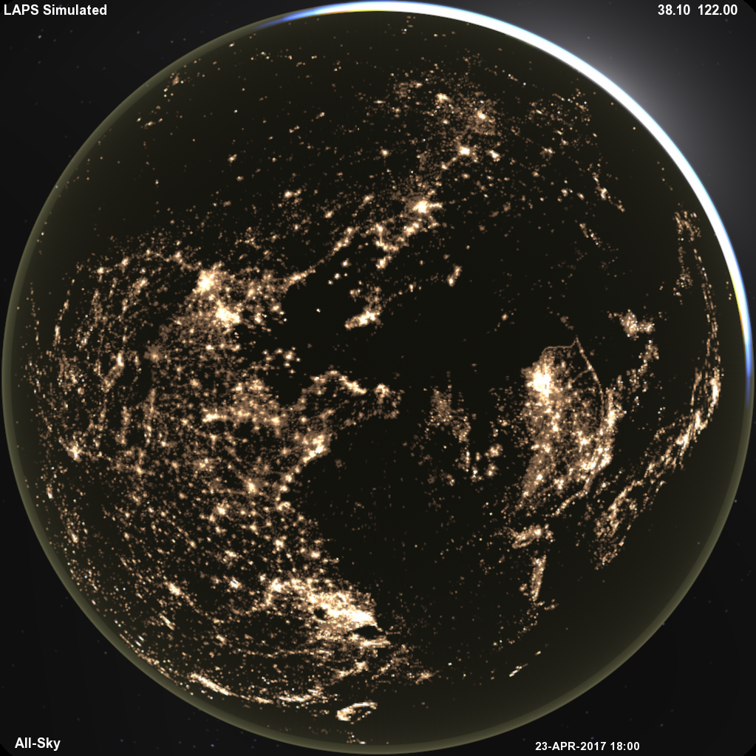
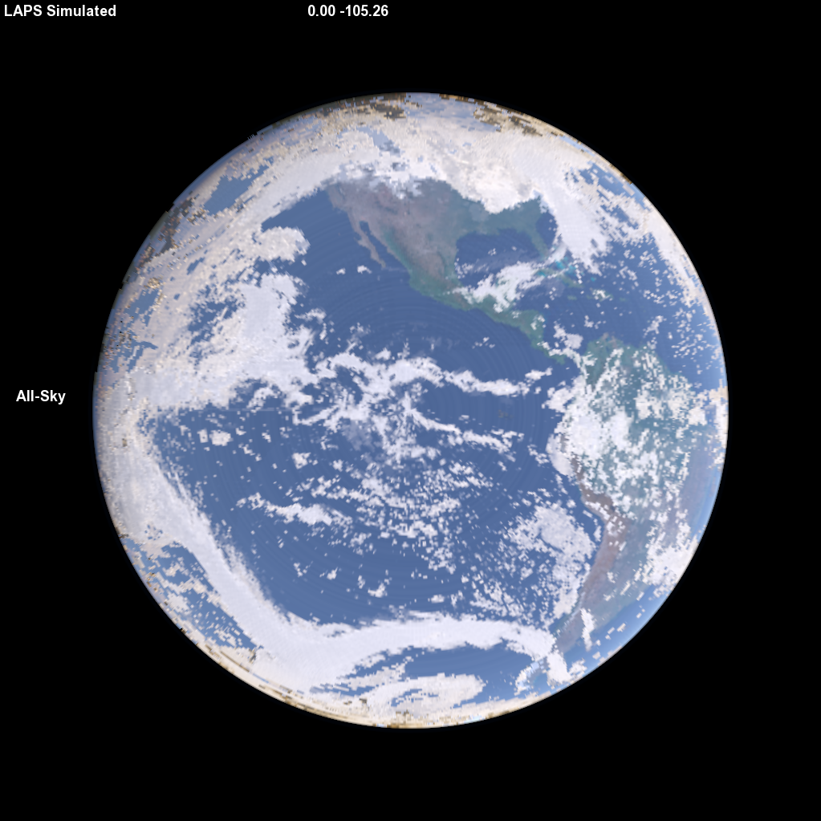
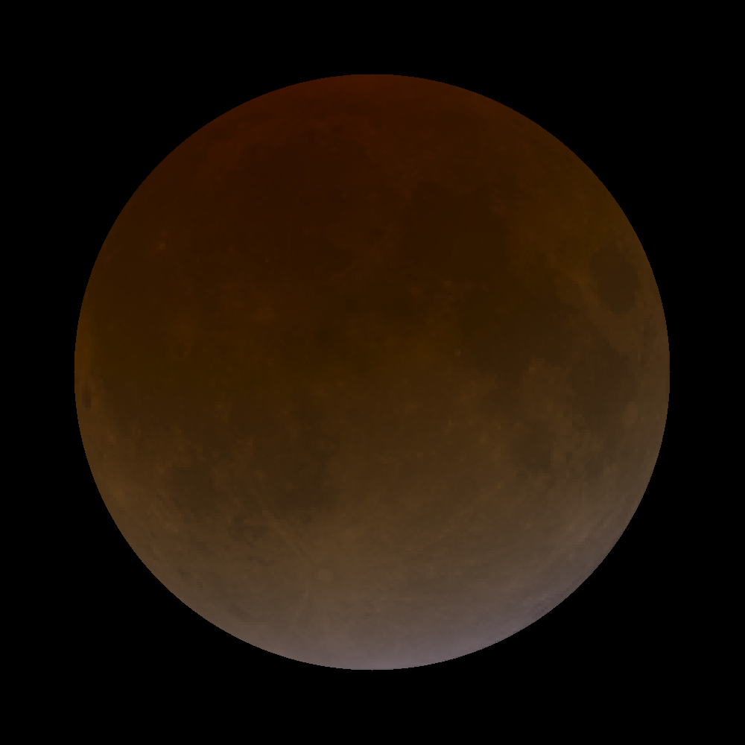

Miscellaneous Simulations
Twilight / Airglow 790km up
+ City Lights, Zodiacal Light, Galactic Glow
Earth global view
Compare with
DSCOVR / Himawari
Lunar Eclipse
Sensitive to stratospheric aerosols, ozone, clouds
Martian Sky – Mainly Dust

Slide 50
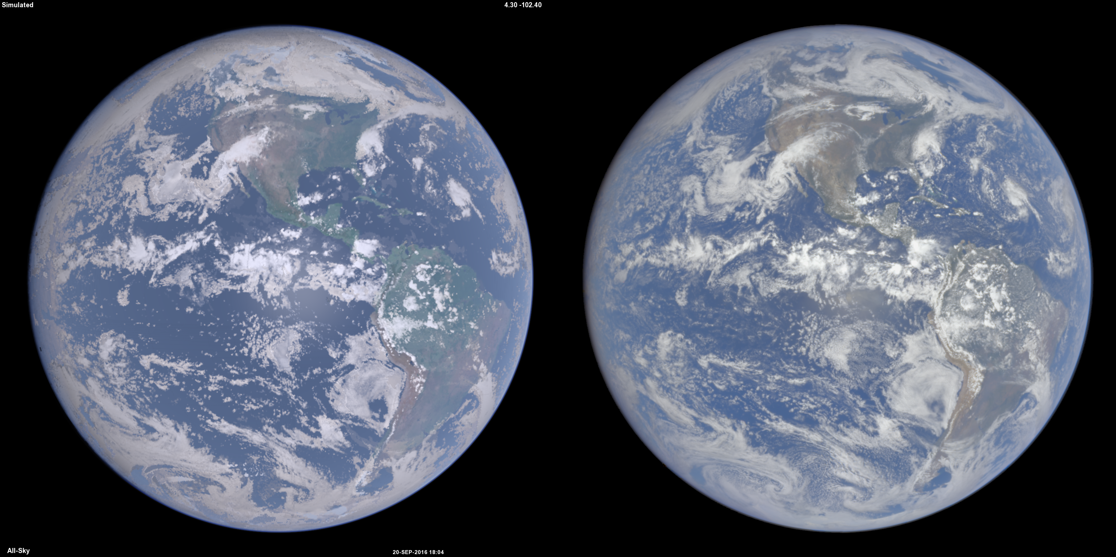
Full Disk Earth View
SIMULATED
OBSERVED (DSCOVR)
Earth global view
Compare with
DSCOVR or Himawari

Slide 51
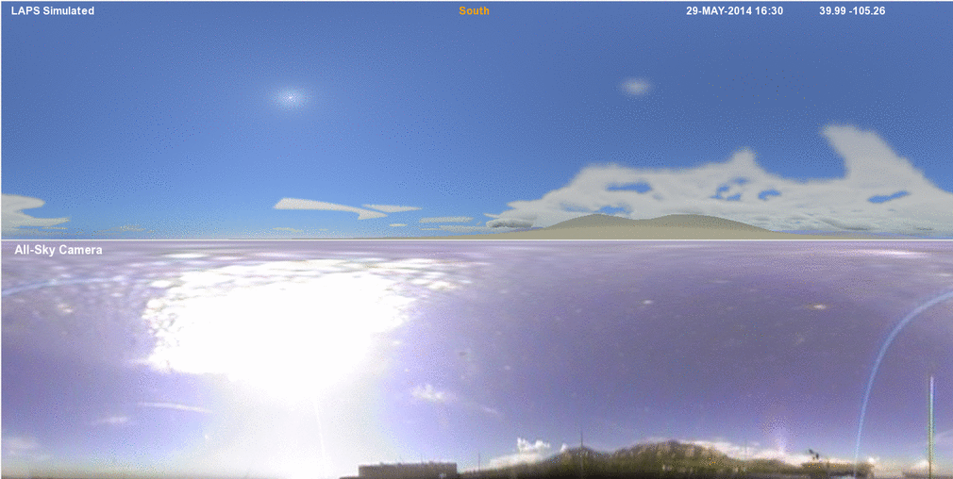
Panoramic Analysis Comparison
(500m grid - 1/4 angular degree resolution - loop)

Slide 52
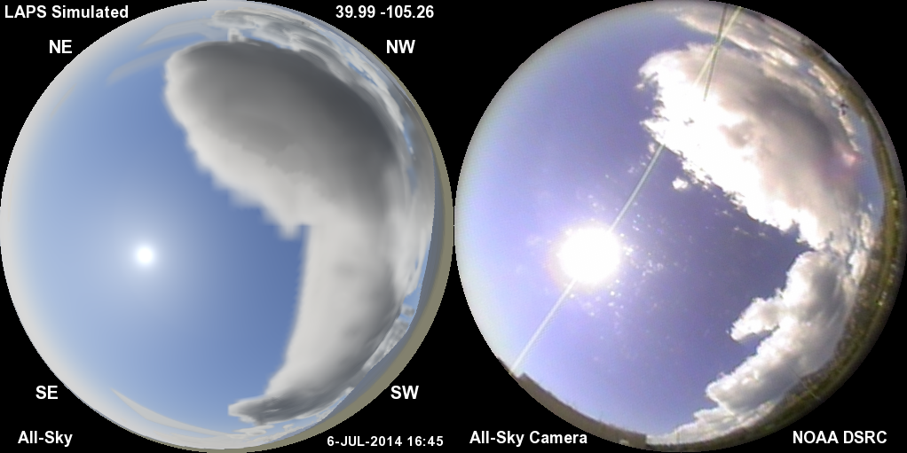
July 6, 2014 case

Slide 53
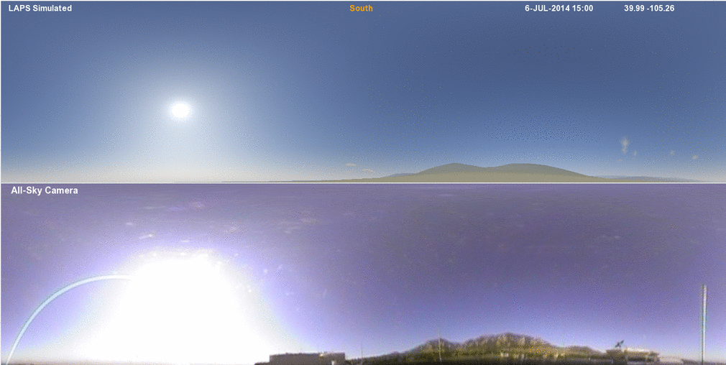
3D 500m CLOUD ANALYSIS - Animation
Unique feature of LAPS, critical for WOF, Nextgen, etc
SIMULATED
OBSERVED
15:00-19:00 UTC July 6, 2014, 15-min frequency

Slide 54
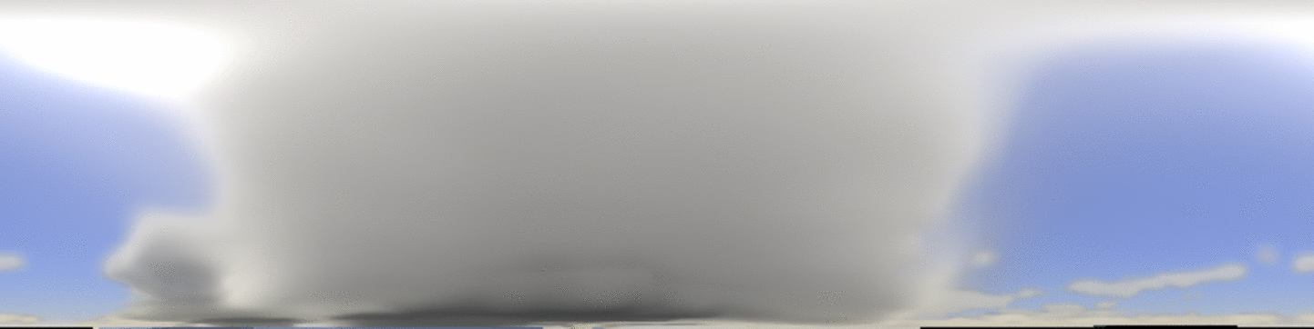

LAPS / WRF Forecast Animation
(1km grid - 1/4 degree angular resolution)
NORTH
Moore tornado storm - May 20, 2013
Initialized 1900 UTC / Valid times 1900-2020 UTC
Moving storm perspective at 1-min intervals
“Chaser Cam”
Good hot-start continuity
“.” ^{is} ^{observer position}
Jiang et. al. 2015, BAMS

Slide 55
Ongoing Cloud Analysis Improvements
(aided by all-sky comparisons)
Improved consistency of cloud fraction, albedo and microphysical variables
Better thin cirrus detection
Satellite navigation
  Apply parallax offset as function of altitude, will try at various scales
  Interpolate satellite imageryq to exact analysis and camera time
  Systematic satellite navigation error correction
Ongoing issues being considered
  Clouds too dense at night with just IR satellite
  Clouds too thin in daytime when using visible satellite

Slide 56
Variational Cloud Analysis
“vLAPS” currently under development
  based originally on traditional LAPS cloud
Simultaneous solution
Use satellite radiance (e.g. CRTM) or algorithms (e.g. DCOMP)
  Add microwave over water
  Add space based radar over land
Hydrometeor control variables
Appropriate forward models and constraints
Use all-sky cameras as input data
More info in Appendix I

Slide 57
All-Sky Applications
Aviation
  Ceiling and Visibility
  Alaska camera network
Renewable energy (e.g. Greenpower Labs)
  Direct Normal Incidence (DNI)
  Global Horizontal Irradiance (GHI)
  Multi-spectral irradiance (in addition to irradiance)
  Use more consistent physical units (e.g. luminance → spectral radiance)
Plans for 2018 Korea Winter Olympics (with KMA)

Slide 58
All-Sky Applications - II
Forestry
  Interaction of radiation with forest canopy
Analysis and Forecast displays
  Public forecast dissemination (e.g. WSI)
  Game Engines (e.g. TerraViz, Unity, Terragen)
  Planetarium dome
Cloud Analysis and Forecast Assimilation / Validation
  Grid-scale and sub-grid parameterizations
  Analysis showing unresolved satellite scales via extrapolation of Fourier (TKE) power spectrum

Slide 59



Quantitative
Verification
False Cloud
Correct Clear
False Clear
  Thresholded Yes/No for clouds
  Color threshold in the daytime
  (intensity at night)
  Time series shown in next slide…
    Accuracy means correct fraction
    Compared with random placement having same cloud fraction
    Correlation Coefficient (non-thresholded for Red, Green, Blue)
Correct Cloud

Slide 60

Quantitative Verification
Image RGB Correlation
  Correlation Coefficient (for Red, Green, Blue channels) - Top
  Cloudy Fraction (Observed and Simulated)
  Accuracy (Percent correct)
  Accuracy of Random Cloud Placement (for reference) Correlation Coefficient (for Red, Green, Blue channels)
1
0
Thresholded Scores
Sim Acc
Rnd Acc
Sim Cloud Frac
Obs Cloud Frac

Slide 61
References (partial list)
Albers S., J. McGinley, D. Birkenheuer, J. Smart 1996: The Local Analysis and Prediction System (LAPS): Analyses of clouds, precipitation, and temperature. Weather and Forecasting, 11, 273-287.
Kaufman et. al., 1994: Size distribution and scattering phase function of aerosol particles retrieved from sky brightness measurements. Papers in Natural Resources, University of Nebraska, Lincoln.
Mishchenko, M., Rossow, W.B., Macke, A., 1996: Sensitivity of cirrus albedo, bidirectional reflectance, and optical thickness retrieval accuracy to ice particle shape. JGR, 101, 16973-16985
Stephens, G., 1978: Radiation Profiles in Extended Water Clouds. II:
Parameterization Schemes. J. Atmos. Sci. , 35, 2123-2132
All-sky Real-time Web page
http://laps.noaa.gov/allsky/allsky.cgi
Four camera locations :
DSRC, Longmont Astronomical Society
BAO Tower (Erie), Pikes Peak

Slide 62
Future Directions
Improve ray-tracing techniques
  Consider aerosols with direct cloud illumination
  Explore Monte-Carlo algorithms
Improve scattering phase functions
Connect to microphysics packages and chemistry models
  More detailed hydrometeor and aerosol info
  Both for validation and for DA
Add IR cameras and visualizations
  ASIVA IR camera used by ARM
Add polarization

Slide 63
Future Directions - II
More cameras, via NOAA’s observing systems?
  Add to ASOS?
  FAA camera networks (e.g. Alaska)
  Airborne cameras?
  CSTAR / AWIPS
Data assimilation with variational cloud and GSI analysis
  Efforts underway to use GSI cloud/hydrometeor analysis (used in HRRR/RAP) with all-sky forward model for nowcasting.
  Use derived METAR, cloud mask, image correlation, or spectral radiances
  Check applicabilty of available RTMs

Slide 64

  The sky is the limit!
“Launch” into the stratosphere (40km up), 360º spherical view
  More info: https://www.cira.colostate.edu/people/employee-list/steve-albers

Slide 65
Appendix I

Slide 66
Variational Cloud Strategies
Choose Object / Fwd Model for Satellite / Radar Obs
Constraints
Physical
Statistical
OR
OR
OR
Water Vapor RH & Q
Saturation Q
Cloud Tau, LWP, Aerosol Retrievals
(e.g. CLAVR-x)
IR B-temp
VIS Albedo
Goddard Satellite
Simulator
CRTM
Notes:
These five constants represents the coefficient of hydrometer concentration, with the unit of 1/kg/m.
Cloud optical depth is equal to the integration of hydrometers from surface to model top vertically.

Slide 67
Variational Cloud Observation Operator
Courtesy Juxiang Peng
Cloud optical depth (satellite retrieval) =
hydrometeor water content analyzed as control variables
Units: m
constants account for
scattering cross-sections
effective particle radius
Notes:
These five constants represents the coefficient of hydrometer concentration, with the unit of 1/kg/m.
Cloud optical depth is equal to the integration of hydrometers from surface to model top vertically.

Slide 68


Variational impact on Cloud Ice Content at 225mb Sept. 13, 2013 1500UTC
vLAPS + Satellite Cloud Optical Depth
vLAPS + non-var Cloud
Notes:
Here are the cloud ice at 225hPa.The left is analyze from using cloud optical depth ,and the right is analyze from using traditional LAPS
The left Cloud ice seems add some detail characteristic when compare with LAPS

Slide 69


Observation Operator with Temperature Constraints Added on Hydrometer Type
Cloud phase
Courtesy Juxiang Peng
Notes:
In order to use cloud phase as constrain condition in minimization, add new coefficient in front of each hydrometer. The new coefficients control the hydrometer as switch. It’s value is based on Background temperature
Here the cloud ice and cloud water reference temperature temporarily set to be zero.

Slide 70


Cloud Ice Content along 40N Sept 13, 2013 1500 UTC
kg/meter**3
kg/meter**3
vLAPS + Satellite Cloud Optical Depth
vLAPS + non-var Cloud
Courtesy Juxiang Peng
Notes:
The Y axis is pressure of STMAS,and X axis is longitude .The left is from COD scheme and the right is from LAPS scheme.
Here is obviously diffenence between the two scheme.On the left hand ,the hight of cloud ice is higher.
Tradition LAPS analysis cloud height from 1200 m to 20000m. STMAS analysis cloud height from sfc to model top.
The large height of cloud ice corresponding to convective area.

Slide 71
Variational Cloud Analysis Experiments
CRTM
      Satellite radiances as input
      Design and coding underway
K-matrix model
Forward model
Interface
Atmospheric state along trace
Load coefficients
Atmosphere structure
Simulated radiances
Surface characteristics in FOV
Surface structure
Sensor and source locations
Gradients
Geometry structure
Special setup for each obs profile
Options structure
DA system
Obs
BK
Control variables
N
Converge?
Update
Minimization
Surface Info
Y
Solution
Notes:
Now, we are building the interface between CRTM and our DA system.
The interface mainly needs to complete two pieces of work: one is loading the CRTM coefficient data files. The other is delaring and filling four structures.
Atmospheric structure is filled with the atmospheric state along the scanning line. The atmospheric state includes the distribution of hydrometeors and aerosols.
Surface structure is filled with the surface characteristics in each FOV.
Geometry structure is filled with the locations of sensors and sources.The source is typically the sun or moon.
Options structure allows users to choose the certain kind of scattering RTM, to enable and disable the antenna correction and so on.
After all the above setup, CRTM is called. Simulated radiance and gradients are produced by its forward model and k-matrix model respectively.
Then, simulated radiance and gradients are used for the minimization of the cost function. If convergence is reached, we get the solution; else the control variables are updated and the iterative loop continues.

Slide 72
Backup Slides

Slide 73

3D 1 km CLOUD ANALYSIS LOOP
Courtesy Steve Albers
Unique feature of LAPS, critical for WOF, Nextgen, etc
Clouds as seen from top of DSRC building in Boulder by LAPS ANALYSIS
19:30-21:15 UTC Oct 31, 2013, 15-min frequency
ALLSKY CAMERA

Slide 74
All-sky Simulation Purpose
Helps communicate capabilities of high-resolution real-time LAPS model, literally “peering inside”
  Analyses
  Forecasts
Display output for scientific and lay audiences
  Connect weather phenomena with what can be seen in the sky (bringing science and art together)
Visual display conveys a lot of information
  Clouds, Precipitation, Aerosols, Land Surface
Helps guide improvements in cloud, etc. analyses and model initialization
  Sensitive independent validation of both model fields and visualization package
Potential use as an input for model data assimilation
  Variational forward model (for vLAPS & GSI)
74

Slide 75
Cylindrical Panoramic Comparison
(1/4 degree resolution)

Slide 76

Panoramic View

Slide 77

Panoramic Analysis Comparison
(500m grid - 1/4 degree angular resolution - loop)

Slide 78

Example Animation #2

Slide 79
Aerosol Scattering Phase Function
Integrates to 1 over the sphere
Four-term phase function
  3 terms are Henyey-Greenstein functions,
  asymmetry factor “g”
  4th term uses the form (1.+b/2) * cos^{b}(x/2)
  Approximates Mie scattering for non-spherical aerosols with bi-modal size distribution
  Agrees with recent AERONET aerosol phase function measurements in Boulder area
Single Scattering Albedo
Angstrom exponent (wavelength dependence for τ)
Wavelength dependent phase function?
Connect to aerosol phase function database?
Consider size distribution of aerosols from chemistry model?

Slide 80

Cloud / Precip Scattering (Thin Clouds)
Integrates to 1 over the sphere
Approximation to more rigorous Mie Theory
Multi-parameter Henyey-Greenstein functions
  each term uses asymmetry factor “g”

Slide 81


Slide 82

3D 1 km CLOUD ANALYSIS - LOOP
Unique feature of LAPS, critical for WOF, Nextgen, etc
Clouds as seen from top of DSRC building in Boulder by LAPS ANALYSIS
ALL-SKY CAMERA
19:00-21:00 UTC Apr 28, 2014, 15-min frequency

Slide 83


Slide 84
Ray Tracing Techniques
Observer
84

Slide 85

WINDSOR, CO TORNADO SIMULATION generated from 3-D cloud analysis
Cylindrical all-sky image forecast initialized at 1700 UTC 2008 05 22
1.7 km resolution LAPS, 1-min output frequency, out to 17 minutes
SOUTH
Loop starts ~45 mins before tornadic winds touched ground.
Supercell approaching from South

Slide 86
Funding?
General benefits to various projects
  LAPS (+ other models) / cloud analysis improvement
  Visualization (EVO)
KMA Winter Olympics (all-sky camera network)
Other Potential Partners
  Greenpower Labs (producing all-sky images)
  EKO Instruments (CRADA Planned)
In general, good future oriented scientific development
Helps showcase GSD modeling and visualization

