Slide 1
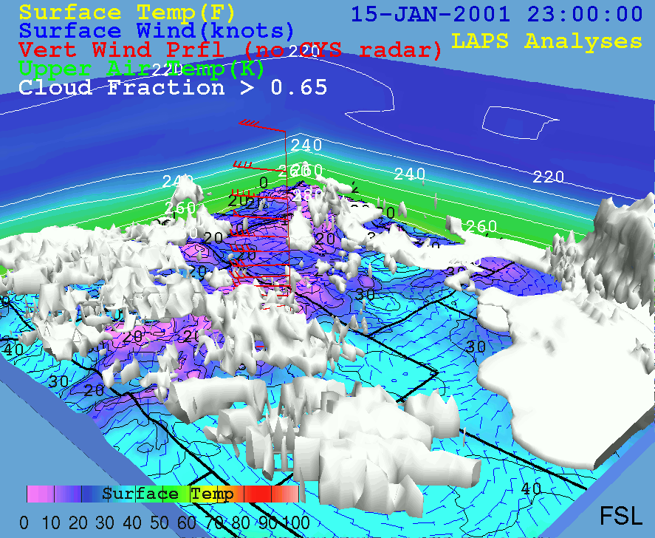
LAPS / STMAS PROGRAM REVIEW
Yuanfu Xie, Steve Albers¹, Hongli Jiang¹, & Zoltan Toth
Global Systems Division
NOAA/OAR/ESRL
¹ CIRA at GSD
Acknowledgements:
FAB
GSD Program Review, 31 January 2012
Notes:
Updated Jan 27 2056 UTC

Slide 2
LAPS / STMAS TEAM
Data assimilation
  Steve Albers, Hongli Jiang, Yuanfu Xie
Satellite and other observations
  Dan Birkenheuer, Seth Gutman, Kirk Holub, Tomoko Koyama, Ruixia Liu (TOB)
Physical processes
  Paul Schultz
Ensemble forecasting
  Brian Etherton, Zoltan Toth
Evaluation and verification
  Ed Tollerud, Ed Szoke, Stanislav Stoytchev
Software engineering
  Linda Wharton, Paula McCaslin
Technical support
  Adrienne Rose, Min Richardson
Former colleagues
  Steve Koch, John McGinley, Huiling Yuan, Brad Beechler, Brent Shaw, Isidora Jankov, etc
Long list of collaborators, visitors, etc

Slide 3
AGENDA
Introduction Zoltan Toth 15 mins
Recent LAPS developments Steve Albers 15 mins
STMAS Yuanfu Xie 15 mins
Plans & Summary Zoltan Toth 5 mins
Questions All 10 mins

Slide 4
MOTIVATION – NEED FOR IMPROVED DA CAPABILITIES
Current operational DA systems can’t meet societal needs
  Particular gap in Warn-On-Forecasting and convective initiation
  NWS Roadmap specifies need for high quality local DA/NWP tools
    Local (WFO) control of configuration, QC, etc
GSD Strategic Plan:
  “Develop and improve local-to global weather, air quality, and intra-seasonal climate data assimilation and prediction models”
FAB’s role
  Focus on local scales, fine special / temporal resolution
    Develop new methods to meet service needs
      Improve operational LAPS system
    Test & transition new techniques to other scales
      As resolution of regional / global models increases with increasing cpu

Slide 5
FAB MISSION & VISION
MISSION
Develop, test, & transition to operations local scale data assimilation and forecasting systems
  For situational awareness and warn-on-forecasting
  In support of “Weather Ready Nation” initiative
VISION
In partnership with the research and operational communities, become a world class contributor to the development of cutting-edge technologies
  New techniques for data assimilation and ensemble forecasting
    First tested on local scale
    Transitioned to other scales as computational power increases

Slide 6
LOCAL ANALYSIS & PREDICTION SYSTEM (LAPS)
Data
Data Ingest
Intermediate
data files
Error
Covariance
Trans
Classic
analysis
GSI
Analysis Scheme
STMAS-3D
Trans
Downscaling
Model prep
WRF-ARW
MM5
WRF-NMM
Verification
Ensemble
Forecast
Notes:
Yellow arrow shows conventional data only;
Green arrow shows all data;
Red arrow shows INCOMPLETE.

Slide 7
ROLE OF LAPS IN NOAA & ENTERPRISE
Purpose – NWP system for
  Situational awareness - Nowcasting
    Verification
  Warn-On-Forecasting
    For severe weather, convective initiation, aviation, fire weather, hydrometeorology, etc
Unique / critical qualities
  Consistency with observations - Quality
  Fine scales to resolve severe weather related processes (1-3 km)
  Efficiency for reduced latency and v. frequent updates (5-15 mins)
  Ease of use
  Portability
Users – 150+ users
  NWS WFOs – AWIPS2
    Critical for local control of analysis (incl. QC) & WOF process
  Other US agencies, private sector, academia
  International applications – numerous countries / weather services

Slide 8
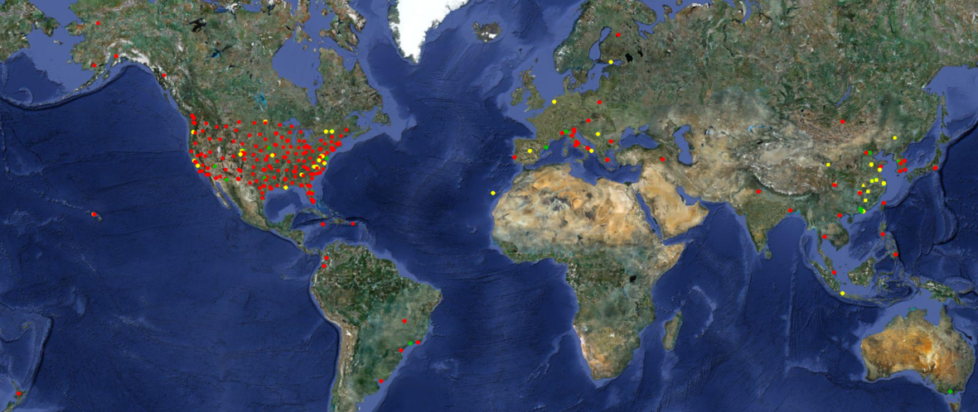
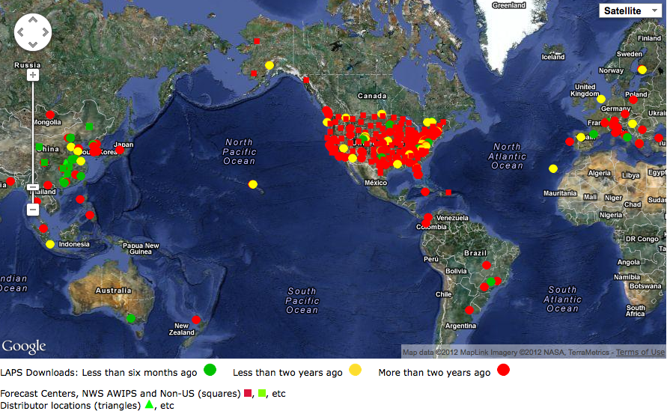
LAPS USER BASE
Private Sector
  Weather Decision Tech., Hydro Meteo,
  Precision Wind, Vaisala, Telvent
International agencies
  KMA, CMA, CWB, Finland (FMI), Italy, Spain,
  BoM (Australia), Canary Islands, HKO,
  Greece, Serbia, Nanjing Inst. of Met.
NOAA
  ~120 WFOs (via AWIPS), ARL, NESDIS
Other US Agencies
  DHS, DoD, FAA, CA DWR, GA Air Qual.
Academia
  Univ of HI, Athens, Arizona, CIRA, UND, McGill

Slide 9
HISTORY OF LAPS
Wind analysis & radar remapping (V, Z) 1989
Cloud analysis / Hotstart 1991
  Major innovation – 150+ citations
T-LAPS - Terminal-LAPS at 40 ITWS/FAA sites 1992
  Major advancement
  5-min update at 2km, 20+ years ahead of national guidance
O-LAPS – System adapted at OU / CAPS 1990s
K-LAPS - Technology transfer to KMA 1990s
Cloud analysis / hot start elements in other systems 1995-2005
  ADAS, RUC, etc
LAPS operationally used at NWS WFOs (AWIPS) ~1998
New 2DVar surface analysis – STMAS 2004
NOAA Tech Transfer Awards 2005, 2008
3D-Var STMAS 2009
STMAS transitioned to FAA operations 2012 - 2015

Slide 10
APPLICATION AREAS
Situational awareness / Nowcasting
  NWS WFOs
Warn-On-Forecasting (WOF)
  HWT
Aviation weather – Convective Initiation
  “STMAS is a key component of the 0-2 hr forecast” – MIT/LL
  Terminal-scale forecasting (ITWS)
Hydro-meteorological Forecasting
  Heavy precipitation – HMT
Decision support for weather dependent operations
  AFTAC, RSA
Fire Weather
  Downscaling wind and other variables
Renewable Energy
  Boundary layer winds & solar radiation
Dispersion modeling
  GTAS (DHS)
Tropical cyclone forecasting
  Taiwan Central Weather Bureau

Slide 11
PRIVATE SECTOR TECH TRANSFER
Doppler radar assimilation for wind energy prediction
  Precision Wind (Boulder, CO)
Avalanche Prediction
  NWP Consultants at Colorado Avalanche Center (CO)
Hydrological forecasting
  Hydro Meteo (Canada)
Rocket launch support
  ENSCO / ACTA (RSA project)
General forecast applications
  Telvent (Minneapolis, MN)
  Vaisala (Louisville, CO)
  Weather Decision Technology (Norman, OK)

Slide 12
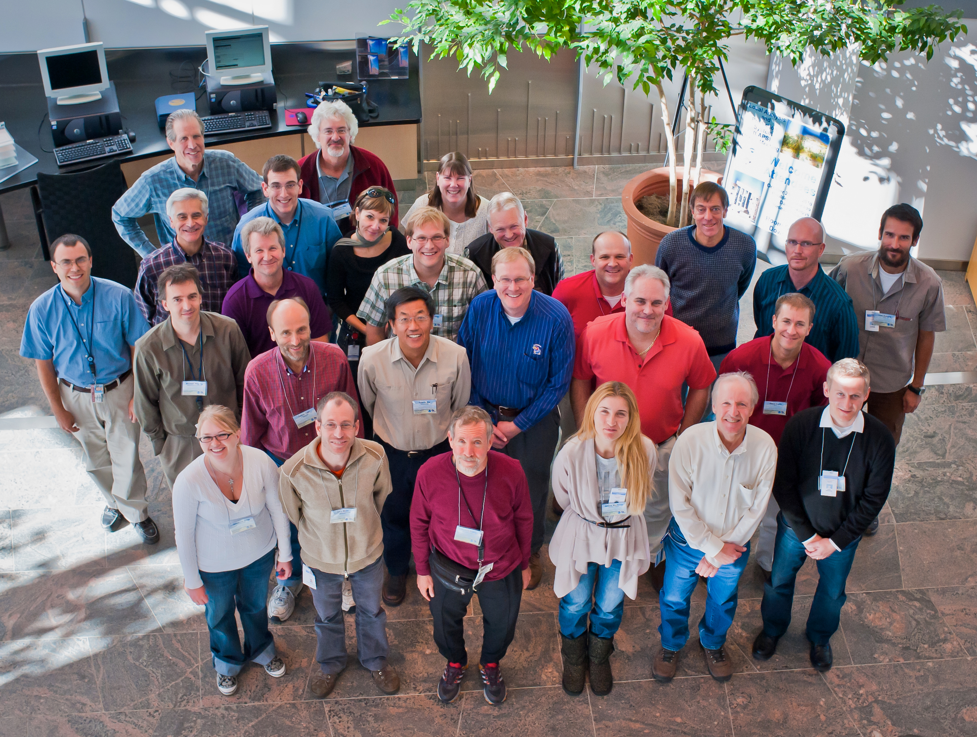

LAPS WORKSHOP SUMMARY
Oct. 25-27 2010, ESRL, Boulder, CO

Slide 13
NWS / WFO LAPS USER SURVEY - 2010
Ben Baranowski & Darrel Kingfield

Slide 14
NWS / WFO LAPS USER SURVEY - 2010
Ben Baranowski & Darrel Kingfield

Slide 15
LAPS USER WORKSHOP REQUESTS
Quality of analyses & forecasts
  Number of problems highlighted
    Noise in analysis, spin-up in forecast, better QC, etc
  Some solutions offered by partners
  Must set priorities
Portability
  AWIPS2 & other platforms
Efficiency
  Must run in timely manner
  Need for parallelization / optimization
Ease of use
  Must remain easy to set up
  User interface must remain simple

Slide 16
FY11 LAPS/STMAS Funding: $1.43+ M

Slide 17
Peer Reviewed Journal Publications since 2010
Conte, D., M. M. Miglietta, A. Moscatello, S. Albers, and V. Levizzani 2010: A GIS approach to ingest Meteosat Second Generation data into the Local Analysis and Prediction System. Environ. Model. Softw., 10, 1064-1074
Cimini D., E. Campos, R. Ware, S. Albers, G. Giuliani, J. Oreamuno, P. Joe, S. Koch, S. Cober, E. R. Westwater 2011: Thermodynamic Atmospheric Profiling during the 2010 Winter Olympics Using Ground-based Microwave Radiometry, IEEE Trans. Geosci. Rem. Sens., accepted, DOI 10.1109/TGRS.2011.2154337, 2011
Marquis, M., S. C. Albers and E. C. Weatherhead, 2011: For Better Integration, Improve the Forecast. Solar Today, 25, 52-53
Xie, Y. F., and A. E. MacDonald, 2011: Selection of Momentum Variables for a Three-Dimensional Variational Analysis. Pure and Applied Geophysics, DOI 10.1007/s00024-011-0374-3
Xie, Y. F., S. Koch, J. McGinley, S. Albers, P. Beringer, M. Wolfson, and M. Chan, 2011: A Space-Time Multiscale Analysis System: A Sequential Variational Analysis Approach. Monthly Weather Review, 139, 1224-1240
Toth, Z., S. C. Albers, and Y. Xie, 2012: Analysis of Fine Scale Weather Phenomena. BAMS, in print

Slide 18
PART II: Recent LAPS Developments
Steve Albers

Slide 19
LAPS Analysis Steps
Multi-scale scale successive correction with variational components
Numerical
Forecast model
Large Scale Model
First Guess
Cycling Option
Wind analysis
Temp/Ht analysis
Humidity analysis
Cloud analysis
balance

Slide 20
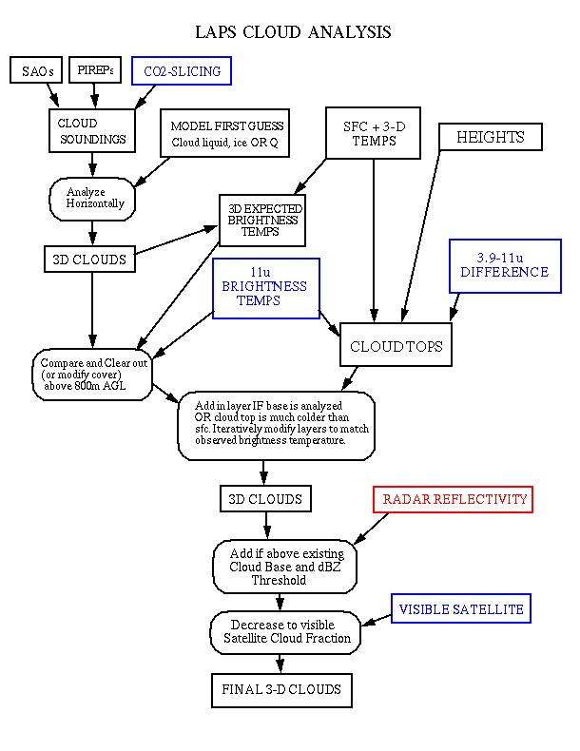
Cloud Analysis Flow Chart
Cloud Fraction 3-D Isosurface

Slide 21
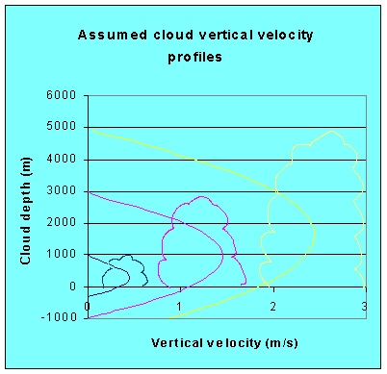

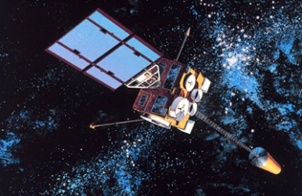
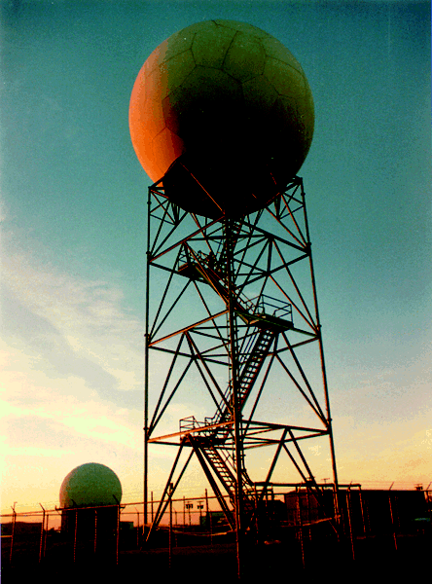
LAPS HOT-START INITIALIZATION
Three-Dimensional Cloud Analysis
FH
FL
METAR
+ FIRST GUESS

Slide 22
Hot-start Components and Recent Improvements
Vertical velocity/horizontal divergence
  Vertical motion now relates to both cloud depth and radar reflectivity
Temperature/height adjustment
  Balance package improvements
Hydrometeor assimilation / post-processing
  Improved for clouds and precipitation
Consistent water vapor fields

Slide 23
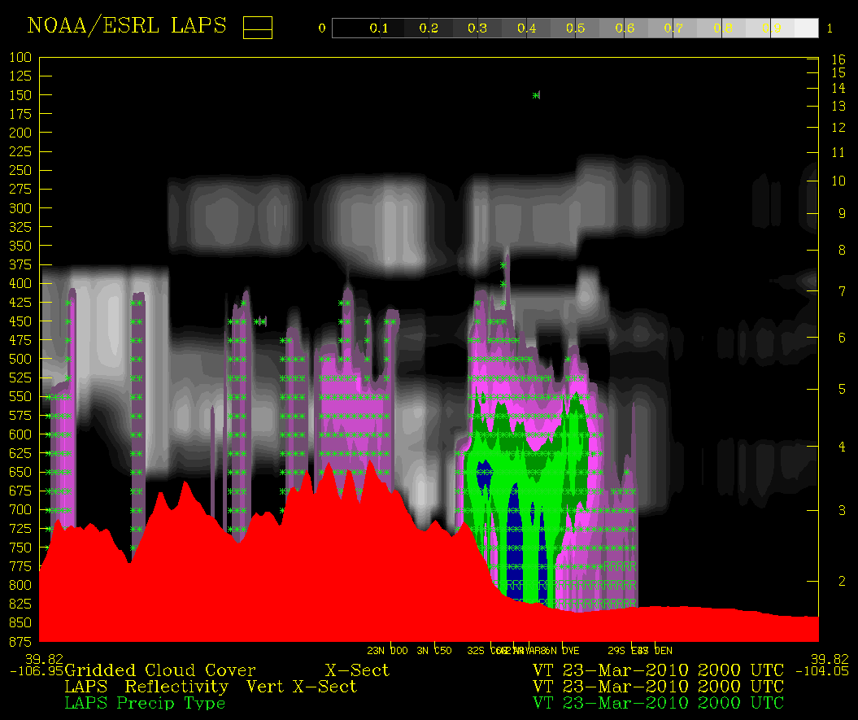
Cloud / Reflectivity / Precip Type (1km 15-min analysis)
Obstructions to visibility along approach paths
DIA

Slide 24
Evaluation and Verification
Variables
  Radar Reflectivity (3-D Thresholded Volumes)
  Solar Radiation, Wind, Temperature,
  Integrated Water Vapor
Comparing against
  Observations, Analyses, Other models (e.g. HRRR)
Results
  Higher (better) ETS and lower BIAS for reflectivity forecasts
  Promising results for surface winds and solar radiation
Explanation/interpretation
  LAPS / STMAS initialization has added forecast benefit

Slide 25
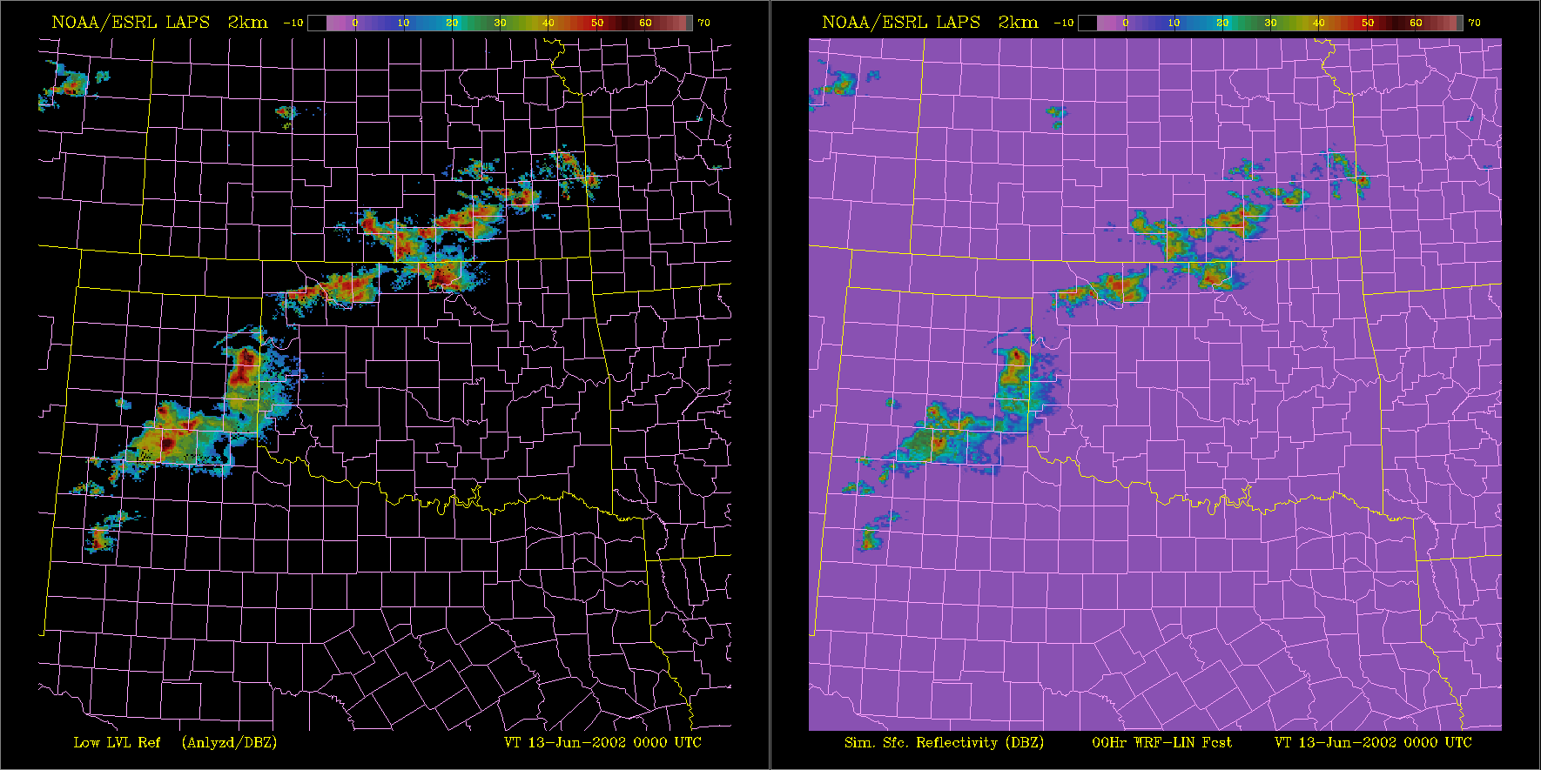
Reflectivity Forecast Verification
6-hr Diabatically (LAPS) initialized
WRF-ARW forecast Lin μPhys
Analysis
13 June 2002
Developing Squall Line at IHOP case Initial Time

Slide 26
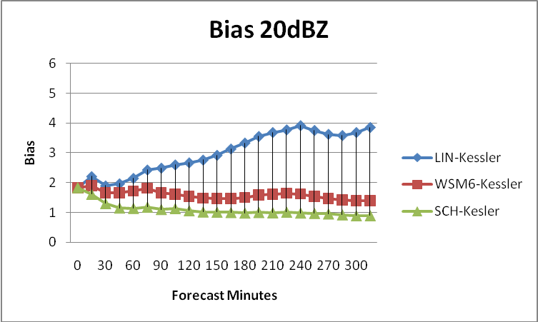
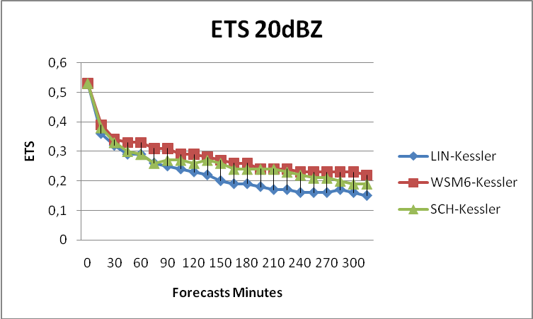
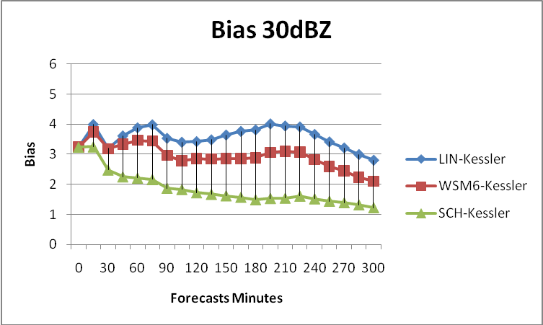
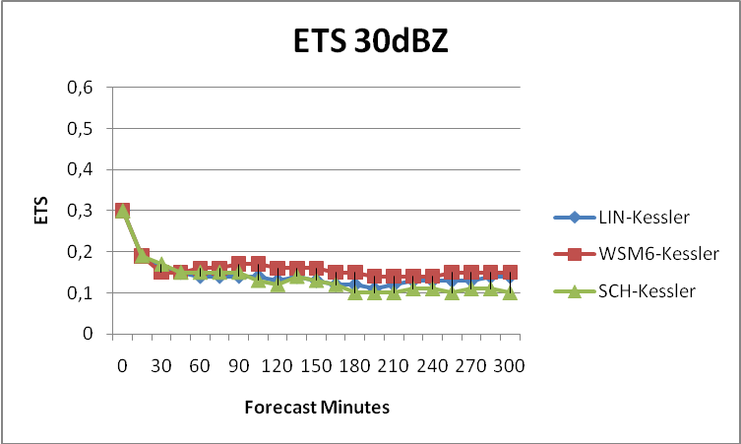
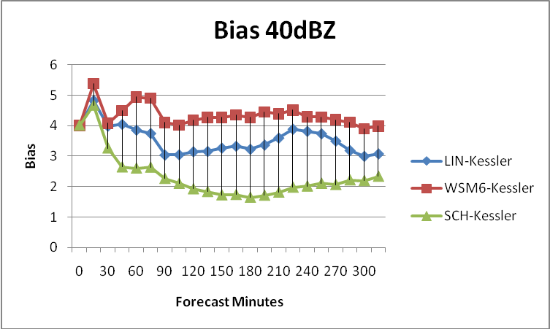
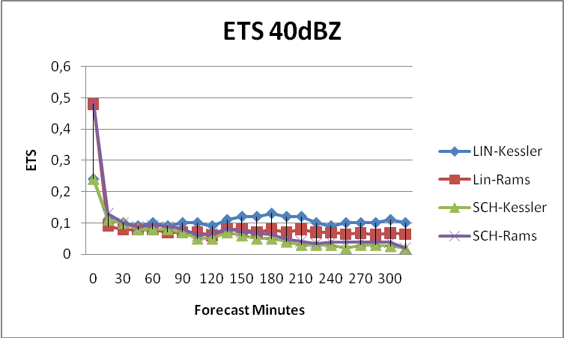
Bias & ETS June 13 2002 (IHOP)
Large Sensitivity in Bias to Variations
in Microphysics
ETS values are highest at early times
due to hot-start

Slide 27
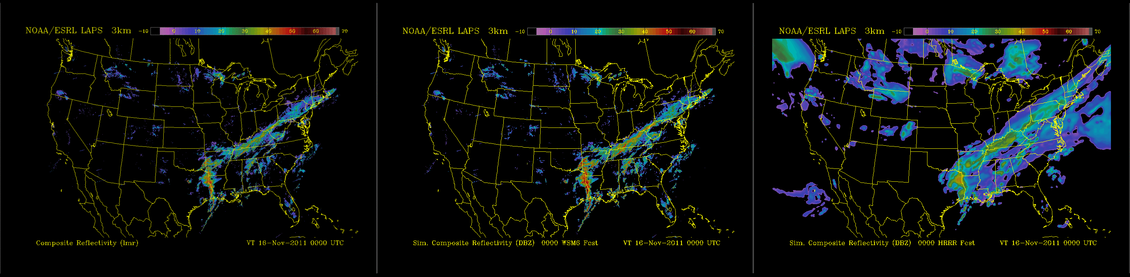
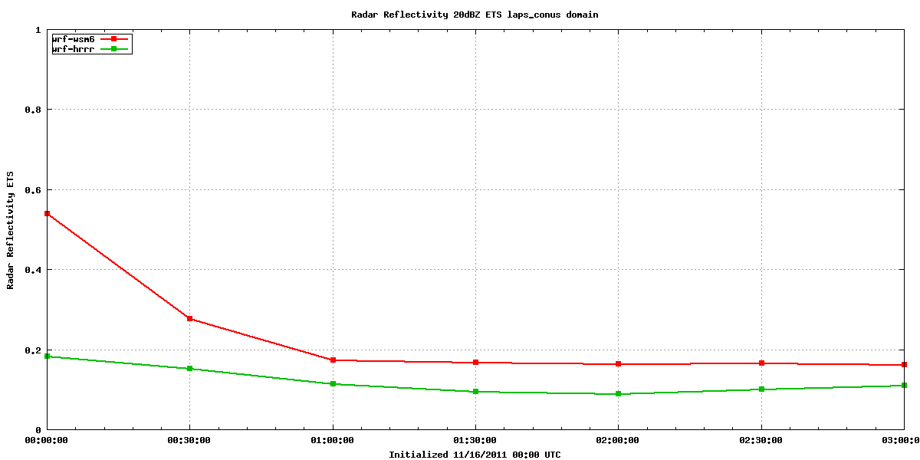
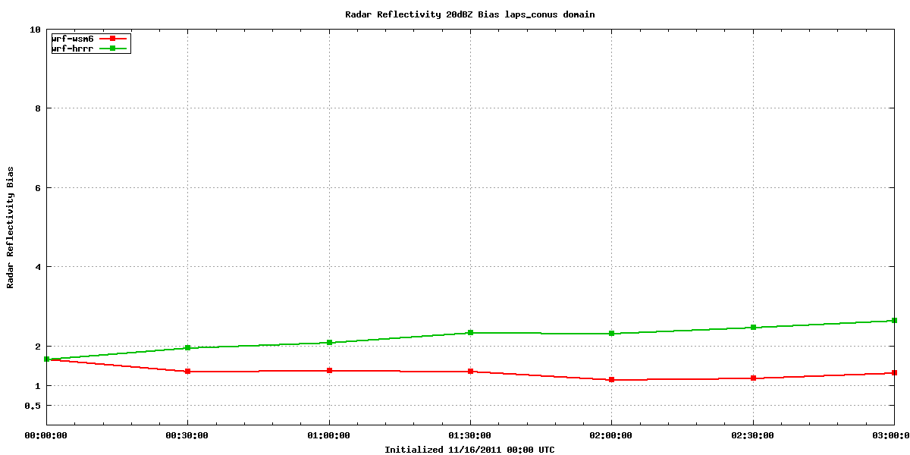
0-3h Radar Forecast Nov 16 2011 00Z
Analysis / 30 mins
LAPS Fcst
HRRR Fcst
Higher ETS & improved bias (best at short leads)
ETS – 20dBZ
Bias – 20dBZ
LAPS
HRRR
HRRR
LAPS

Slide 28
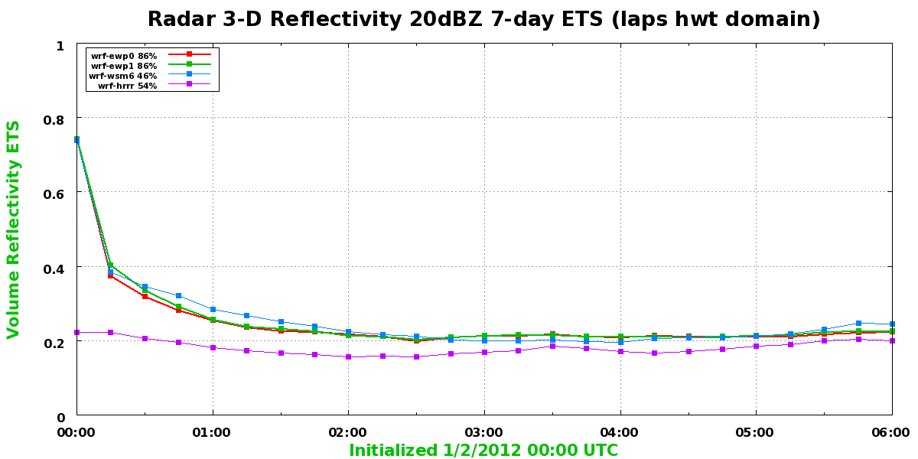
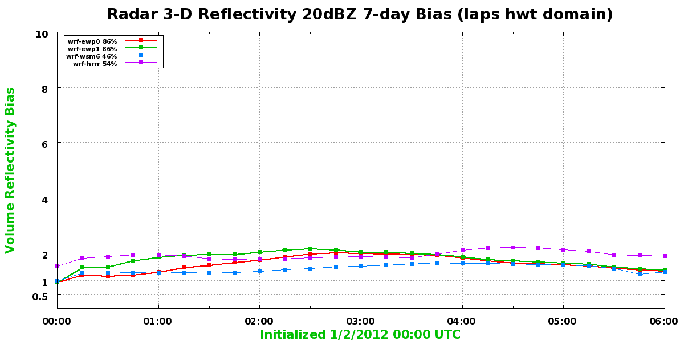
HWT Domain 7-day period
20-dBZ volume reflectivity scores
ETS 0-6h
Bias 0-6h
LAPS / STMAS
HRRR
LAPS / STMAS initialization provides improved ETS
Less high bias with Thompson microphysics (red vs green)

Slide 29
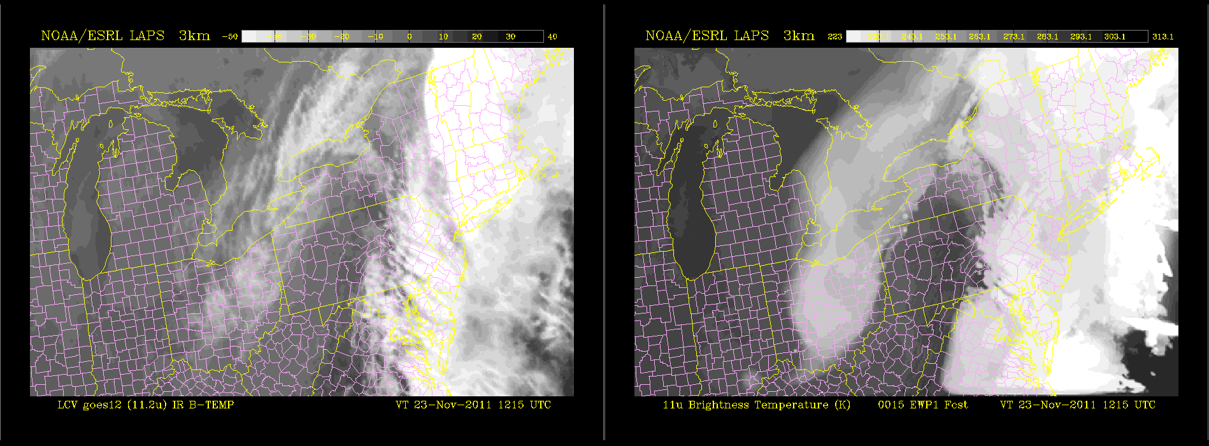
Simulated IR Satellite Forecast
Observed / 15 mins
Forecast
Simulated VIS also available – derived from cloud amount
Forecasters are naturally familiar with satellite images
Plan to add objective cloud forecast verification

Slide 30
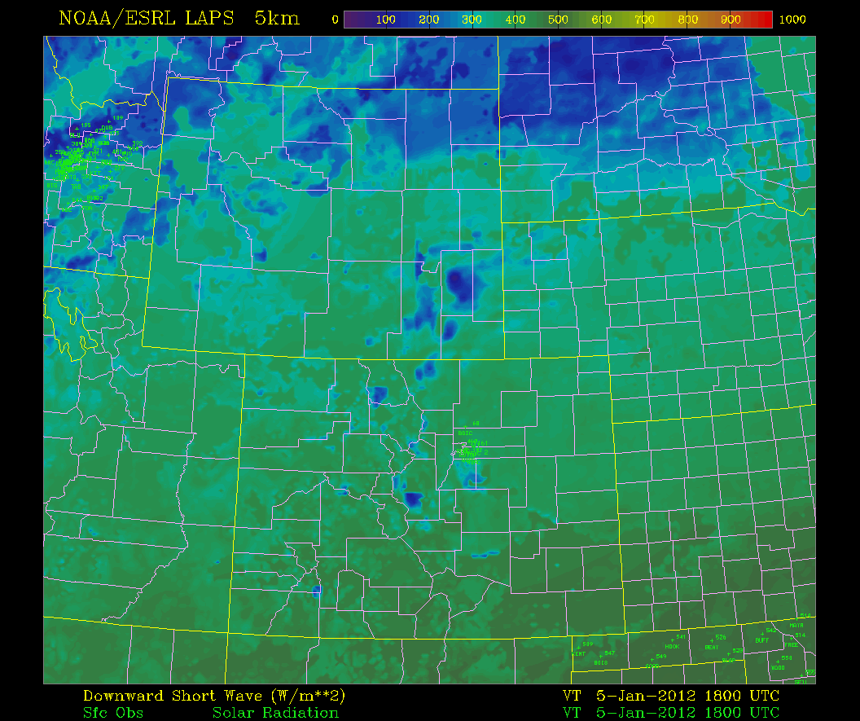
“Global” Solar Radiation Analysis Verification Stats
(Colorado Region)
SWI W/m² with time (16-22 UTC) 31 December 2010
Forecast
mean
Observed mean
RMS error
Compared with independent MADIS OBS
Forecasts also verified on our real-time web site

Slide 31
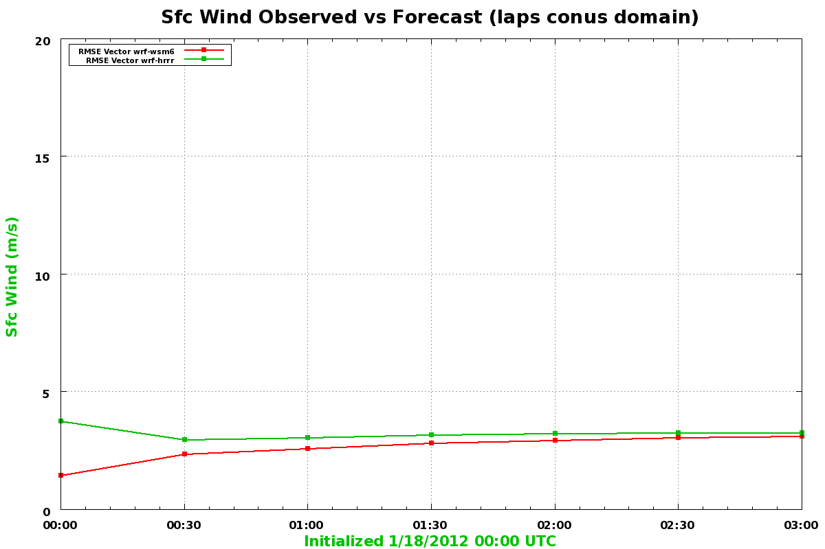
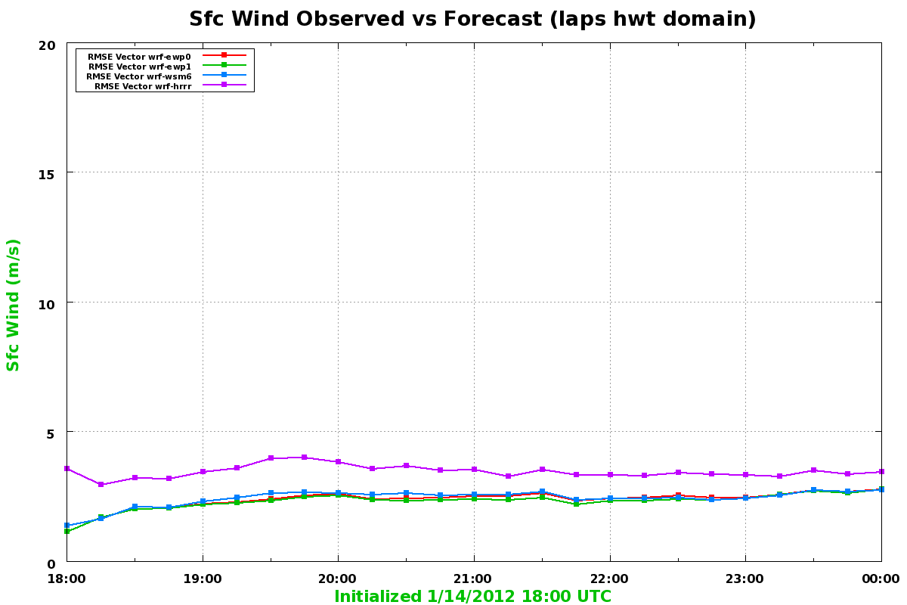
WIND VECTOR RMS ERROR AGAINST OBSERVATIONS
Two LAPS & STMAS
with different microphysics
vs. HRRR
LAPS vs. HRRR
CONUS domain
HWT domain
HRRR
HRRR
LAPS
LAPS / STMAS
More wind verification against obs in statistics
and at 80m height will come soon

Slide 32
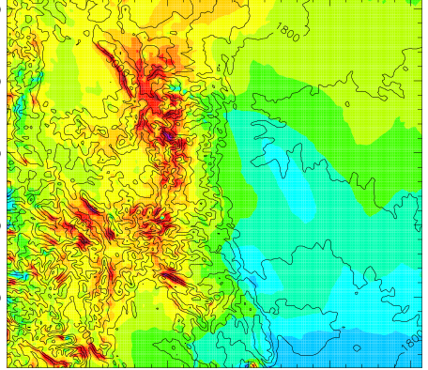
Example of Downscaling: Four Mile Canyon Fire
Surface U wind (colors)
Initial input at 8km res
36
33
30
27
24
21
18
15
12
9
6
3
0
-3
-6
NORTH-SOUTH
Contour lines: topography
0
100
200
EAST – WEST (km)
Downscaled output at 1km resolution
Finer details in wind in response to high resolution terrain
Jiang et al.
0
100
200
EAST – WEST (km)

Slide 33
Status of STMAS downscaling
  Multiscale downscaling produces fine scale wind structure in steep terrain areas;
  It has the great potential for generating high-resolution wind fields for applications in Aviation, Fire Weather, and Renewable energy;
Issues
  We are working on evaluation of the wind fields; planning to test with additional cases;
      We are evaluating the cost and efficiency of downscaling vs. finer resolution WRF;
      Addresses difficulty with running WRF at 1 km resolution over complex terrain;
Transfer a tested downscaling module to NCEP.
Jiang et al.

Slide 34
PART III: STMAS
Yuanfu Xie and Hongli Jiang

Slide 35
MODERN DATA ASSIMILATION
Variational approach
Main advantage - combines all information in one step
  All observations, background forecast, balance constraints
Limitation
  Presumes covariances used to spread observational info are reliable
    Known to be false = >
  Observations impact large scales only – fine scales defined by first guess
Sequential / ensemble-based methods
Potential advantage
  Flow dependent covariances
Main limitations
  Size of ensemble
    Known to be far too small
      Coarse scale covariance - only large scale information used from observations
  Balance constraints not considered = >
    Noise introduced
Consensus
Variational approach preferred – 4DVar outperforms ENKF at ECMWF
  Ensemble-based covariances considered (Hybrid approach)
  Limitation remains
    Observations impact only large scales

Slide 36
GRIDPOINT STATISTICAL INTERPOLATION (GSI)
History
  Spectral Statistical Interpolation (SSI) developed in early 1990s
    3D-Var designed for coarse scales
    Transformed into GSI in 2000s
    Performance lags behind centers w 4DVar (ECMWF, UKMet)
Limitation – Convective processes not initialized
  Observations do not impact fine scales due to choice of covariance
  Moist processes ignored in simplified balance constraints
Rapid Refresh (RR) approach
  Modify GSI analysis to reflect convective heating
    Reduce noise via digital filtering
  Approach follows traditional LAPS
    Prepare analysis, then run hotstart & balance package
Current work – Hybrid DA
  Uses GSI with covariance modified based on info from ENKF ensemble

Slide 37
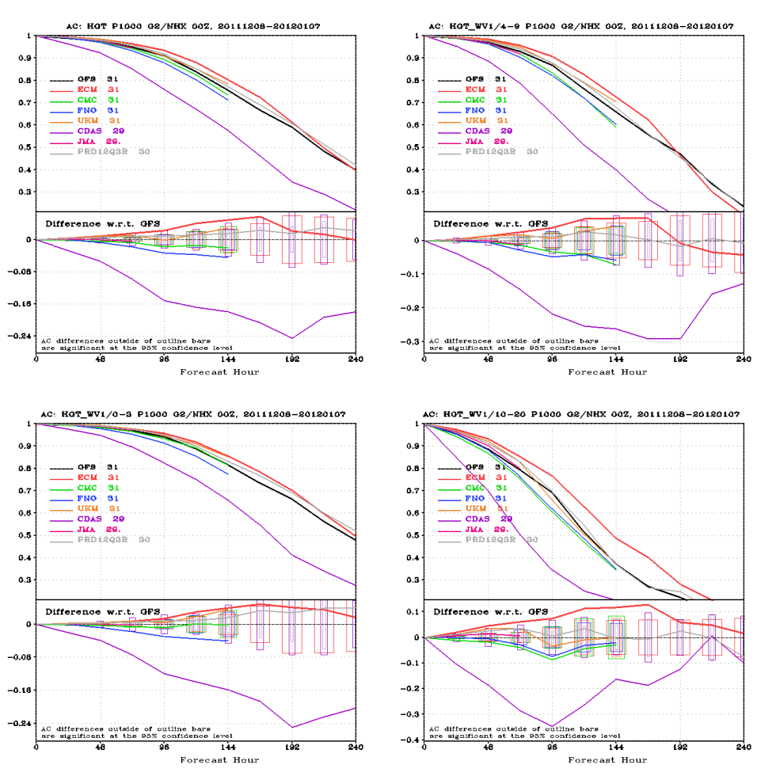
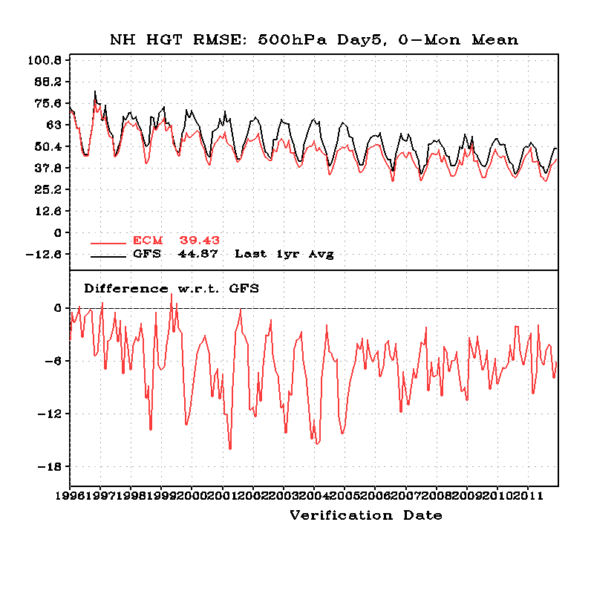
NH 500 Height skill comparison

Slide 38
LAPS
State-of-the-art at time of initial development (~1990)
Main advantages
Multi-scale analysis via multiple passes over observations
  Information from observations extracted on all scales
Initialization of moist processes – “Hotstart”
Disadvantages
Univariate approach
  Cross variable covariances not considered
Not fully variational
  Some steps done sequentially
Vertical coordinate
  Isobaric analysis results in high frequency noise in hotstart and balances
Lack of proper balances
  Application of balance constraint on analysis may remove information
  More constraints are needed for remotely sensed data
Time to consider modernization to a full variational analysis =>
Space-Time Multiscale Analysis System (STMAS)

Slide 39
STMAS – COMBINING BENEFITS OF LAPS & MODERN DA
A multigrid technique
Build on strengths
  Multigrid, following multiscale approach in LAPS
    Extract information from observations on multiple scales
  Hot-start from LAPS
    Initialize fine scale moist processes
  Variational solver (3-4DVAR approach)
    Reduced noise
  Ensemble-based covariance
    Flow dependent information on some scales
Reduce limitations
  Balance (both LAPS, 3DVAR and ensemble filters)
  Covariance (LAPS, 3DVAR and 4DVAR)
  Efficiency (3DVAR and 4DVAR)
  All data sources in a unified balance analysis (LAPS)

Slide 40
Multigrid Approach
Long waves
Short waves
Solve a sequence of 3-4DVARs with proper balances
Variational analysis simulating LAPS objective analysis
A Space–Time Multiscale Analysis System:
A Sequential Variational Analysis Approach
Xie, et al., 2011 Monthly Weather Review.
Standard 3-4DVAR
With a band covariance
Possible ensemble
Filter application
Hayden, and Purser, 1995: J. Appl. Meteor. also shows
a 3DVAR is equivalent to one LAPS pass.

Slide 41
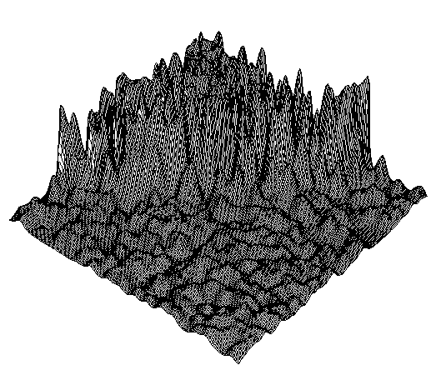
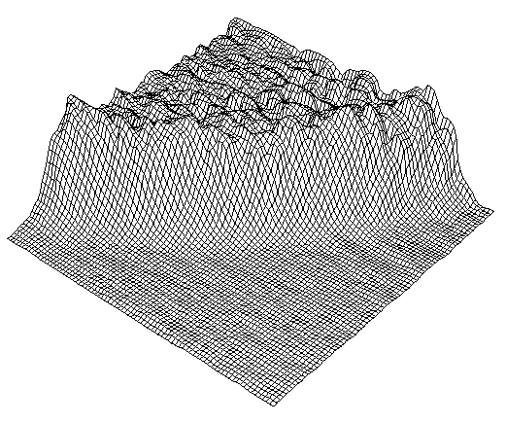
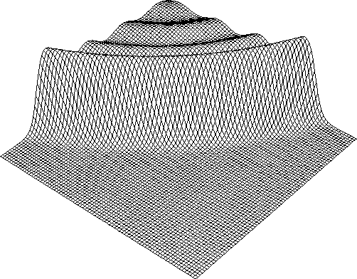
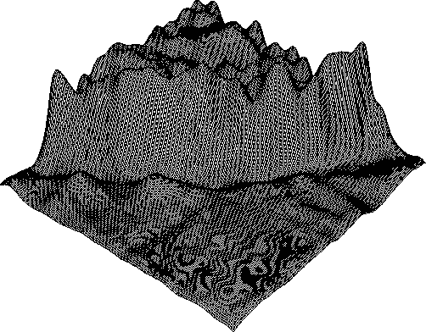
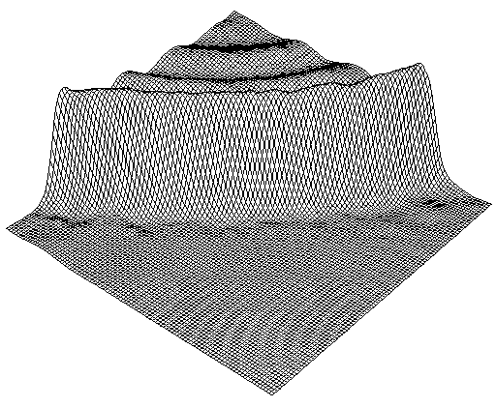
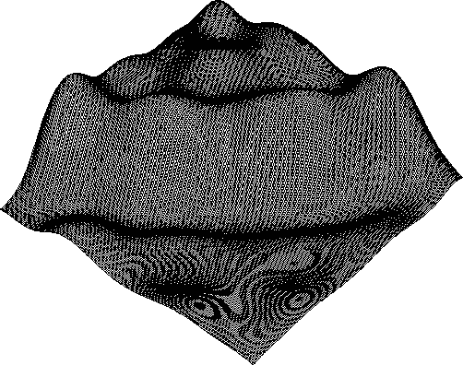
LAPS, STMAS vs. STANDARD 3DVAR
LAPS
3DVAR with
small-scale
covariance
Truth
Medium-
scale
STMAS
3DVAR with
large-scale
covariance

Slide 42
From LAPS toward STMAS
STMAS
Basic 3DVAR,
cloud analysis
balance and constraints
In one variational analysis
Ultimately
Numerical
Forecast model
Temporarily
Wind
analysis
Temp/Ht analysis
Humidity analysis
Cloud analysis
balance
LAPS

Slide 43
STMAS analysis and forecast Applications
STMAS surface analysis has been used by MIT LL for storm boundary detection and for modification of RUC CAPE forecasts;
STMAS downscaling for fire weather applications;
STMAS full 4-dimensional analysis has been used in experiments of hurricane/typhoon, severe storm, and even tornado forecasts and achieves improved results comparing to LAPS and other operational systems.

Slide 44
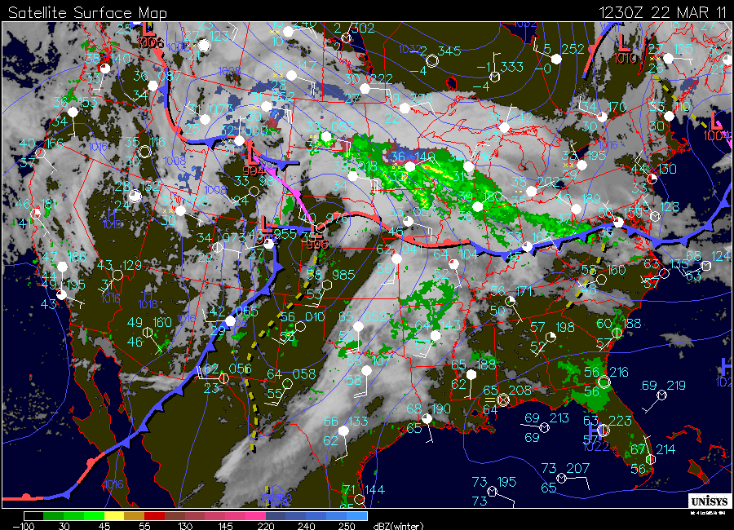
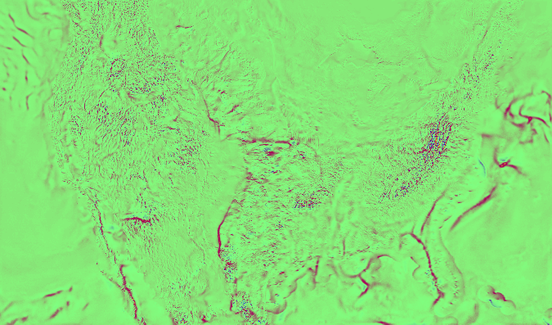
STMAS front analysis for the case of Mar. 23, 2011 1230Z

Slide 45
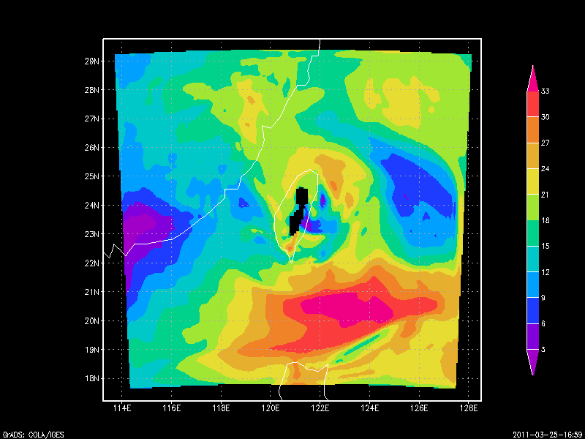
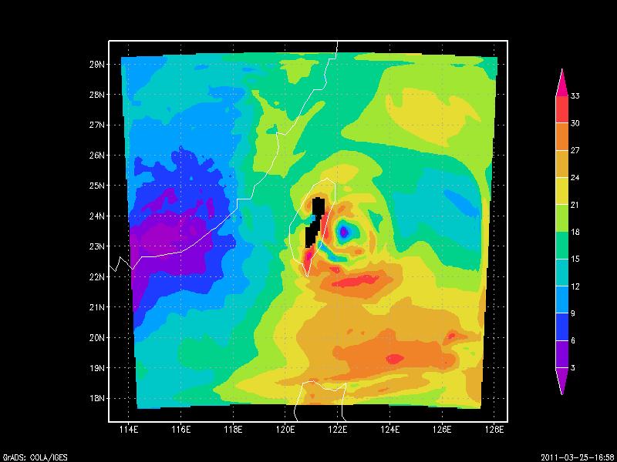
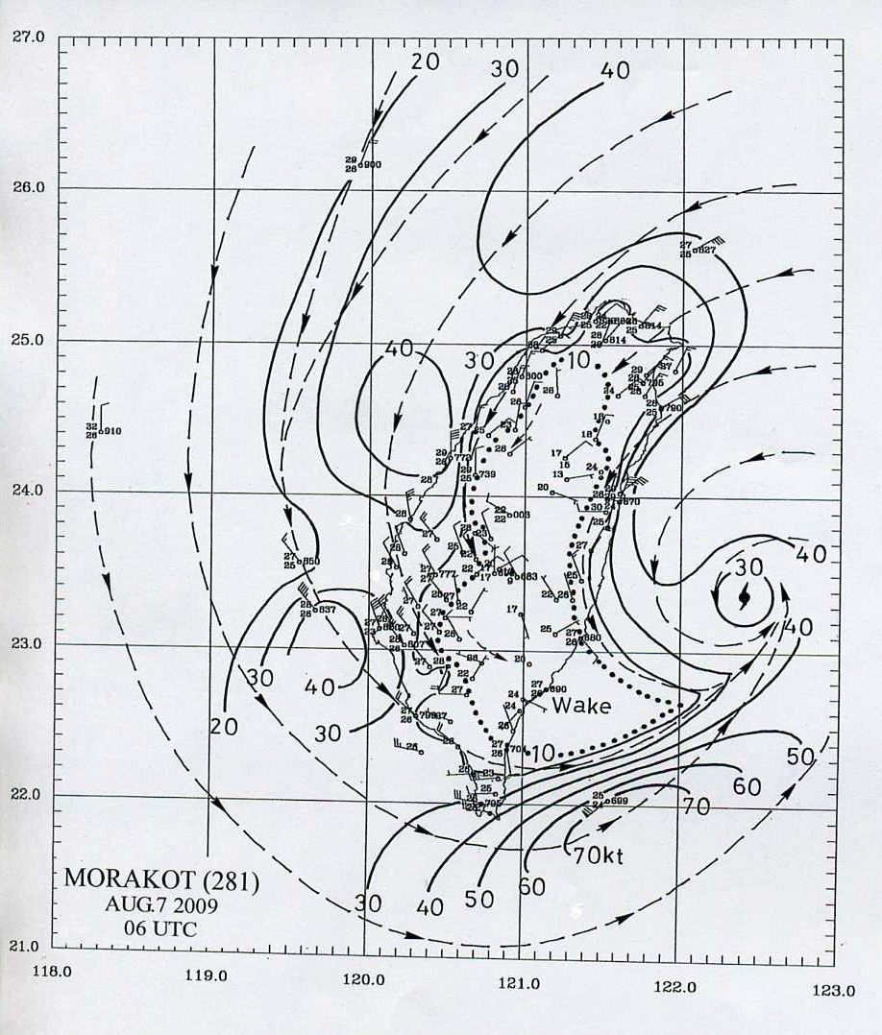
Wind speed forecasts at 6h
LAPS
STMAS

Slide 46
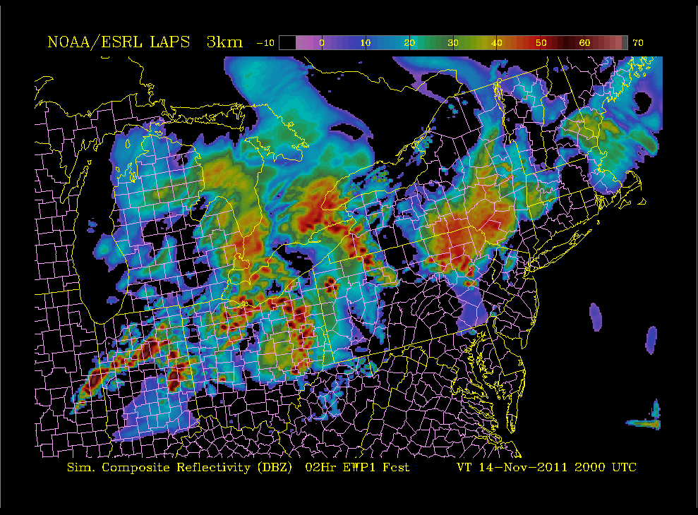
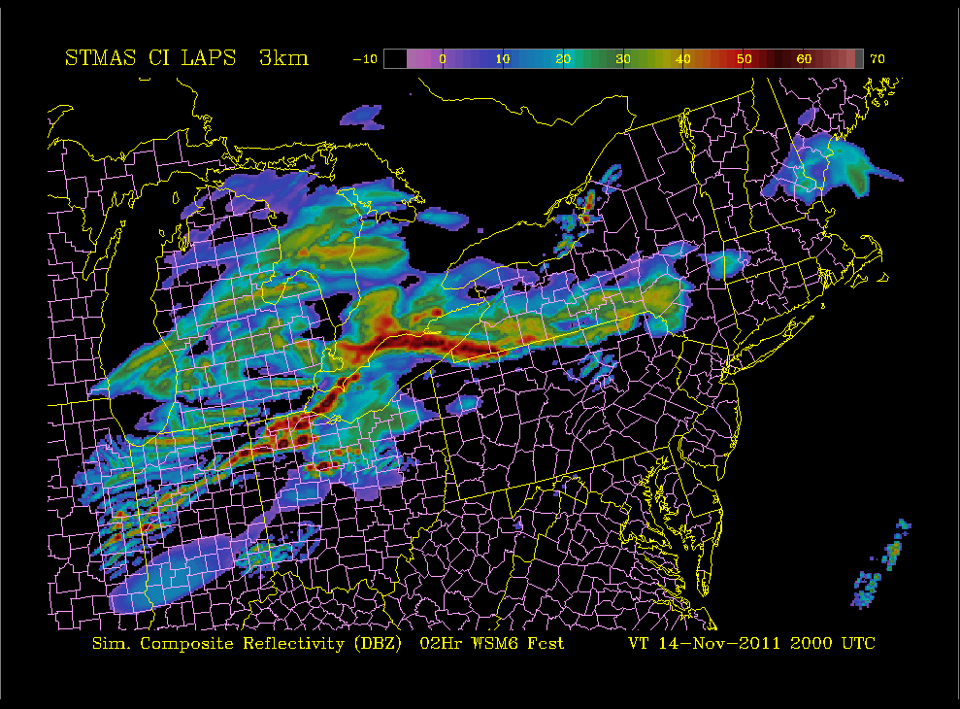
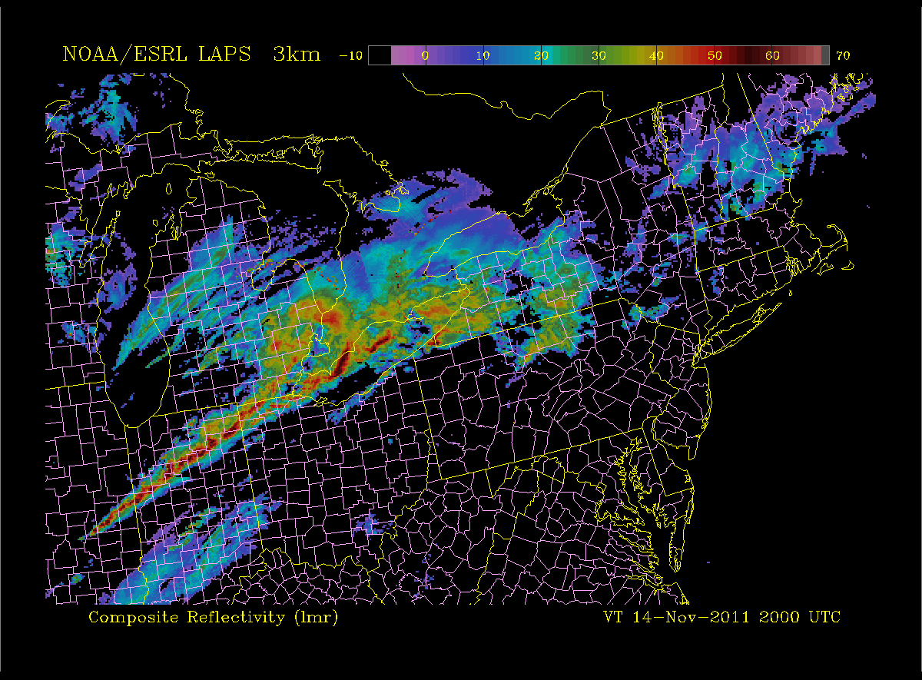
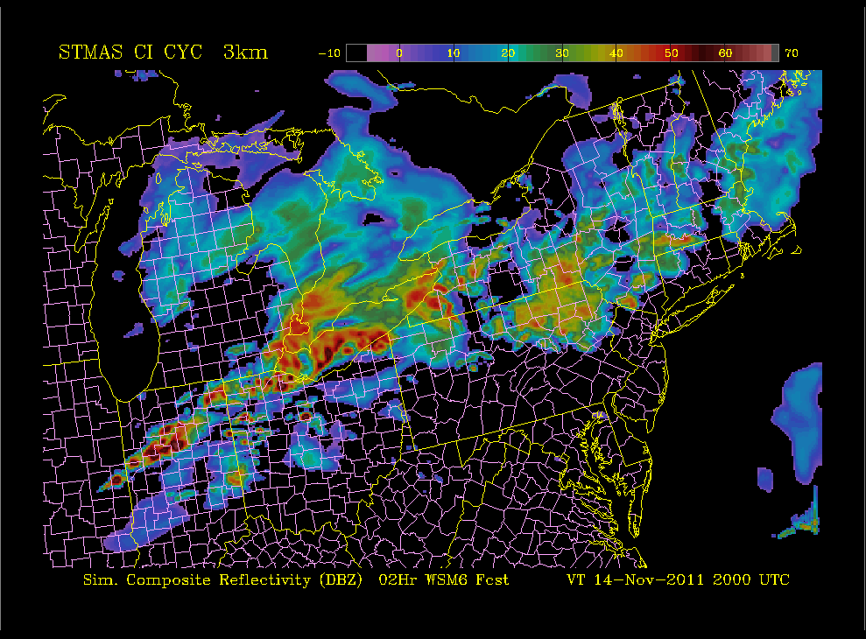
2-hour forecast valid 2000 UTC of Composite Reflectivity
LAPS Forecast
STMAS “Cold Start” Forecast
LAPS Analysis
STMAS Forecast
By 2-h into the forecast all 3 runs have echoes along the cold front.

Slide 47
INNOVATIONS – (TRANSITION TO GSI)
Downscaling first guess (easy)
Enhanced STMAS surface analysis (easy)
Enhanced use of observations (easy)
Improved background error covariance (easy)
Variational hot-start (moderate)
More sophisticated optimization technique (moderate)
Improved physical balance constraints (moderate)
Multigrid technique (difficult)
New control variables (difficult)
Non-linear variational approach inside GSI inner loop (difficult)
Preconditioning of the minimization (difficult)

Slide 48
GSI COMPONENTS TO BE USED
Data ingest modules
Satellite bias correction
Some forward operators handling remotely sensed data

Slide 49
STMAS TIMELINE
2DVar STMAS surface analysis 2004
3D-Var STMAS 2009
Terrain-following coordinate system 2012
Transition STMAS to FAA operations 2012 – 2015
Transfer STMAS downscaling tool to NCEP 2012
Variational hot-start including physical constraints 2013
Replace traditional DA in LAPS by STMAS in AWIPS2 2014
Test use of ensemble-based covariances 2014
Test & transition new elements from STMAS into GSI 2014
  With DTC contributions
Test multi-scale STMAS on global scale 2015
  Icosahedral or cylindrical equidistant grid (NIM, MPAS, FIM)
Contribute to next generation variational DA 2015-
  Multi-scale hybrid 4D-Var with ensemble-based covariances

Slide 50
PART lV: Plans & Summary
Zoltan Toth

Slide 51
ORGANIZATION OF WORK
Internal
  Strengthen collaboration between FAB & AMB DA & modeling efforts
    Build on strengths of each group
    Cross pollination, use best methods in various suites (LAPS/STMAS, RR, HRRR)
Broader research community
  Adapt leading technologies for testing in NOAA
  Leverage work with DTC
    Coordination of testing and publicizing of software releases
User community
  Hold periodic LAPS Workshops
    Partner with OCWWS
  Establish formal pre-implementation testing & evaluation
  Contribute to training / outreach
International partners
  Continue hosting visitors
  Establish MOUs with major partners

Slide 52
EMERGING OPPORTUNITIES
Stronger engagement with HMT
  High impact weather
    Urban-scale forecasting of heavy precipitation, etc
FAA CoSPA and other terminal scale applications
  Nowscasting and very short-range forecasting
Renewable Energy
  Off-shore wind and solar energy
    Focus on 0-6 hrs
Weather Ready Nation initiative
  Situational awareness & Warn-On-Forecasting
Improved utility
  Timeliness – STMAS parallelization
  User friendliness – New user interface
  Portability – GPU utilization

Slide 53
ACCOMPLISHMENTS
Significant scientific innovations
  Hot-start – convection-scale initialization
  Multiscale analysis
Critical service to community - DA systems
  LAPS
  STMAS
Major transitions to operations
  NOAA, US & international agencies, academia, and private sector
Outlook
  Complete STMAS development
  Local to global applications
    Contribute to next generation NOAA DA systems

Slide 54
SUMMARY
LAPS serves critical NOAA, national, & international needs
  Situational awareness, Warn-On-Forecasting
NWS Roadmap specifies need for high quality local DA/NWP tools
  Local (WFO) control of configuration, resolution, QC, etc
Requirements formulated by LAPS user community (workshop)
  Major improvements in pipeline – STMAS
Role of LAPS in Weather Ready Nation initiative
  Incident response, etc
Contribute to next generation NOAA DA systems
  Transition cutting-edge techniques tested locally to regional/global systems
Strengthen engagement with user community
  Next LAPS Workshop co-sponsored by NWS (Oct 2012)
  Plan for formal evaluation of LAPS by WFOs for future implementations

Slide 55
Cloud / Reflectivity / Precip Type (1km 15-min analysis)
Obstructions to visibility along approach paths
DIA

Slide 56
The End
Questions?
More info at http://laps.noaa.gov

Slide 57
Reserve Slides
PPT Updated Jan 31 2012 0127 UTC

Slide 58
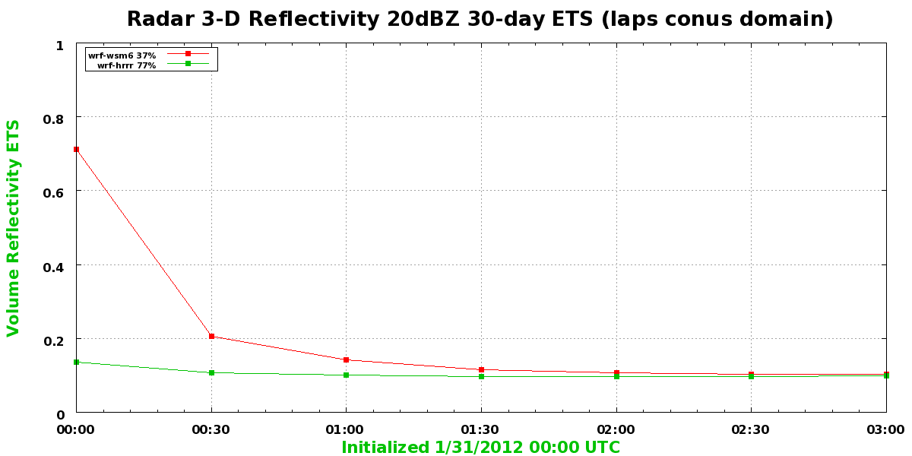

Slide 59
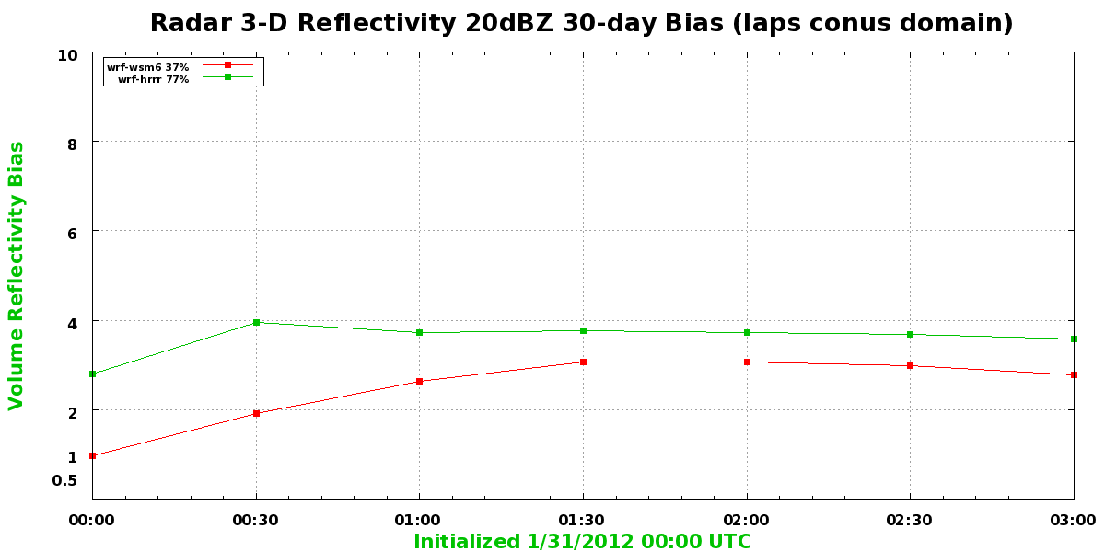

Slide 60
Societal Needs of LAPS/STMAS
Quality, portability,
efficiency, ease of use
LAPS workshop 2010: recommendations
And demands for LAPS/STMAS from 150 users or agencies worldwide
3-4DVAR, QC, background, covariance, initialization, uncertainty
Static and dynamic data, new data, rapid update cycle
LAPS-WRF portal, efficiency, documentations, protocol to external developers

Slide 61
DA Plans
Transferring STMAS downscaling tool to NCEP (2012);
Changing LAPS hot-start to STMAS variational hot-start (2013);
Replacing LAPS analysis by STMAS for AWIPS II (2013);
Transiting from LAPS objective analysis to a fully variational analysis of STMAS with ensemble error covariance (2014)
Testing new ideas on LAPS/STMAS platform for future improvement of NOAA operational system (e.g., GSI).
Developing STMAS for global data assimilation on an Icosahedral grid (FIM or NIM);
Developing a full 4-DVAR STMAS analysis for NOAA future data assimilation system;

Slide 62
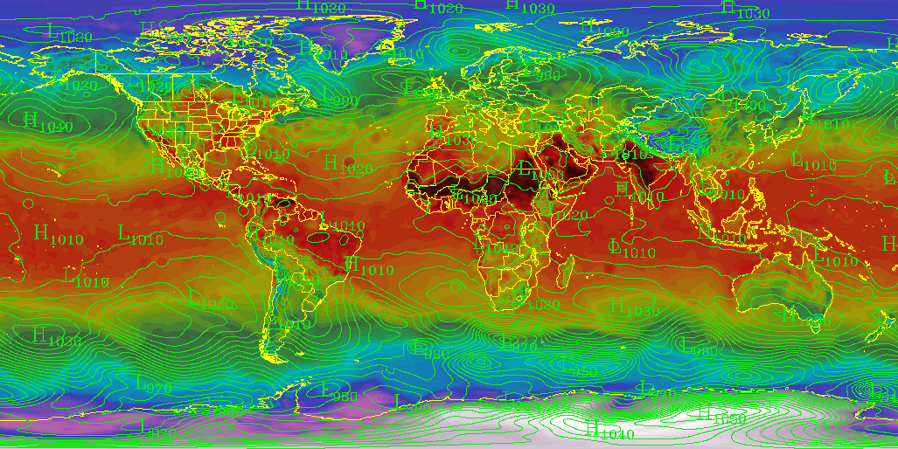
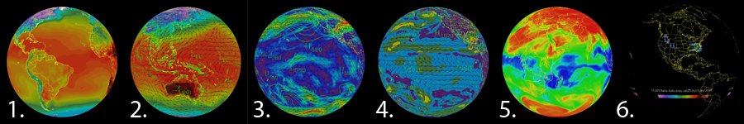
Global Analysis and Prediction System
G-LAPS
Sfc Temperature, MSLP

Slide 63
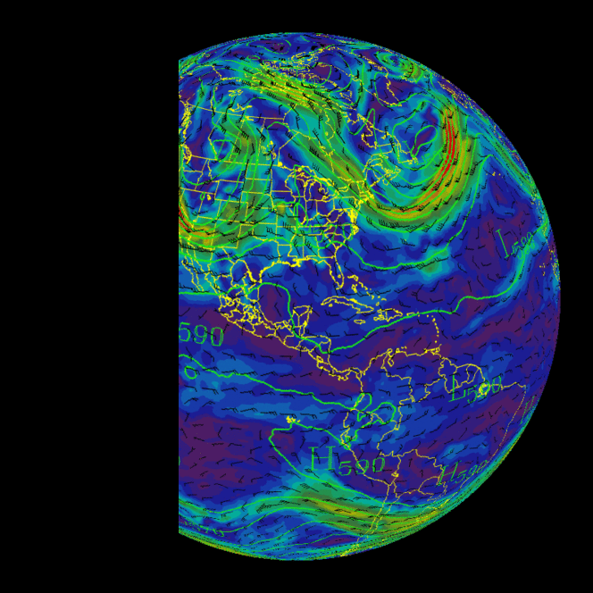
Current GLAPS Status
GLAPS is an implementation of the
Local Analyses and Prediction System (LAPS) currently running over a global domain.
As a GLAPS first guess the global FIM (with options for GFS and/or ECMWF) is being used.
An operational version of GLAPS is running with a grid spacing of 21 km on a lat-lon grid projection.
The analysis is being produced in real time on an hourly basis.
The output is distributed via web interface and with Science On a Sphere.
500 mb HT, |v|

Slide 64
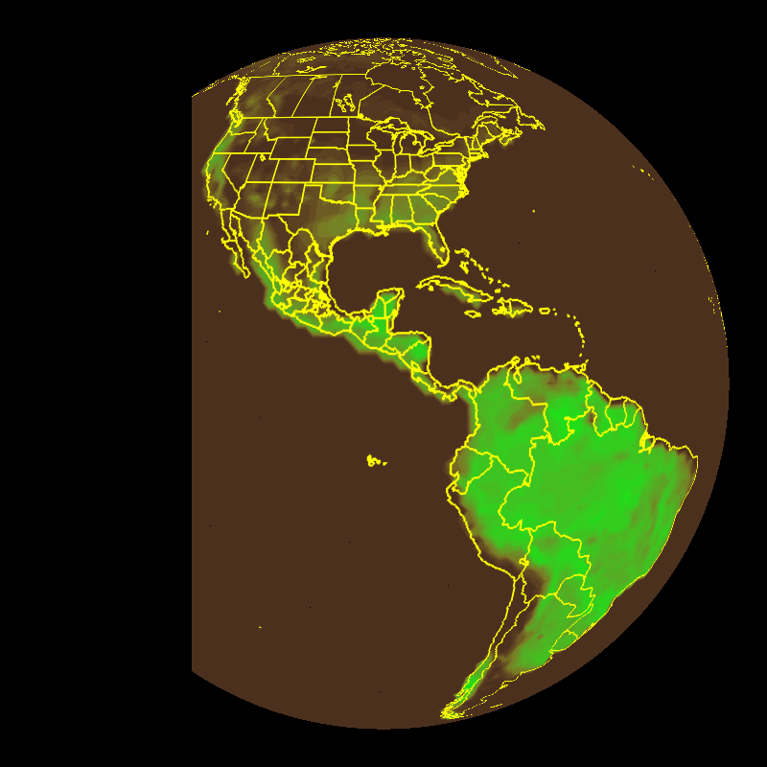
Future global efforts
Improvement in runtime efficiency and corresponding decrease in grid spacing.
Interface with global observational datasets as they become available at ESRL/GSD (e.g. satellite).
Continue development on cylindrical equidistant (lat-lon) or icosahedral projection.
Initialization (hot-start) of FIM, transition to holistic models.
Green Fraction Climatology

Slide 65
Future DA development
Serving societal needs based on the feedbacks:
  Improving analysis quality, portability, efficiency, and easy to use
  Transiting from LAPS to STMAS multi-scale 3-4DVAR addressing covariance, balance and uncertainty
  Assimilating new data, i.e., new satellite and radar data
  Building LAPS portal, documentations and protocols for collaborations
Improving NOAA DA operational systems:
  Testing and developing new technique, such as control variables and multigrid, on LAPS/STMAS platform;
  Building more portable modules for improving operational systems.

Slide 66
LAPS Worldwide Users
LAPS USER BASE
NOAA
  ~120 WFOs
Other US Agencies
  DHS, complete list
International agencies
  KMA, CMA, CWB, Finland, Italy, Spain, etc?

Slide 67
Skill comparison with ECMWF

Slide 68
STMAS APPROACH
STMAS uses a multigrid technique
combining the advantages of LAPS analysis and other modern data assimilation techniques
  Multiscale (advantage from LAPS)
  Hotstart (advantage from LAPS)
  Variational with ensemble at proper scales (advantage from 3-4DVAR and EnKF)
reducing their limitations
  Balance (both LAPS, 3DVAR and ensemble filters)
  Covariance (LAPS, 3DVAR and 4DVAR)
  Efficiency (3DVAR and 4DVAR)
  All data sources in a unified balance analysis (LAPS)

Slide 69
Future Modeling Plans
(User Driven)
QPF (HMT)
Continue to improve winter season QPF and PQPF
Microphysics related research
Ensemble stream flow
Convective weather (HWT)
Increased resolution diabatic NWP initialization (LAPS/STMAS)
Increased spatial/temporal resolution forecasts
Ensemble approach (DET)
Ongoing verification for both analyses and forecasts for various fields including solar radiation

Slide 70
SUMMARY
There is societal need worldwide of LAPS/STMAS as well as NOAA WFOs, HMT etc.
LAPS/STMAS provides a research and development platform for improving NOAA operational data assimilation systems,
  New ideas, techniques and methodologies;
  New data sources;
  Efficiency and latency.
In the past two years, great improvement is made on DA, cycling, downscaling, ensemble and model initialization.

Slide 71
PART IV: 1. Improving Wind Forecasts using Downscaling
2. Cycling
Hongli Jiang
Notes:
Need hongli’s slides

Slide 72
Why downscaling (in general)?
From global scale data on 20 – 100 km (horizontal grid spacing), to regional scale data on 1 – 20 km, to local scale 10 – 500 m, data must be downscaled to obtain both spatial and temporal representation;
In regions over complex terrain, observations are sparse, or lack of high-quality measurements, downscaled data will provide dynamically balanced fine scale proxy for analysis;
Downscaled data is needed to initialize a fine scale forecast model;

Slide 73
Why do we need downscaling?
  Fire weather:
    To generate high resolution winds over complex terrain;
    To compensate model limitation: WRF output at 1km resolution over complex terrain is noisy; runs slowly;
  Aviation:
    To improve terminal scale wind forecasts;
  Renewable energy:
    To improve boundary layer winds especially with complex terrain and land cover variations;
  NCEP expresses strong interest in the downscaling;

Slide 74
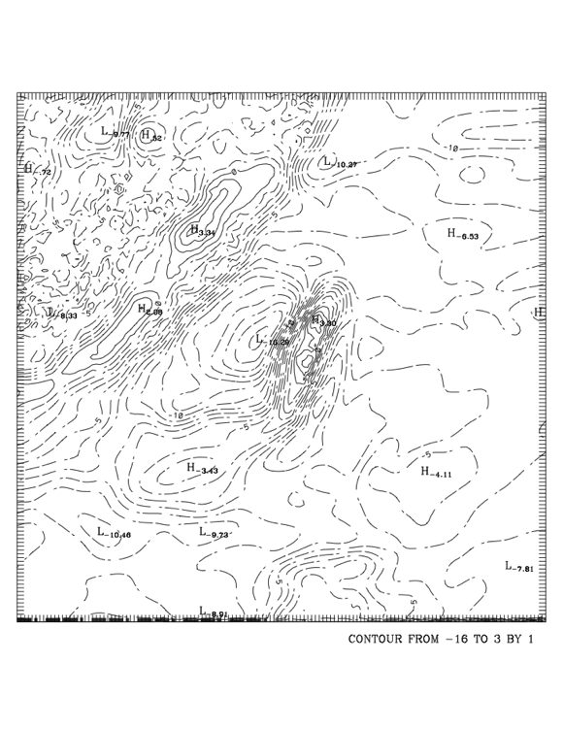
Multiscale Downscaling Technique
Input: coarse resolution data
Output: downscaled fields
Evaluation against Observations
Produces the small scales
  At each grid level, it is variational with physically-based balances to yield a solution.
  At each finer grid, additional (smaller) scale information is introduced.
  At the finest grid, the solution is the downscaled fields;
Notes:
This has been re-done to read better.

Slide 75

Four Mile Canyon, Boulder, CO (6 Sept. 2010)
LAPS 1km wind Analysis , 22UTC
No surface OBS in Four Mile Canyon;
Few OBS over the higher terrain;
How reliable is the observed wind over complex terrain?
How to evaluate?

Slide 76
STMAS DEVELOPMENT TIMELINE
Terrain following coordinate system 2012
Variational hotstart 2013
New variational balance constraints 2014

Slide 77
STMAS - MULTIPLE PATHS TO OPERATIONS
Replace traditional DA in LAPS by STMAS
  Operational implementation planned for 2013-14
Test & transition new elements from STMAS into GSI
  With DTC contributions
Contribute to next generation variational DA
  Multi-scale hybrid 4D-Var with ensemble-based covariances

Slide 78
STMAS WRF Cycling
In 2011, significant effort was made to investigate STMAS WRF cycling;
Inconsistency of initial and boundary conditions are found;
WRF-DA boundary update scheme is applied;
STMAS WRF cycling was run for a long time without any periodic restart;
HWT domain for
Apr. 15, 2011,
Fcst hr : 12 h,
Cycling: 6 h
Notes:
Hongli, if you have some previous cycling and non-cycling comparison plots, please insert here

Slide 79
SUMMARY
LAPS serves critical NOAA, national, & intlernational needs
  Situational awareness, Warn-On-Forecasting
NWS Roadmap specifies need for high quality local DA/NWP tools
  Local (WFO) control of configuration, QC, etc
Role of LAPS in Weather Ready Nation initiative
  Incident response, etc
Requirements formulated by LAPS user community (workshop)
  Major improvements in pipeline – STMAS
Contribute to next generation NOAA DA system
  Transition cutting-edge techniques tested locally
Strengthen engagement with user community
  Next LAPS Workshop co-sponsored by NWS (Oct 2012)
  Plan for formal evaluation of LAPS by WFOs for future implementations

Slide 80
SPACE-TIME MULTI-SCALE ANALYSIS SYSTEM
Approach
Include unique LAPS features into variational approach
  Combines all information in a single minimization procedure
  First guess cycled through own analysis
Unique features
Multi-scale method
  Allows to extract information from observations on all scales
  Much improved efficiency (find needle in haystack)
Hotstart included
  Balance constraints reflecting moist physics
CURRENT STATUS
3-DVar basic analysis, with LAPS hotstart and balance
  Matches LAPS performance

Slide 81
STMAS HOT-START INITIALIZATION
Minimization of STMAS variational cost function
Currently under development
Subject to dynamic constraints and appropriate
forward models
NWP
FH
FL
METAR
+ FIRST GUESS

